Slide 1
Designing Physical Security
Security Planning Susan Lincke
Notes:
This material is taken mainly from CISA Review Manual 2011, Chapter 5.7-5.8.
The castle symbolizes Defense in Depth.

Slide 2
Objectives
The students should be able to:
Define power failures: blackout, brownout, sags, spike & surges, electromagnetic interference (EMI)
Define protections against power failures: surge protector, universal power supply (UPS) , alternate power generators
Define and describe mediums for Fire Suppression System: dry pipe, charged, FM200, Argonite
Define physical access controls: biometric door locks, bolting, deadman doors
Describe the relationship between deadman door and piggybacking

Slide 3
Physical Security Problems
Assets:
Computer: computer devices, equipment, files/media
Non-IT: equipment, paper files – or other things of value: money, checks, art, chemicals, prototypes, ideas on boards, etc.
Attacks:
Skimmer-attacks: ATM, Point of Sale at banks, gas stations, retail stores
Organization-reported: lost, misdelivered or stolen media, documents, and faxes.
Vandalism

Slide 4
Steps in Designing Physical Security
Inventory Assets & Assign Classes
Select Controls for Sensitivity Classes
Select Controls for Criticality Classes

Slide 5
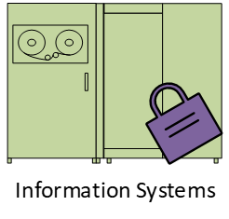
Remember Sensitivity Classification
Proprietary:
Strategic Plan
Confidential:
Salary &
Health Info
Privileged:
Product Plans
Public
Product Users Manual
near Release
Internal
Notes:
The Sensitivity Classification is concerned with how much the organization wants to protect the info from release both within the organization and outside. The data classification shown above is an example, not an absolute. In other words, different companies will categorize their data differently.

Slide 6
… and Criticality Classification?
Critical $$$$: Cannot be performed manually. Tolerance to interruption is very low
Vital $$: Can be performed manually for very short time
Sensitive $: Can be performed manually for a period of time, but may cost more in staff
Nonsensitive ¢: Can be performed manually for an extended period of time with little additional cost and minimal recovery effort
Notes:
The criticality classification is concerned with whether the company can survive without automated (computerized) access to the data. These class names are common in industry.

Slide 7
Step 1: Inventory & Classify Room
Room | Purpose of Room | Sensitivity & Criticality Class | Sensitive Assets or Information
124 | Public classroom | Privileged, Vital-sensitive | Computer, projector, display Vital during school year- sensitive otherwise
128 | Public classroom | Privileged, Vital-sensitive | Lab equipment, computer, projector, display
130 | Public classroom | Public, non-sensitive | Tables, chairs
132 | Server Room | Confidential, critical | Servers, network equipment, disk and tape drives.
129 | Office | Confidential, non-sensitive | Exam/homework papers, laptop, display

Slide 8
Workbook: Physical Security Physical Security map
Rm.
124
Rm.
128
Rm
130
Rm 132
Comp.
Facility
Lobby
Rm.
123
Rm.
125
Rm.
129
Sensitivity Classification:
Black: Confidential
Gray: Privileged
Light: Public
Criticality Classification: (Availability)
Rm 132: Critical
Rm 124, 125, 128, 129: Vital
Notes:
This map shows a layout of a floor, including which rooms are Protected and Confidential. Door entry is also shown. The Criticality classification may be shown on the map too, instead of as a note.

Slide 9
Defense in Depth
Locked Work
Stations
Video cameras &
Alarm system
Bonded personnel
Controlled visitor access
Security Guards, manual
logging & photo ID badges
Controlled single entry
point & barred windows
Defense in Depth:
Physical access
controls with Guards
Which controls are
Preventive?
Reactive?
Corrective?
Notes:
Alarm system: Protects doors, windows. Video cameras: sophisticated activate on motion, record for playback
Manual Logging: People (visitors) sign in Bonded personnel: Contract personnel are bonded
Controlled Visitor Access: Employees must accompany visitors

Slide 10
Physical Controls For Confidentiality & Integrity
Inventory Assets & Assign Classes
Select Controls for Sensitivity Classes
Select Controls for Criticality Classes
External Security
Door Locks & Security
Mobile Data
Point-of-Sale, ATM

Slide 11
External Security
Main Door
Welcome
Guards
Walkway
Low bushes
Trees: Friendly, insecure
Benches

Slide 12
Door Lock Systems
Door
Locks
Bolting
Combi-
nation
Electronic
Biometric
Which systems…
Enable electronic logging to track who entered at which times?
Can prevent entry by time of day to particular persons?
Are prone to error, theft, or impersonation?
Are expensive to install & maintain?
Which system do you think is best?
key
eye
3-6-4
Notes:
Function of each door lock system:
Bolting: requires the traditional metal key to gain access. Its important the key is stamped with “Don’t Duplicate”, stored securely and giving to only authorized personnel.
Combination: has a key pad or dial to gain access. Its important the code to gain access is regularly changed.
Electronic: has a magnetic or embedded chip-based plastic card key or token to gain access.
Biometric: requires authorized personnel to use a unique body feature. For example: voice, eyes, fingerprint or signature. This system is used for extremely sensitive facilities like the military.
Electronic and Biometric enable electronic logging and prevent entry by time of day. Combination and electronic can be easily changed if the logical access key is divulged or stolen.
Source: CISA® Review Manual 2011 © 2010, ISACA. All rights reserved. Used by permission.

Slide 13
Deadman Doors
Double set of doors: only one can be open at a time
One person permitted in holding area
Reduces risk of piggybacking: unauthorized person follows authorized person into restricted area

Slide 14
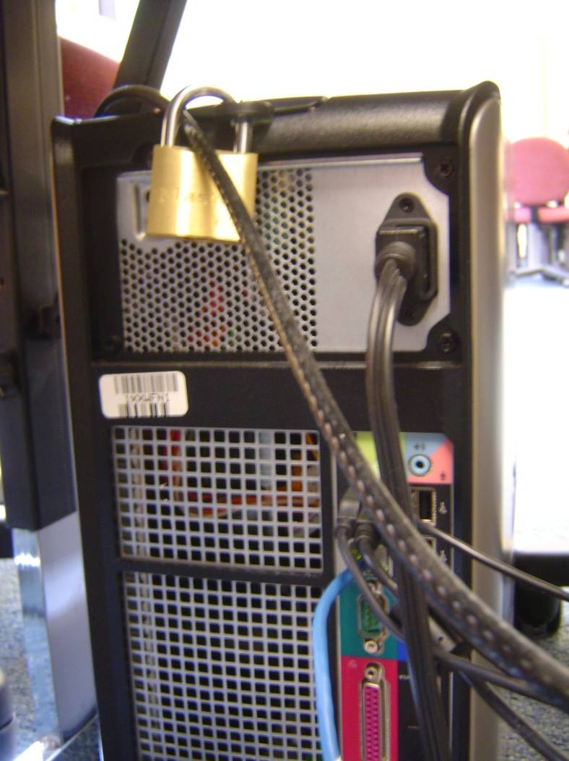
Computers in Public Places
Logical Protections
Physical Locks
Imaged computers
No client storage for programs and/or data
Antivirus / antispyware
Protects users from each other
Web filters
Avoid pornography, violence, adult content
Login/passwords
If privileged clientele allowed
Firewall protection from rest of organization
Notes:
Computers in public places should be locked and cabled to something non-moveable. Non-portable PCs have loop holes to ensure that locks can prevent people from opening the back of the PC. This prevents both PC and PC cards from walking away. Here you can see that the lock locks the computer to its back cover, and includes a cable.

Slide 15

Commercial Copy Machines
Large disk storage
Data may be sensitive
Internet access or stolen disk
Security features:
Encrypted disks
Overwrite: writes random data daily or weekly, or per job.
Contract: Copier is returned without disk(s) or disks are securely destroyed by contractor.

Slide 16
Mobile Computing
Engrave a serial number and company name/logo on laptop using engraver or tamper-resistant tags
Back up critical/sensitive data
Use cable locking system
Encrypt disks
Allocate passwords to individual files maybe not useful
Consider if password forgotten or person leaves company…?
Establish a theft response team for when a laptop is stolen.
Report loss of laptop to police
Determine effect of lost or compromised data on company, clients, third parties
Notes:
Disappearing laptops are one of the most common security problems.I
n computer labs, universities use a cable locking system to lock down computers (and their parts) – to ensure the computers are NOT mobile!!!

Slide 17
Device Security
Smartphones & PDAs
Approved & registered
Configuration: controlled, licensed, & tested S/W
Encryption
Antivirus
Training & Due Care (including camera use)
Easily misplaced
Flash & Mini Hard Drive
Banned and USB disabled
OR
Encrypt all data
Notes:
Here are some ways to ensure security with devices.

Slide 18
ATM & Point-of-Sale: Skimmer Problems
Skimmers inserted in ATM/POS to record payment card information
come in all sizes and colors to match targets.
pinhole cameras record PIN codes.
installed in seconds.
may collect data wirelessly
often installed by outsiders, sometimes insiders (waiters, cashiers, bank tellers) may be solicited to record, skim or install skimmers as collusion
Alternative attacks:
PoS devices can be quickly replaced by an identical device with a skimmer installed; the stolen PoS device is also altered and put into service elsewhere.
A partner ‘customer’ distracts the attendant while the skimmer is installed

Slide 19
Protecting PoS & ATMs
Installing devices in a tamper-proof way according to directions
Prevent booting from an infected memory
PCI DSS requires:
Organizations inventory PoS/ATM devices, listing make, model, serial number and location
Prepare policies to inspect devices periodically; more frequently in public places.
Train employees to:
Recognize tampering and substitution
Procedure should include a picture and recorded serial numbers
Report suspicious actions: unplugging devices or intimidation.
Check for loose parts.
Alternatively, mark device with an ultraviolet light marker.

Slide 20
Data Centers with Payment Card Info
PCI DSS requires that entry to sensitive data centers that process or store payment card data be monitored
Log individual access via keycard or biometric identification, video, or Close Circuit TV (CCTV)
Carefully authenticate anyone claiming to be a PoS/ATM maintenance person

Slide 21
Workbook: Physical Security Step 2: Sensitivity Class Handling
Sensitivity Class. | Description | Special Treatment
Confidential | Room contains Confidential info. storage or server | Key card and password entry Badge must be visible. Visitors must be escorted
Privileged | Room contains computer equipment or controlled substances | Computers are physically secured using cable locking system Doors locked between 5 PM and 7 AM, and weekends unless class in session.
Notes:
Here we can name a Room Sensitivity Class (which may correspond to the Data Sensitivity Class – or not). We need to define what defines a Room Sensitivity, and then how each room classification shall be handled. Above, we have a school system, where Protected rooms are public part time. A room is Confidential if it has files in paper or electronic form, that contain Confidential information.

Slide 22
Workbook: Physical Security Allocating Controls to Rooms
Room | Sensitivity & Crit. Class | Sensitive Assets or Info. | Room Controls
Rm 123 | Privileged, Vital | Computer Lab: Computers, Printer | Cable locking system Doors locked 9PM-8AM by security
Rm 125 | Privileged, Vital | Classroom: Computer & projector | Cable locking system Teachers have keys to door.
Rm 132 | Confidential, Critical | Servers and critical/sensitive information | Key-card + password entry logs personnel. Badges required.

Slide 23
Physical Issues and Controls For Availability
Inventory Assets & Assign Classes
Select Controls for Sensitivity Classes
Select Controls for Criticality Classes
Power Protection
Fire Suppression
IPF Environment
External Security

Slide 24
Power Protection Systems
< x ms
< 30 minutes
Hours or days
Surge
Protector
UPS:
Universal
Power
Supply
Alternate Power Generators
Blackout: Total loss of power
Brownout: Reduced, nonstandard power levels may cause damage
Sags, spikes & surges: Temporary changes in power level (sag=drop) may cause damage
Electromagnetic Interference (EMI): Fluctuations in power due to electrical storms or electrical equipment may cause computer crash or damage
Notes:
Definitions –
Surge Protector: Electric device reduces the risk of damage to equipment due to power spikes, sags, and surges. Voltage regulators makes sure the incoming electric is at a safe voltage, by increasing or decreasing the charge. A surge protector can be built into a Universal Power Supply (UPS)
Universal Power Supply: Has either a battery or gas powered generator, which cleans the power entering the computer by making sure the wattage is consistent.
Alternate Power Generator: Another source of power if power failure occurs.
How long each power protection last:
Surge Protector: Protects interruptions less then a few milliseconds.
UPS: Protects interruptions from a few milliseconds to 30 minutes.
Alternate Power Generator: Protects interruptions long term from a few milliseconds to several days.
Depending on how long you expect the power failure to be, depending on what system you select.
Source: CISA® Review Manual 2011 © 2010, ISACA. All rights reserved. Used by permission.

Slide 25
Computer Room Equipped with…
Water Detector: Placed under raised floors
Risk of electric shock; training necessary
Location of water detectors marked on floor
Manual Fire Alarm: Placed throughout facility
Smoke Detectors: Above & below ceiling tiles, below room floor
Emergency Power-Off Switch: Turn off power to all equipment
Fire Extinguishers: At strategic locations
Tagged & inspected annually
Alarms should sound locally, at monitored guard station, and preferably fire dept.
Notes:
A facility is shown above, with devices to ensure Availability.

Slide 26
Information Processing Facility (IPF) IPF Environment
Computer room on middle floor
Fire department inspects room annually
Fire-resistant walls, floor, ceiling, furniture, electrical panel & conduit
Two-hour fire resistance rating for walls
Emergency Power-off switch: Panel in and outside room
Redundant power lines reduce risk of environmental hazards
Surge protectors & UPS
No smoking, food or water in IPF
Audit: Observe some, request documentation, may test batteries, handheld fire extinguishers, ensure fire suppression system is to code
Notes:
IPF=Information Processing Facilities
Computer room on middle floor: To high and fire department can’t get to it. Too low and susceptible to break-in or floods.

Slide 27
Fire Suppression Systems
Water sprinkler systems
cause water damage when dispersed.
Charged pipes contain water and
can break or leak.
Gas systems do not damage
equipment during fire.
Dangerous systems replace oxygen
with another gas, and need lead time
for people to exit.
Halon was banned due to damage to
ozone layer.
FM-200 cools equipment down,
lowering combustion probability.
Enviro-friendly is safer to humans,
does not damage equipment.
Charged
water
sprinkler
Dry pipe
Fire
Suppression
Halon
gas
dangerous
Carbon Dioxide
FM-200
enviro-
friendly
Argonite
Notes:
Definitions:
Charged: Water is always held in the charged pipes. This system helps water sprinkler systems, but are depended on pipes not leaking or breaking. Water damages can occur if pipes are leaking or are broken, which can end up being expensive.
Dry pipe: Initially there is no water in the pipes. Once a fire alarm is activated, water gets sent through the pipes.
Halon: The system releases Halon gas to remove oxygen in the air. This process contains the fire and not allow it to spread.
Carbon Dioxide: The system releases CO2 into a protected area to replace oxygen. CO2 is not a human friendly option, and thus is dangerous.
FM-200: Suppresses fire by releasing gas onto the surface of combustible materials.
Argonite: A combination of 50% argon and 50% nitrogen, which acts as an effective fire extinguisher and spreads to reduce fire.
Source: CISA® Review Manual 2011 © 2010, ISACA. All rights reserved. Used by permission.

Slide 28
Physical Workbook: Step 3: Criticality Class Handling Table
Criticality Class. | Description | Special Treatment (Controls related to Availability)
Critical | Room contains Critical computing resources, which cannot be performed manually. | Availability controls include: Temperature control, UPS, smoke & water detector, fire alarm, fire suppressant, emergency power off switch
Vital | Room contains Vital computing resources, which can be performed manually for a short time. | Availability controls include: surge protector, temperature control, fire extinguisher.

Slide 29
Summary of Physical Controls
Physical Access Control
Walls, Doors, Locks
Badges, smart cards
Biometrics
Security cameras & guards
Fences, lighting, sensors
Cable locking system
Computer screen hoods
Environmental Controls
Backup power
Air conditioning
Fire suppressant
Secure procedures
Engraved serial numbers
Locked files, desks
Clean desk
Paper shredders
Locking screensaver
Secure procedures: locked doors at night

Slide 30
Question
A Fire Suppression system that is environmentally friendly, is not lethal, and does not damage equipment is:
Dry Pipe
Halon
Charged
FM-200
Notes:
4 – FM-200.

Slide 31
Question
The best way to prevent piggybacking into secured areas is:
Deadman door
Bolting door
Guard
Camera
Notes:
1 – Deadmand door
Camera is not a preventative technique; guard and bolting door may allow someone in other than the authorized person.

Slide 32
Question
A surge protector is the best protection against
Electromagnetic interference
Loss of power for 10-30 minutes
A blackout
Sags and spikes
Notes:
4 - Sags and spikes: Since sags and spikes are a short term interruptions (last from a millionths to a few thousandths of a second), surge protector can protect a computer with interruptions less than a few milliseconds. A surge protector reduces the risk of damages to equipment by regulating power spikes. It either increases or decreases the electric current to make electric current consistent.

Slide 33
Question
To eliminate problems with incomplete transactions during a sudden power failure, Joe has decided that some form of temporary power supply is necessary to ensure a graceful shut down. The best option for Joe is:
UPS
Surge protector
Alternate power generator
Battery supply
Notes:
1 – UPS: UPS system consists of a battery or gasoline powered generator that ensures wattages into the computer is consistent, so if a power failures happens the UPS system will provide electricity from the generator to the computer for a certain amount of time.

Slide 34
Summary
Availability
Confidentiality & Integrity
Potential problems: Power outage, deviations in power, network outage, fire, flood, human damage
Apply Criticality Classification to rooms, defining controls
Common problem: Lost computers, PDAs, media
Encrypt to avoid Confidentiality issues
Physically lock down
Common problem: ATM/POS attacks
Smash-and-grab
Skimmers
Other problems: copier disk access
Apply Sensitivity Classification to rooms, defining controls

Slide 35
Health First Case Study
Jamie Ramon MD
Doctor
Chris Ramon RD
Dietician
Terry
Licensed
Practicing Nurse
Pat
Software Consultant
Designing Physical Security

Slide 36
Steps in Designing Physical Security
Inventory Assets & Assign Classes
Select Controls for Sensitivity Classes
Select Controls for Criticality Classes

Slide 37
Step 1: Inventory & Classify Room
Room | Purpose of Room | Sensitivity & Criticality Class | Sensitive Assets or Information
124 | Public classroom | Privileged, sensitive | Computer, projector, display
128 | Public classroom | Privileged, sensitive | Lab equipment, computer, projector, display
130 | Public classroom | Public, non-sensitive | Tables, chairs
132 | Server Room | Confidential, critical | Servers, network equipment, disk and tape drives.
129 | Office | Confidential, non-sensitive | Exam/homework papers, laptop, display

Slide 38
Physical Security Map drawn with MS Visio
Chris’s Office
Sensitivity
Classification
Color Key:
Green: Public
Yellow: Privileged
Red: Confidential
Jamie’s Office
Reception Office

Slide 39
Workbook: Physical Security Step 2: Sensitivity Class Handling
Sensitivity Class. | Description | Special Treatment
Confidential | Room contains Confidential info. storage or server | Key card and password entry Badge must be visible. Visitors must be escorted
Privileged | Room contains computer equipment or controlled substances | Computers are physically secured using cable locking system Doors locked between 5 PM and 7 AM, and weekends unless class in session.
Notes:
Here we can name a Room Sensitivity Class (which may correspond to the Data Sensitivity Class – or not). We need to define what defines a Room Sensitivity, and then how each room classification shall be handled. Above, we have a school system, where Protected rooms are public part time. A room is Confidential if it has files in paper or electronic form, that contain Confidential information.

Slide 40
Workbook: Physical Security Allocating Controls to Rooms
Room | Sensitivity & Crit. Class | Sensitive Assets or Info. | Room Controls
Rm 123 | Privileged, Vital | Computer Lab: Computers, Printer | Cable locking system Doors locked 9PM-8AM by security
Rm 125 | Privileged, Vital | Classroom: Computer & projector | Cable locking system Teachers have keys to door.
Rm 132 | Confidential, Critical | Servers and critical/sensitive information | Key-card + password entry logs personnel. Badges required.

Slide 41
Physical Workbook: Step 3: Criticality Class Handling Table
Criticality Class. | Description | Special Treatment (Controls related to Availability)
Critical | Room contains Critical computing resources, which cannot be performed manually. | Availability controls include: Temperature control, UPS, smoke & water detector, fire alarm, fire suppressant, emergency power off switch
Vital | Room contains Vital computing resources, which can be performed manually for a short time. | Availability controls include: surge protector, temperature control, fire extinguisher.

