Slide 1
Managing Risk
Security Planning
Susan Lincke

Slide 2
Objectives
Students should be able to:
Define risk management process: risk management, risk assessment, risk analysis, risk appetite, risk treatment, accept residual risk
Define treat risk terms: risk acceptance/risk retention, risk avoidance, risk mitigation/risk reduction, risk transference
Describe threat types: natural, unintentional, intentional, intentional (non-physical)
Define threat agent types: hacker/crackers, criminals, terrorists, industry spies, insiders
Describe risk analysis strategies: qualitative, quantitative
Define vulnerability, SLE, ARO, ALE, due diligence, due care

Slide 3
How Much to Invest in Security?
How much is too much?
Firewall
Intrusion Detection/Prevention
Guard
Biometrics
Virtual Private Network
Encrypted Data & Transmission
Card Readers
Policies & Procedures
Audit & Control Testing
Antivirus / Spyware
Wireless Security
How much is too little?
Hacker attack
Internal Fraud
Loss of Confidentiality
Stolen data
Loss of Reputation
Loss of Business
Penalties
Legal liability
Theft & Misappropriation
Security is a Balancing Act between Security Costs & Losses
Notes:
The items on the left cost money – so do the items on the right (e.g., loss in income)

Slide 4
Risk Management
Internal Factors
Structure
Management’s
Risk Tolerance
Regulation
Corporate History
External Factors
Organizational
Maturity
Culture
Industry
Risk Mgmt Strategies are determined by both internal & external factors
Risk Tolerance or Appetite: The level of risk that management is comfortable with
Notes:
A number of areas affect risk management. Internal factors are factors that are company-specific. External factors also affect risk.
Management’s risk tolerance is an example of an internal factor. Some people just like to take risks, while others don’t.
Industry also affects risk. If you are in the banking industry, you are a target of crackers and of legislation to protect consumers.
Source: CISM® Review Manual 2009, © 2008, ISACA. All rights reserved. Used by permission.
Cism09 2.5

Slide 5
Risk Appetite
Do you operate your computer with or without antivirus software?
Do you have antispyware?
Do you open emails with forwarded attachments from friends or follow questionable web links?
Have you ever given your bank account information to a foreign emailer to make $$$?
What is your risk appetite?
If liberal, is it due to risk acceptance or ignorance?
Companies too have risk appetites, decided after evaluating risk
Notes:
This explains or defines Risk Appetite, an important concept.

Slide 6
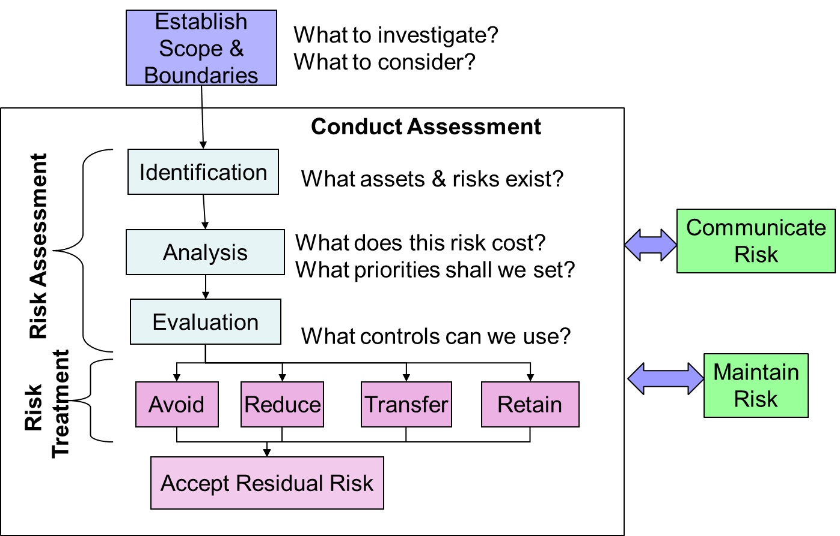
Risk Management Process
Notes:
Kahili-
Risk management: the overall effort to mange risk. The entire process, as shown above.
The risk management process consist of:
Establish scope and boundaries
Risk assessment
Risk treatment
Accept residual risk
Risk communication and monitoring
Defining each process in risk management:
Establish Scope and Boundaries: a process for establishing of global parameters for the performance of risk management within an organization.
Risk Assessment: a process which involves three steps identification, analysis, and evaluation.
Risk Analysis is the detailed analysis of costs of risk
Risk Treatment: a process of selecting strategies to deal with risk. There are 4 strategies for risk treatment: avoid, reduce, transfer, and retain (or accept).
Transfer risk is to purchase insurance or hire another company to manage the risk for you.
Risk acceptance: approved by management that the possible threat will just be accepted without further action.
Accept Residual Risk: Residual risk is the remaining risk after implementing actions to reduce or eliminate risk.
Risk Communication and Monitoring: a process to exchange and share information related to risk and reviewing the effectiveness of the whole risk management process.
Source: CISM® Review Manual 2012, © 2011, ISACA. All rights reserved. Used by permission.

Slide 7
Continuous Risk Mgmt Process
Risk
Appetite
Risks change with time as
business & environment changes
Controls degrade over time
and are subject to failure
Countermeasures may open
new risks
Identify &
Assess Risks
Proactive
Monitoring
Develop Risk
Mgmt Plan
Implement Risk
Mgmt Plan
Notes:
Risk Management is a continuing process consisting of these 4 steps.
Source: CISM® Review Manual 2009, © 2008, ISACA. All rights reserved. Used by permission.
Cism09 exhibit 2.3

Slide 8
Risk Assessment Overview
Assign value to assets
Determine loss due to threats & vulnerabilities
Estimate likelihood of exploitation
Compute Expected Loss
Treat Risk
Manage & Communicate Risk
Five Steps include:
Assign Values to Assets:
  Where are the Crown Jewels?
Determine Loss due to Threats & Vulnerabilities
  Confidentiality, Integrity, Availability
Estimate Likelihood of Exploitation
  Weekly, monthly, 1 year, 10 years?
Compute Expected Loss
  Loss = Downtime + Recovery + Liability + Replacement
  Risk Exposure = ProbabilityOfVulnerability * $Loss
Treat Risk
  Reduce, Transfer, Avoid or Accept Risk
  Risk Leverage = (Risk exposure before reduction) – (risk exposure after reduction) / (cost of risk reduction)
Notes:
Actually, Risk Assessment with Treat Risk. The next slides go into more detail of this process.

Slide 9
Step 1:
Determine Value of Assets
Identify & Determine Value of Assets (Crown Jewels):
Assets include:
  IT-Related: Information/data, hardware, software, services, documents, personnel
  Other: Buildings, inventory, cash, reputation, sales opportunities
What is the value of this asset to the company?
How much of our income can we attribute to this asset?
How much would it cost to recover this?
How much liability would we be subject to if the asset were compromised?
Notes:
Step 1 is Determine Value of Assets. In testing for CISA or CISM, there is often a question: what is the first step to assessing risk?

Slide 10
Determine Cost of Assets
Costs
Sales
Tangible $ Intangible: High/Med/Low
Risk: Replacement Cost=
Cost of loss of integrity=
Cost of loss of availability=
Cost of loss of confidentiality=
Product A
Product B
Risk: Replacement Cost=
Cost of loss of integrity=
Cost of loss of availability=
Cost of loss of confidentiality=
Product C
Risk: Replacement Cost=
Cost of loss of integrity=
Cost of loss of availability=
Cost of loss of confidentiality=
Notes:
Replacement cost: how much to replace or rebuild?
Loss of integrity: unauthorized changes are made to data or systems, could result in faulty decisionmaking or be a steppingstone for further attacks
Loss of availability: a system crashes, or a hard drive is corrupted and data can’t be retrieved– loss of productivity, decreased sales
Loss of confidentiality: customer information or trade secrets are compromised – decline in consumer confidence or market competitiveness, also possible legal ramifications (HIPAA)
Source: CISM® Review Manual 2009, © 2008, ISACA. All rights reserved. Used by permission. Cism09 2.12.4

Slide 11
Step 2: Determine Loss
Due to Threats
Human Threats
Ethical/Criminal: Fraud, espionage, hacking, social engineering, identity theft, malware, vandalism, denial of service
External Environmental: industry competition, contract failure, or changes in market, politics, regulation or tech.
Internal: management error, IT complexity, organization immaturity, accidental data loss, mistakes, software defects, incompetence and poor risk evaluation
Physical Threats
Natural: Flood, fire, cyclones, hail/snow, plagues and earthquakes
Unintentional: Fire, water, building damage/collapse, loss of utility services and equipment failure
Intentional: Fire, water, theft and vandalism
Notes:
When considering loss due to threats, you can use this list and others on following pages as potential threats.
Source: CISM® Review Manual 2009, © 2008, ISACA. All rights reserved. Used by permission.
Cism09 2.10.5

Slide 12
Security Vocabulary
Asset: Diamonds
Threat: Theft
Vulnerability: Open door or windows
Threat agent: Burglar
Owner: Those accountable or who value the asset
Risk: Danger to assets
Notes:
This is not only HIPAA but standard security vocabulary.
Vulnerability is not the threat itself, but the enabler for the threat.
To a computer, a threat could also be a power outage.

Slide 13
Threat Agent Types
Hackers/ Crackers | Challenge, rebellion | Unauthorized access
Criminals | Financial gain, Disclosure, destruction of info. | Fraud, computer crimes
Terrorists/ Hostile Intel. Service | Spying, destruction, revenge, extortion | DOS, info warfare
Industry Spies | Competitive advantage | Info theft, econ. exploitation
Insiders | Opportunity, personal issues | Fraud/ theft, malware, abuse
Notes:
These threat types are useful to consider in naming threats to a business, as part of Step 2 of Risk Analysis.
First column: Who also known as Threat Agents
Second column: Motivation
Third column: Result

Slide 14
Step 2: Determine Threats
Due to Vulnerabilities
System
Vulnerabilities
Behavioral:
Disgruntled employee,
uncontrolled processes,
poor network design,
improperly configured
equipment
Misinterpretation:
Poorly-defined
procedures,
employee error,
Insufficient staff,
Inadequate mgmt,
Inadequate compliance
enforcement
Coding
Problems:
Security ignorance,
poorly-defined
requirements,
defective software,
unprotected
communication
Physical
Vulnerabilities:
Fire, flood,
negligence, theft,
kicked terminals,
no redundancy
Notes:
Vulnerability = hole in security system, enabling threat to occur
Threat refers to any entity or event that could cause damage to an enterprise. A vulnerability is a weak spot that would allow that damage to happen. A risk is a combination of the two; a threat without a relevant vulnerability (or vice versa) does not constitute a risk.
Threat: burglar. Vulnerability: unlocked door. Risk: your TV will be stolen.
There may be little an organization can do to affect threats directly, but by finding and minimizing vulnerabilities they can affect the impact of the threats.

Slide 15
Matrix of Loss Scenario
(taken from CISM Exhibit 2.16)
 | Size of Loss | Repu-tation | Law-suit Loss | Fines/ Reg. Loss | Mar-ket Loss | Exp. Yearly Loss
Hacker steals customer data; publicly blackmails company | 1-10K Records | $1M- $20M | $1M- $10M | $1M- $35M | $1M- $5M | $10M
Employee steals strategic plan; sells data to competitor | 3-year | Min. | Min. | Min. | $20M | $2M
Backup tapes and Cust. data found in garbage; makes front-page news | 10M Records | $20M | $20M | $10M | $5M | $200K
Contractor steals employee data; sells data to hackers | 10K Records | $5M | $10M | Min. | Min. | $200K
Notes:
The expected yearly loss serves to prioritize threats and determine what defenses are needed. The values above indicate ranges of losses expected in a given year assuming no controls are in place. Pay attention to the row and column headers.

Slide 16
Regional Risks
Region | Top Attack Types (Verizon 2022) | Motive (Verizon 2022) | Nation | Average Cost of Breach (in millions) (IBM 2022)
North America | System intrusion Social engineering Web app attacks | Financial: 96% Espionage: 3% Grudge: 1% | United States | $9.44
 |  |  | Canada | $5.64
Europe-Africa | Social engineering System intrusion Web app attacks | Financial: 79% Espionage: 21% | Middle East | $7.46
 |  |  | Western E.U. nations | $3.74-$4.85
 |  |  | U.K. | $5.75
 |  |  | Scandinavia | $2.08
Asia Pacific | Social engineering Web app attacks System intrusion | Financial: 54% Espionage: 46% | Japan | $4.57
 |  |  | ASEAN-Australia | $2.87-$2.92
 |  |  | India | $2.32
Latin & South America | System intrusion Denial of service Social engineering | Financial: 92% Convenience: 3% Espionage: 2% Grudge: 2% | Latin America | $2.80
 |  |  | Brazil | $1.38

Slide 17
IBM Cost of a Data Breach Report
(IBM, Ponemon) 2021, 2022
Category | Most Common Initial Attack Vector | Avg. Cost per Breach Type (in millions)
Data breach cost – total [IBM22] | Stolen or compromised credentials (19%) | $4.50
 | Phishing (16%) | $4.91
 | Cloud misconfiguration (15%) | $4.14
 | Third party software vulnerability (13%) | $4.55
 | Average Breach Cost | $4.35
Mega breach cost [IBM21] | 1 million-10 million records breached | $52
 | 50 million-65 million records breached | $401

Slide 18
2021 Cost of Data Breach Statistics (Ponemon, IBM)
Industry | Cost of Breach (in millions)
Communications | $3.62
Consumer | $3.7
Education | $3.79
Energy | $4.65
Financial | $5.72
Health care | $9.23
Hospitality | $3.03
Industry | $4.24
Media | $3.17
Pharmaceutical | $5.04
Public sector | $1.93
Research | $3.6
Retail | $3.27
Services | $4.65
Technology | $4.88
Transportation | $3.75

Slide 19
Step 1: Determine Value of Assets
Step 2: Determine Loss due to Threats
Work
book
Asset Name | $ Value Direct Loss: Replacement | $ Value Consequential Financial Loss | Confidentiality, Integrity, and Availability Notes
Student(s) and/or Instructor(s) | $2,000 per student (tuition) | Lawsuit= $1 Million Investigation costs= $100,000 Reputation= $400,000 | (E.g.,) School Shooting: Availability (of persons lives) Issues may arise if we should have removed a potentially harmful student, or did not act fast enough.
Registration Server | $10,000 | Breach Cost (low estimate)=$644,000 Registration loss per day =$16,000 | Affects: Confidentiality, Availability. Conf=> Breach Notification Law =>Possible FERPA Violation =>Forensic Help Availability=> Loss of Registrations
Grades Server | $10,000 | Lawsuit = $1 million FERPA = $1 million Forensic help = $100,000 | Affects: Confidentiality, Integrity. Integrity => Student Lawsuit Confidentiality => FERPA violation Both => Forensic help
Notes:
The Breach Notification Law requires us to tell all customers if their private information was breached. On average, this costs $130 (or more) per customer in lawyers fees, mailings, etc.
Direct Loss = Cost of Replacement
Consequential Loss = Loss of income, reputation, fines, legal proceedings, etc.
This slide is labeled ‘Workbook’ to indicate that you will encounter this within the Workbook.
Only two rows are shown, but it may help as a reference as you work with the Workbook.

Slide 20
Consequential Financial Loss Calculations
Consequential Financial Loss | Total Loss | Calculations or Notes
Lost business for one day (1D) | 1D=$16,000 | Registration = $0-500,000 per day in income (avg. $16,000)
Breach Cost | $644,000 | IBM Breach Cost Estimate using per record cost= $161* x 4000 Students =$644,000 OR maximum estimate for education industry: IBM Breach Cost: $3.79 million* Comprehensive number includes forensic help (* from [IBM21])
Lawsuit | $1 Million | Student lawsuit may result as a liability.
FERPA regulation | $1 Million | Violation of FERPA regulation can lead to loss of government aid, assumes negligence.

Slide 21
Step 3: Estimate Likelihood of Exploitation
Assign value to assets
Determine loss due to threats & vulnerabilities
Estimate likelihood of exploitation
Compute Expected Loss
Treat Risk
Manage & Communicate Risk
Best sources:
Past experience
National & international standards & guidelines: NIPC, OIG, FedCIRC, mass media
Specialists and expert advice
Economic, engineering, or other models
Market research & analysis
Experiments & prototypes
If no good numbers emerge, estimates can be used, if management is notified of guesswork
Notes:
What is the probability this threat will occur?
What is the extent of the vulnerability? Vulnerabilities are not either/or; some may be more easily exploited than others, and controls may fully or partially mitigate them.
Although there are good estimates out there, there is no accurate forecast, with past experience perhaps being the best – if you have experienced a problem before.

Slide 22
Historical Rate of Breach (2-year average)
Nation | Breach %
ASEAN (includes Indonesia, Singapore) | 26.6%
Brazil | 43%
Canada | 18.2%
Germany | 14.3%
India | 34.7%
Japan | 21.9%
Middle-east | 32.6%
South Africa | 40.9%
United Kingdom | 27.2%
United States | 26.9%
2018 Cost of Data Breach Statistics (Ponemon, IBM)

Slide 23
Security Attacks by Industry
Verizon Data Breach Investigations Report 2022
 | Attack Source | Motive | Top attack types | Compromised data
Accommodation, Food services | External: 90% Internal: 10% | Financial: 91% Espionage: 9% | System intrusion Social engineering Web app attacks | Credentials: 45% Personal: 45% Payment: 41% Other: 18%
Education | External: 75% Internal: 25% | Financial: 95% Espionage: 5% | System intrusion Web app attacks Errors | Personal: 63% Credentials: 41% Other: 23% Internal: 10%
Entertain-ment, Recreation | External: 74% Internal: 26% | Financial: 97% Grudge: 3% | Web app attacks System intrusion Errors | Personal: 66% Credentials: 49% Other: 23% Medical: 15%
Finance, Insurance | External: 73% Internal: 27% | Financial: 95% Espionage: 5% | Web app attacks System intrusion Errors | Personal:71% Credentials: 40% Other 27% Bank: 22%
Healthcare | External: 61% Internal: 39% | Financial: 95% Espionage: 4% Convenience: 1% Grudge: 1% | Web app attacks Errors System intrusion | Personal: 58% Medical: 46% Credentials: 29% Other: 29%
Adapted from: 2018 Data Breach Investigations Report (Verizon)

Slide 24
Security Attacks by Industry (continued)
Verizon Data Breach Investigations Report 2022
Information | External: 76% Internal: 24% | Financial: 78% Espionage: 20% Ideology: 1% Grudge: 1% | System intrusion Web app attack Errors | Personal: 66% Other: 35% Credentials: 27% Internal: 17%
Manufacturing | External: 88% Internal: 12% Partner: 1% | Financial: 88% Espionage: 11% Grudge: 1% Secondary: 1% | System intrusion Web app attack Social engineering | Personal: 58% Credentials: 40% Other: 36% Internal: 14%
Mining, Utilities | External: 96% Internal: 4% | Financial: 78% Espionage: 22% | Social engineering System intrusion Web app attacks | Credentials: 73% Personal:22% Internal: 9%
Professional Services | External: 84% Internal: 17% Multiple: 1% | Financial: 90% Espionage: 10% | System intrusion Web app attacks Social engineering | Credentials: 56% Personal: 48% Other: 26% Internal: 14%
Public Admin | External: 78% Internal: 22% | Financial: 80% Espionage: 18% Ideology: 1% Grudge: 1% | System intrusion Errors Web app attacks | Personal: 46% Credentials: 34% Other: 28% Internal: 28%
Retail | External: 87% Internal: 13% | Financial: 98% Espionage: 2% | System intrusion Social engineering Web app attacks | Credentials: 45% Personal: 27% Other: 25% Payment: 24%
Very Small Business | External: 69% Internal: 34% Multiple: 3% | Financial: 100% | System intrusion Social engineering Privilege misuse | Credentials: 93% Internal: 4% Bank: 2% Personal: 2%

Slide 25
Step 4: Compute Expected Loss Risk Analysis Strategies
Assign value to assets
Determine loss due to threats & vulnerabilities
Estimate likelihood of exploitation
Compute Expected Loss
Treat Risk
Manage & Communicate Risk
Qualitative: Prioritizes risks so that highest risks can be addressed first
Based on judgment, intuition, and experience
May factor in reputation, goodwill, nontangibles
Quantitative: Measures approximate cost of impact in financial terms
Semiquantitative: Combination of Qualitative & Quantitative techniques
Notes:
These are described in the next slides.

Slide 26
Step 4: Compute Loss Using
Qualitative Analysis
Assign value to assets
Determine loss due to threats & vulnerabilities
Estimate likelihood of exploitation
Compute Expected Loss
Treat Risk
Manage & Communicate Risk
Qualitative Analysis is used:
As a preliminary look at risk
With non-tangibles, such as reputation, image -> market share, share value
When there is insufficient information to perform a more quantified analysis

Slide 27

Vulnerability Assessment Quadrant Map
(part of Qualitative Risk Analysis)
Work
book
2
Threat
(Probability)
1
Snow emergency
Intruder
Hacker/Criminal
Malware
Disgruntled Employee
Vulnerability
(Severity)
Flood
Spy
Fire
Terrorist
4
3
Notes:
Qualitative Risk Analysis can use this graph and add/move threats as appropriate.
The red area is high risk, with high cost/severity and high probability.
The yellow areas are either high cost or high probability, but not both.
The green area is low cost and low probability.
You will do this for the case study. You can move threats (e.g, fire, terrorist) around as appropriate.

Slide 28
Step 4: Compute Loss Using
Semi-Quantitative Analysis
Impact
Insignificant: No meaningful impact
Minor: Impacts a small part of the business, < $1M
Major: Impacts company brand, >$1M
Material: Requires external reporting, >$200M
Catastrophic: Failure or downsizing of company
Likelihood
Rare
Unlikely: Not seen within the last 5 years
Moderate: Occurred in last 5 years, but not in last year
Likely: Occurred in last year
Frequent: Occurs on a regular basis
Risk = Impact * Likelihood
Notes:
Alternatively, we can categorize the impact into five categories, and the likelihood into 5 categories, for Semi-Quantitative Analysis
Semi-q involves assigning values to assets; they may not reflect real world values but should be approximately proportional. That is, you may not know exactly what something is going to cost but you can try to decide whether it’s more or less costly than something else. If real-world values could be used then a quantitative analysis would be more appropriate.

Slide 29
SemiQuantitative Impact Matrix
Catastrophic
(5)
Material
(4)
Major
(3)
Minor
(2)
Insignificant
(1)
SEVERE
HIGH
MEDIUM
LOW
Impact
Rare(1) Unlikely(2) Moderate(3) Likely (4) Frequent(5)
Likelihood
Notes:
Red risks are the ones we should spend the most resources on. Green ones we may accept without mitigation, possibly.
Source: CISM® Review Manual 2009, © 2008, ISACA. All rights reserved. Used by permission. Cism09 exhibit 2.12

Slide 30
Step 4: Compute Loss Using Quantitative Analysis
Single Loss Expectancy (SLE): The cost to the organization if one threat occurs once
  Eg. Stolen laptop=
        Replacement cost +
        Cost of installation of special software and data
        Assumes no liability
  SLE = Asset Value (AV) x Exposure Factor (EF)
    With Stolen Laptop EF > 1.0
Annualized Rate of Occurrence (ARO): Probability or frequency of the threat occurring in one year
  If a fire occurs once every 25 years, ARO=1/25
Annual Loss Expectancy (ALE): The annual expected financial loss to an asset, resulting from a specific threat
  ALE = SLE x ARO
Notes:
The important thing to get out of this slide is that ALE = SLE x ARO. It is also important to understand each of the concepts: SLE, ARO, ALE.
Exposure Factor: the maximum possible reduction in value from a threat (inherently or due to mitigating controls).
For example, if the value of a building would be reduced from $400,000 to $100,000 by a fire, the exposure factor for the risk of fire to the building is 75%.

Slide 31
Risk Assessment Using Quantitative Analysis
Quantitative:
Cost of HIPAA accident with insufficient protections
  SLE = $50K + (1 year in jail:) $100K = $150K
  Plus loss of reputation…
Estimate of Time = 10 years or less = 0.1
Annualized Loss Expectancy (ALE)= $150K x .1 =$15K
Notes:
Estimate of Time is the frequency of this threat occurring or the ARO.
ALE = SLE x ARO

Slide 32
Annualized Loss Expectancy
Asset Value-> | $1K | $10K | $100K | $1M
1 Yr | 1K | 10K | 100K | 1000K
5 Yrs | 200 | 2K | 20K | 200K
10 Yrs | 100 | 1K | 10K | 100K
20 Yrs | 50 | 1K | 5K | 50K
Asset Costs $10K Risk of Loss 20% per Year
Over 5 years, average loss = $10K
Spend up to $2K each year to prevent loss
Notes:
Kahili-
Formula to get annualized loss expectancy:
ALE = SLE X ARO
ALE – Annualized Loss Expectancy
SLE – Single Loss expected
ARO – Annualized rate of occurrence (frequency)
How to find SLE:
SLE = AV X EF = Asset Value X Exposure Factor
EF - Exposure Factor: proportion of an assets value that is likely to be destroyed by a particular risk.
For example: If the asset value is $10 K and estimated loss is per year. (Follow the chart above to get SLE value)
SLE = 10K the loss per year
How to find ARO :
ARO: estimated number of times a threat will occur on a single asset
For example: If the estimated risk loss is 20%
How to find ALE:
Use the value found above and multiple.
For example: 10k * .20 = 2k
Example:
This is a generalized table for consideration of asset risk, using SLE as column head.
The rows show average frequency of loss or ARO.
Thus, if a asset costs $1,000 and lost is once per year, the loss is $1K per year. (This becomes the ALE)
But if loss is every 5 years, then 1K x .2 = $200.
If loss is every 10 years, then 1K x .1 = $100.

Slide 33
Quantitative
Risk
Work
book
Asset | Threat | Single Loss Expectancy (SLE) | Annualized Rate of Occurrence (ARO) | Annual Loss Expectancy (ALE)
Registration Server | System or Disk Failure | System failure: $10,000 Registration x 2 days: $32,000 | 0.2 (5 years) | $8,400
Registration Server | Hacker penetration | Breach Estimate: $644,000 Max: $3.7 million Registration x 2days: $32,000 | 0.20 (5 years) | $676,000x.2 =$135,200 Max: $3.7M x.2 =$740,000
Grades Server | Hacker penetration | Breach Estimate: $644,000 | 0.05 (20 years) | $644,000x0.05 =$32,200
Faculty Laptop | Stolen | $1,000 ______________ FERPA = $1 million Loss of Reputation | 2 (5 years * 10 instructors) 0.01 | $2,000 $10,000
Notes:
Our case study will ask you to complete such a table.
The Laptop loss costs that much due to Breach notification law ($9K)

Slide 34
Step 5: Treat Risk
Assign value to assets
Determine loss due to threats & vulnerabilities
Estimate likelihood of exploitation
Compute Expected Loss
Treat Risk
Manage & Communicate Risk
Risk Acceptance: Handle attack when necessary
E.g.: Comet hits
Ignore risk if risk exposure is negligible
Risk Avoidance: Stop doing risky behavior
E.g.: Do not use Social Security Numbers
Risk Mitigation: Implement control to minimize vulnerability
E.g. Purchase & configure a firewall
Risk Transference: Pay someone to assume risk for you
E.g., Buy malpractice insurance (doctor)
While financial impact can be transferred, legal responsibility cannot
Risk Planning: Implement a set of controls
Notes:
This defines the different ways of treating risk: risk avoidance, risk mitigation, risk transference. See the examples.
After a risk management plan is complete, whatever risk has not been covered by avoidance, mitigation or transference is called residual risk. If the residual risk is unacceptably high (this will be decided by management at the appropriate level – process owners or senior staff) then you need to go back to the plan and improve your controls until the residual risk is at a level the organization can live with, i.e. accept. That is, the residual risk is not bigger than the organization’s risk appetite (discussed way back on slide 6, and this note could have gone up there instead). Acceptance should come before the cost of the controls exceeds the probable cost of an incident.

Slide 35
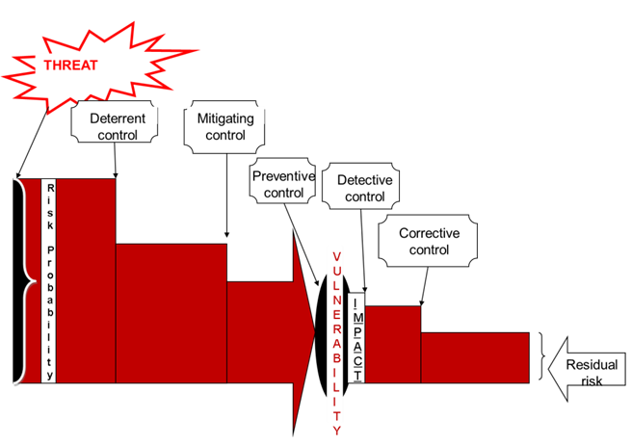
Notes:
This shows how the risk is reduced by risk treatment, resulting in the final Residual Risk.
Examples of
Deterrent: threat of job loss, criminal prosecution
Mitigating: firewall
Detective: hash totals, access logs, IDS
Preventive: not using SSNs, encryption, physical security procedures
Corrective: contingency and recovery plans

Slide 36
Controls & Countermeasures
Cost of control should never exceed the expected loss assuming no control
Countermeasure = Targeted Control
  Aimed at a specific threat or vulnerability
  Problem: Firewall cannot process packets fast enough due to IP packet attacks
  Solution: Add border router to eliminate invalid accesses
Notes:
Here, the border router is a countermeasure or targeted control to address the specific hacker threat of port mapping.

Slide 37
Analysis of Risk vs. Controls
Workbook
Risk | ALE Score | Control | Cost of Control
Stolen Faculty Laptop | $2K $10,000 (FERPA) | Encryption | $60/device
Registration System or Disk Failure | $8,400 | RAID (Redundant disks) | $750
Registration Hacker Penetration | $135,200 (max $740,000) | Unified Threat Mgmt Firewall Log monitoring Network monitoring | $1K
Cost of Some Controls is shown in Case Study Appendix
Notes:
Here we compare the cost of our average losses versus the cost of controls (shown above as purchase price). In all cases, the cost of controls is less than the cost of encountering the risk – so we should go with the control.
You will run into this table as part of the case study.

Slide 38
Extra Step:
Step 6: Risk Monitoring
Stolen Laptop | In investigation | $2k, legal issues
HIPAA Incident Response | Procedure being defined – incident response | $200K
Cost overruns | Internal audit investigation | $400K
HIPAA: Physical security | Training occurred | $200K
Security Dashboard, Heat chart or Stoplight Chart
Report to Mgmt status of security
Metrics showing current performance
Outstanding issues
Newly arising issues
How handled – when resolution is expected
Notes:
A report like this one is used to keep management informed of ongoing issues. Senior managers don’t want to know about all the technical details. The red/yellow/green shows the overall status of an issue; other fields show a brief description and approximate cost. In the above chart, a flaw in physical security was fixed by training the personnel involved. That issue has been resolved and won’t appear on the next report. Some cost overruns are being investigated – that issue is underway. Finally a laptop has been stolen and a new procedure for HIPAA incidents is needed. Those are new issues for which remediation has not begun or is about to.
This kind of reporting tool would not be used for serious incidents. It’s a part of the ongoing risk management process.

Slide 39
Training
Training shall cover:
Importance of following policies & procedures
Clean desk policy
Incident or emergency response
Authentication & access control
Privacy and confidentiality
Recognizing and reporting security incidents
Recognizing and dealing with social engineering
Notes:
Training should also be part of an ongoing management process. Periodic training events to remind staff of their security responsibilities helps to create a security-conscious environment and a security-friendly culture in an organization.
Source: CISM® Review Manual 2009, © 2008, ISACA. All rights reserved. Used by permission. Cism09 2.17

Slide 40
Security Control Baselines & Metrics
Baseline: A measurement of performance
Metrics are regularly and consistently measured, quantifiable, inexpensively collected
Leads to subsequent performance evaluation
E.g. How many viruses is help desk reporting?
(Company data - Not real)
Notes:
Baseline can have two definitions: a measure of status now as compared to a desired future state, or the minimum amount of protection needed for a particular system. This slide refers to the former.

Slide 41
Risk Management
Risk Management is aligned with business strategy & direction
Risk mgmt must be a joint effort between all key business units & IS
Business-Driven (not Technology-Driven)
Steering Committee:
Sets risk management priorities
Define Risk management objectives to
achieve business strategy
Notes:
The best way to convince business management that risk and security is important, is to consider the impact of threats to the bottom line (or income of the organization).

Slide 42
Risk Management Roles
Governance & Sr Mgmt:
Allocate resources, assess
& use risk assessment results
Info. Security Mgr
Develops, collaborates, and
manages IS risk mgmt process
Chief Info Officer
IT planning, budget,
performance incl. risk
Business Managers
(Process Owners)
Make difficult decisions
relating to priority to
achieve business goals
IT Security Practitioners
Implement security requirem.
into IT systems: network,
system, DB, app, admin.
System / Info Owners
Responsible to ensure
controls in place to
address CIA.
Sign off on changes
Security Trainers
Develop appropriate
training materials, including
risk assessment, to
educate end users.
Notes:
The slide shows higher ranking positions on top, lower ranking on the bottom.

Slide 43
Due Diligence
Due Diligence = Did careful risk assessment (RA)
Due Care = Implemented recommended controls from RA
Liability minimized if reasonable precautions taken
Policies & Procedures
Compliance
Risk Assessment
Adequate Security Controls
Senior Mgmt Support
Backup & Recovery
Business Continuity &
Disaster Recovery
Monitoring
& Metrics
Notes:
These terms have to do with liability; an organization must fully investigate its vulnerabilities and take reasonable steps to control them, or at least to minimize the potential damage, in order to protect itself.

Slide 44
Risk Tolerance Table
Considerations
Example Table
Decisions may be made per treatment class:
Financial impact: A range of ALE costs for a risk
Reputational impact: Impact on public perception if risk were to occur
Legal impact: Adhering (or not) to a regulation or standard
Another consideration: how may risks be handled?
may they be transferred (via insurance)?
must they be mitigated or avoided?
Risk Priority & Handling | Qualifications for Priority
High Risk: Always treated | Legal impact
Medium Risk: Negotiable Decided individually by management | Financial impact > $N Reputational impact
Low Risk: Always accepted | Financial impact < $N

Slide 45
Risk Exception Table
Considerations
Example Risk Exception Table
High or medium priority risks may not be managed at a given time
due to insufficient technology, finances or personnel.
Risk Exceptions are then signed off on for specific unhandled risks
reviewed regularly (quarterly or annually)
Risk Priority & Description | Reason for Exception | Mgmt Sign-off

Slide 46
Three Ethical Risk Cases
On eve of doomed Challenger space shuttle launch, an executive told another: “Take off your engineering hat and put on your management hat.”
In Bhopal, India, a chemical leak killed approx. 3000 people, settlement was < 1/2 Exxon Valdez oil spill’s settlement.
  Human life = projected income (low in developing nations)
The Three Mile Island nuclear disaster was a ‘success’ because no lives were lost
  Public acceptance of nuclear technologies eroded due to the environmental problems and the proven threat
It is easy to underestimate the cost of others’ lives, when your life is not impacted.

Slide 47
Question
Risk Assessment includes:
The steps: risk analysis, risk treatment, risk acceptance, and risk monitoring
Answers the question: What risks are we prone to, and what is the financial costs of these risks?
Assesses controls after implementation
The identification, financial analysis, and prioritization of risks, and evaluation of controls
Notes:
1= Risk Management
2= Risk Analysis
3= Proactive Monitoring
4= Risk Assessment

Slide 48
Question
Risk Management includes:
The steps: risk analysis, risk treatment, risk acceptance, and risk monitoring
Answers the question: What risks are we prone to, and what is the financial costs of these risks?
Assesses controls after implementation
The identification, financial analysis, and prioritization of risks, and evaluation of controls
Notes:
1= Risk Management
2= Risk Analysis
3= Proactive Monitoring
4= Risk Assessment

Slide 49
Question
The FIRST step in Security Risk Assessment is:
Determine threats and vulnerabilities
Determine values of key assets
Estimate likelihood of exploitation
Analyze existing controls
Notes:
2 - The first step is to determine what the primary assets are to the organization. Where are the Crown Jewels?

Slide 50
Question
Single Loss Expectancy refers to:
The probability that an attack will occur in one year
The duration of time where a loss is expected to occur (e.g., one month, one year, one decade)
The cost when the risk occurs to the asset once
The average cost of loss of this asset per year
Notes:
3 – The cost of losing an asset once.

Slide 51
Question
The role(s) responsible for deciding whether risks should be accepted, transferred, or mitigated is:
The Chief Information Officer
The Chief Risk Officer
The Chief Information Security Officer
Enterprise governance and senior business management
Notes:
4. High level business management is responsible for deciding and accepting risk.

Slide 52
Question
Which of these risks is best measured using a qualitative process?
Temporary power outage in an office building
Loss of consumer confidence due to a malfunctioning website
Theft of an employee’s laptop while traveling
Disruption of supply deliveries due to flooding
Notes:
B is the best answer.

Slide 53
Question
The risk that is assumed after implementing controls is known as:
Accepted Risk
Annualized Loss Expectancy
Quantitative risk
Residual risk
Notes:
4 – Residual risk: After eliminating, mitigating, and transferring risk, residual risk remains.

Slide 54
Question
The primary purpose of risk management is to:
Eliminate all risk
Find the most cost-effective controls
Reduce risk to an acceptable level
Determine budget for residual risk
Notes:
3. Reduce risk to an acceptable level

Slide 55
Question
Due Diligence ensures that
An organization has exercised the best possible security practices according to best practices
An organization has exercised acceptably reasonable security practices addressing all major security areas
An organization has implemented risk management and established the necessary controls
An organization has allocated a Chief Information Security Officer who is responsible for securing the organization’s information assets
Notes:
3

Slide 56
Question
ALE is:
The average cost of loss of this asset, for a single incident
An estimate using quantitative risk management of the frequency of asset loss due to a threat
An estimate using qualitative risk management of the priority of the vulnerability
ALE = SLE x ARO
Notes:
Annual Loss Expectancy = Single Loss Expectancy x Annual Rate of Occurrence

Slide 57
Advanced
Financial Aspects – Larger Organizations

Slide 58
Input
Activity
Output
Hardware, software
System Characterization
System boundary
System functions
System/data criticality
System/data sensitivity
Company history
Intelligence agency
data: NIPC, OIG
Identify Threats
List of threats
& vulnerabilities
Audit &
test results
Identify Vulnerabilities
Current and Planned
Controls
Analyze Controls
List of current &
planned controls
Threat motivation/
capacity
Determine Likelihood
Likelihood Rating
Business Impact
Analysis
Data Criticality &
Sensitivity analysis
Analyze Impact
Impact Rating
Likelihood of threat
exploitation
Magnitude of impact
Plan for risk
Determine Risk
Documented Risks
Recommend Controls
Recommended Controls
NIST Risk
Assessment
Methodology
Document Results
Risk Assessment
Report
Notes:
This is a NIST (National Institute for Science and Technology) table, showing inputs, processes, and outputs.
Source: CISM® Review Manual 2009, © 2008, ISACA. All rights reserved. Used by permission. Cism09 exhibit 2.6

Slide 59
Metrics & Baselines
Previous history help s to generate an accurate likelihood
A well-selected set of metrics or statistics are:
Quantifiable
collected periodically
preferably automated
Example metric: The number of viruses the help desk reports per month
Baseline: a measurement of performance at a particular point in time.
Metrics (consistently measured) enables:
observe changes in the metrics over time,
discover trends for future risk analysis,
measure the effectiveness of controls.

Slide 60
Layered Risk Management
Process of Assessment
Perform Risk Analysis at all Levels
At each level, risk assessment should be
Consistent with higher levels and related risk assessments
Scoped to cohesively focus on selected area
Consider details associated with the scope or project (e.g., specific software development project)
Generate a Risk Assessment Report as final output
report ensures that security controls were tested and pass inspection
Certify product or area for use
Strategic
Organizational Level
Tactical
Business Process
Business Project
Operational
Operational
IS Project

Slide 61
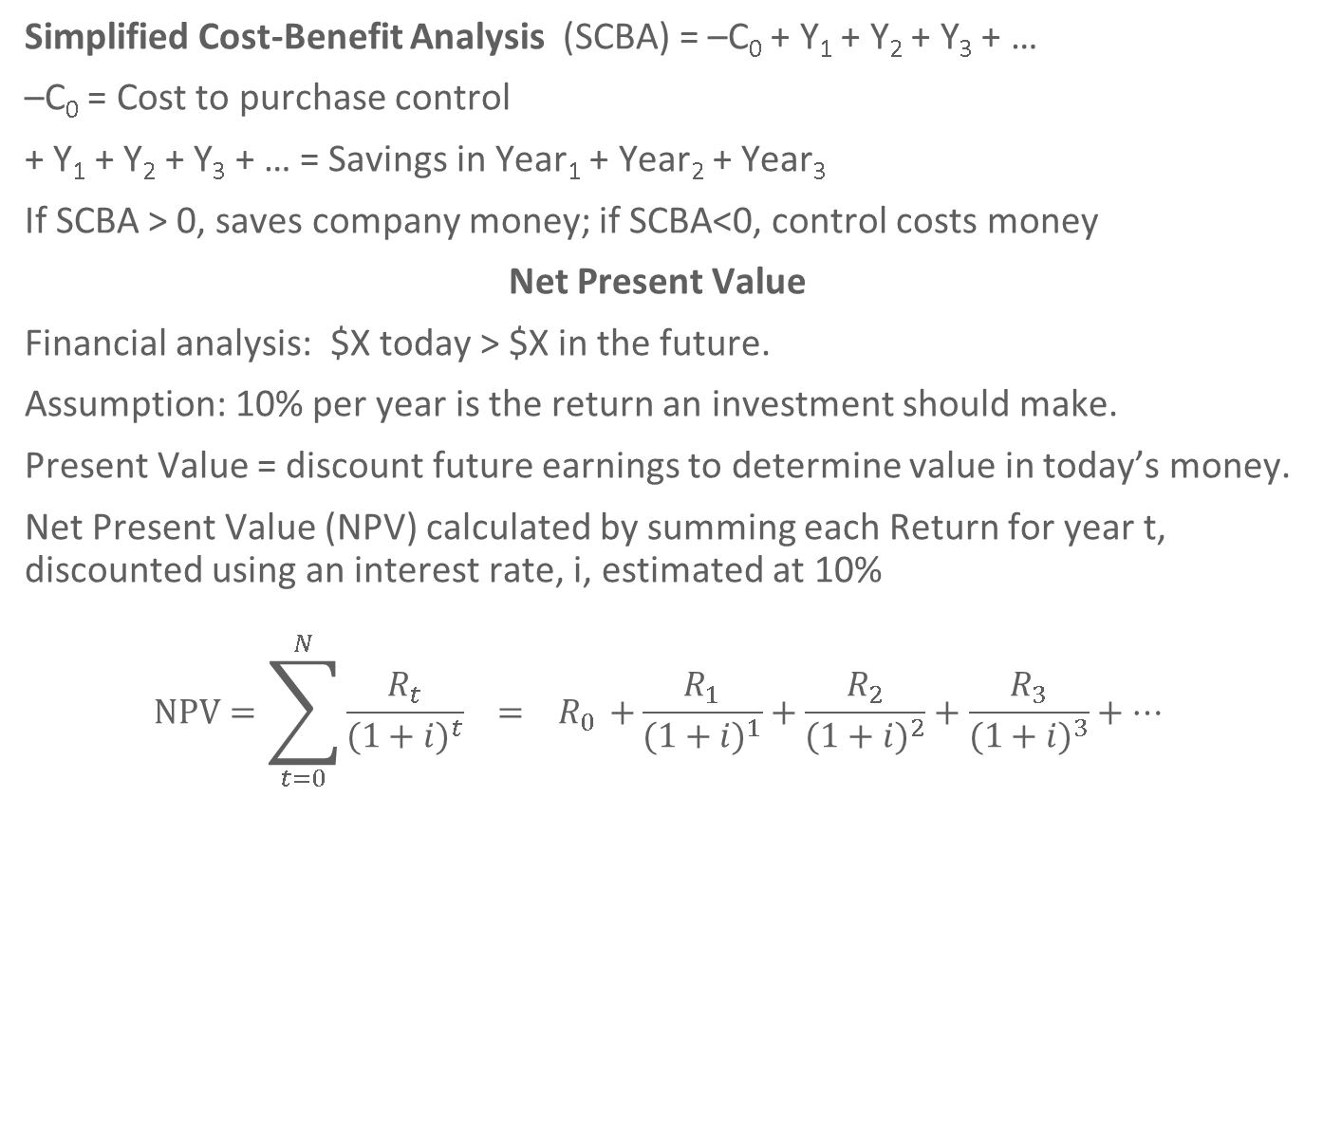
Cost-Benefit Analysis

Slide 62
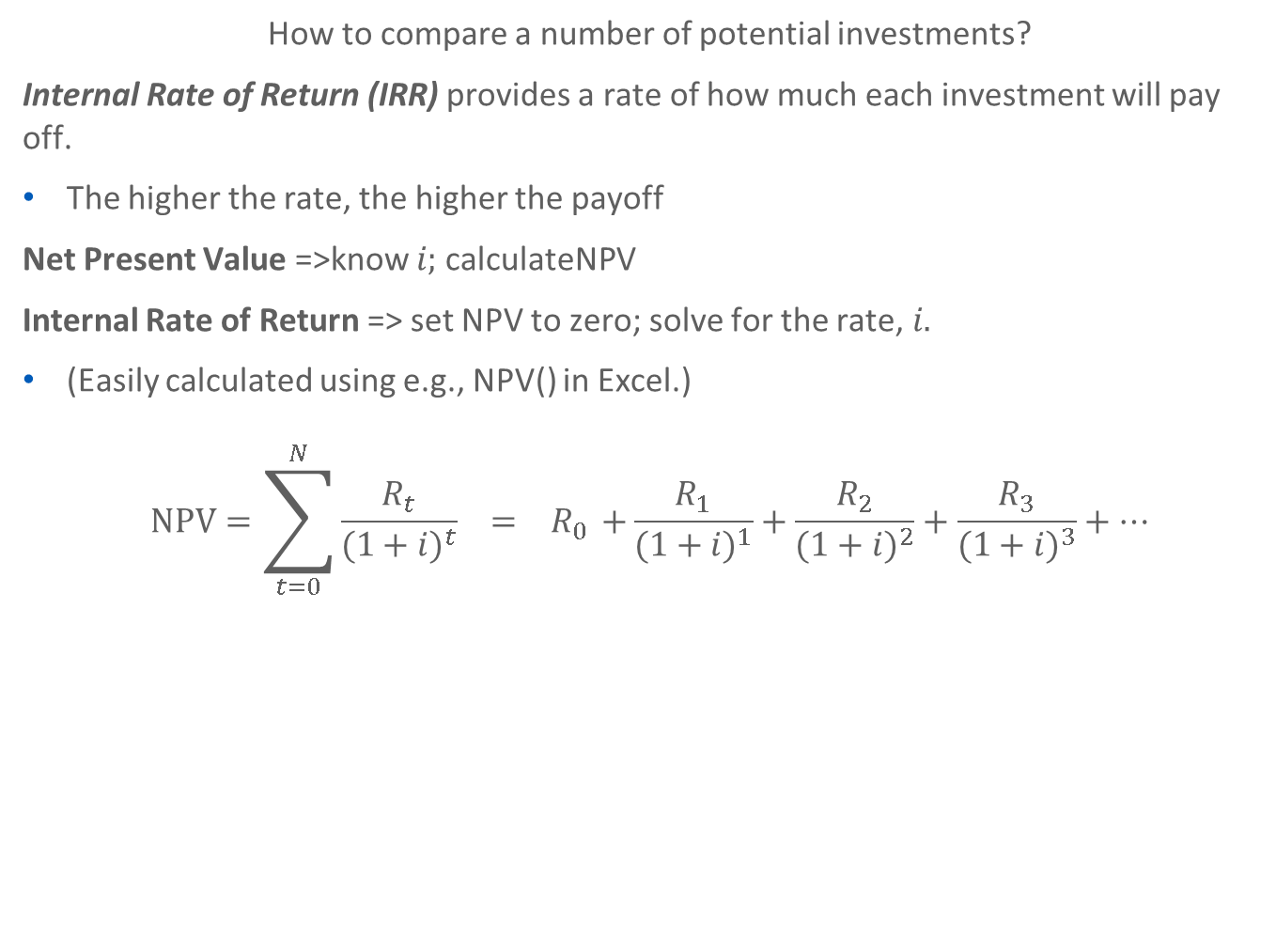
Internal Rate of Return

Slide 63
Example: Purchase Encryption Software
Explanation
Net Present Value
Calculation
Encryption software costs
$35 per license
100 laptops with confidential data
Cost = 3500
Estimated savings for 5 years:
$1000 per year
SCBA = -3500 + 5*1000 = 1500
Discounted interest = 10%.
NPV = $290.78
IRR = 13.2%.
Year | $ Value | Present Value
0 | – 3500 | -3500
1 | 1000 | 909.09
2 | 1000 | 826.45
3 | 1000 | 751.31
4 | 1000 | 683.01
5 | 1000 | 620.92
Total | 1500 | 290.78

Slide 64
Summary
Risk Assessment Process:
Assign Values to Assets:
Determine Loss due to Threats & Vulnerabilities
Estimate Likelihood of Exploitation
Compute Expected Loss
Treat Risk
Consider:
Financial Analysis
Real World Data: Professional versus Own Metrics
Ethical Impact
Continual Process
Coverage – Prioritized versus Complete

Slide 65
Health First Case Study
Jamie Ramon MD
Doctor
Chris Ramon RD
Dietician
Terry
Licensed
Practicing Nurse
Pat
Software Consultant
Analyzing Risk

Slide 66
Step 1: Define Assets
Notes:
Many of our assets are listed in our Income Statement and the Balance Sheet.

Slide 67
Step 1: Define Assets
Consider Consequential Financial Loss
Asset Name | $ Value Direct Loss: Replacement | $ Value Consequential Financial Loss | Confidentiality, Integrity, and Availability Notes
Medical DB |  |  | C? I? A?
Daily Operation (DO)
Medical Malpractice (M)
HIPAA Liability (H)
Notification Law Liability (NL)
Notes:
Consider the Medical database, in terms of its requirements for Confidentiality, Integrity and Availability.
If the DB were not available, it would impact Daily Operation and Medical Malpractice. Also, if the DB is not confidential, the office could be liable under HIPAA and Notification Law. Find the daily cost of not being in business, due to the medical DB not being available. Put this $ under Consequential Financial Loss, Daily Operation. Then in Medical DB, put DO in the Consequential Financial Loss column.

Slide 68
Step 1: Define Assets
Consider Consequential Financial Loss
Asset Name | $ Value Direct Loss: Replacement | $ Value Consequential Financial Loss | Confidentiality, Integrity, and Availability Notes
Medical DB |  | DO+M_H+NL | C I A
Daily Operation (DO) |  | $
Medical Malpractice (M) |  | $
HIPAA Liability (H) |  | $
Notification Law Liability (NL) |  | $
Notes:
Find the daily cost of not being in business, due to the medical DB not being available. Put this $ under Consequential Financial Loss, Daily Operation. Then in Medical DB, put DO in the Consequential Financial Loss column.

Slide 69
HIPAA Criminal Penalties
$ Penalty | Imprison-ment | Offense
Up to $50K | Up to one year | Wrongful disclosure of individually identifiable health information
Up to $100K | Up to 5 years | …committed under false pretenses
Up to $500K | Up to 10 years | … with intent to sell, achieve personal gain, or cause malicious harm
Then consider bad press, state audit, state law penalties, civil lawsuits, lost claims, …
Notes:
As we can see (and from what I hear actually occurs) people are fined large amounts and can go to jail for not being careful with health information – or at least get fired.

Slide 70
HITECH Act (2009)
 | Each Violation | Max $ Per Year
CE/BA exercised reasonable diligence but did not learn about violation | $100-$50k | $1.5 Million
Violation is due to reasonable cause | $1k- $50k | $1.5 Million
CE/BA demonstrated willful neglect but corrected violation | $10k-$50k | $1.5 Million
CE/BA demonstrated willful neglect and took no corrective action | $50k | $1.5 Million
Penalties are prohibited if problem is corrected within 30 days and no willful neglect
Penalties pay for enforcement and redress for harm caused

Slide 71
Step 2: Estimate Potential Loss for Threats
Step 3: Estimate Likelihood of Exploitation
Normal threats: Threats common to all organizations
Inherent threats: Threats particular to your specific industry
Known vulnerabilities: Previous audit reports indicate deficiencies.
Notes:
Consider which threats are likely to have a financial impact on the firm, if they occurred. There are more threat ideas in the Workbook.

Slide 72
Step 2: Estimate Potential Loss for Threats
Step 3: Estimate Likelihood of Exploitation
Notes:
Do these threats look like they are in the correct quadrant? Are there inherent threats that should be added?

Slide 73
Step 4: Compute Expected Loss
Step 5: Treat Risk
Step 4: Compute E(Loss)
ALE = SLE * ARO
Step 5: Treat Risk
Risk Acceptance: Handle attack when necessary
Risk Avoidance: Stop doing risky behavior
Risk Mitigation: Implement control to minimize vulnerability
Risk Transference: Pay someone to assume risk for you
Risk Planning: Implement a set of controls
Asset | Threat | Single Loss Expectancy (SLE) | Annualized Rate of Occurrence (ARO) | Annual Loss Expectancy (ALE)

