Slide 1
Planning for Secure Software Requirements and Design with UML
Secure UML
Security Planning
Susan Lincke

Slide 2
Objectives
The Student shall be able to:
Define command injection, cross-site scripting, cross-site request forgery.
Draw a Misuse Case Diagram and Security Use Case Diagram
Prepare a Misuse Case Description and Security Use Case Description
Define the five steps of the OCTAVE security requirements process
Describe the functionality of a Missequence diagram, Misuse Deployment Diagram, state diagram
Describe how and why each of the following coding recommendations are important: sanitize input and output; never expose internal data structures; minimize access; use tried and true security algorithms; validate and control the configuration; and manage exceptions.
Define BugBar, fuzz testing, reliability testing, sandbox, vulnerability scanner, web spider.

Slide 3
Secure Software Principles
Usability
Psychological acceptability
Authorization
Least Privilege
Fail Safe/Fail Secure
Efficiency
Modularity, Encapsulation, Abstraction
Open Design
Economy of Mechanism: Simplicity of Design
Fortification
Reduce attack surfaces
Least Common Mechanism: Separation, Isolation
Defense in Depth: Layering
Trust relationship
Least astonishment
Complete mediation

Slide 4
Principles of Secure Software Design: Usability
Psychological Acceptability: Security implementations should not make a resource more difficult to use than an implementation without security.
Balance of security & usability: Security can not make a product too difficult or onerous to use in actual environments.
Least Astonishment: Security mechanisms should be understandable to users and work effectively within users’ activities [Smith12]. Some security features (e.g., passwords) may be a bother, but users understand the need and how the functions work.
Trust Relationship: The system, including all information and security mechanisms are considered safe.
Safe organizations; safe networks and computer systems.

Slide 5
Principles of Secure Software Design: Efficiency
Open Design: Assume the attacker knows your system.
The algorithm is known. The system must be strong enough that even when the attacker has the code, they cannot break in.
Example: AES, RSA, other encryption and integrity checks
Economy of Mechanism or Minimization: Security mechanisms should be as simple as possible.
Example: Centralized password and security package implementation; driven by policy.
Modularity, Encapsulation, Simplicity

Slide 6
Principles of Secure Software Design: Authorization
Least privilege. Provide program and user the minimum possible required privileges.
Example: Unix sudo allows users temporary privileges to perform an administrative task to minimize duration of such privileges.
Separation of privilege. A protection implementation is more secure when it requires two different keys to unlock it. Separation of Duties: Origination, Authorization, Distribution, Verification (Fraud)
Two-person control prevents unilateral action by a corrupted individual (e.g., nuclear weapons)
Complete mediation. Access rights are completely validated every time an access occurs.
Example: File permissions change during a file access connection.
Example: Web interface accesses to data: validate at the beginning or all the way through.
Fail Closed or Fail Secure Default: A subject is given explicit access to an object, only when access is explicitly defined.
Authorized use of data is defined by security policy and control is restricted by security mechanisms.
Example: Firewall stops working: let packets through or shut down?
Fail Safe or Fail Open: A locked door becomes open during an emergency (e.g., fire)

Slide 7
Principles of Secure Software Design: Fortification
Reduce attack surfaces: Risk analysis attempts to mitigate vulnerabilities, by minimizing their impact or frequency, or by avoiding risky behavior altogether (e.g., not saving confidential data).
Layering or Defense in Depth: Layering of defenses ensures that if an attacker penetrates one layer, they are stopped by the next layers.
Layers of software defenses may include: authentication, access control, logging, code reviews, input validation, vulnerability tests, etc.
Least common mechanism. Isolate services so to avoid shared devices, leading to additional vulnerabilities and springboard opportunities. Applications, users, systems should minimize sharing to avoid cross contamination or leakage.
Example: Leaking may happen when two applications share the same computer (via covert channel) OR
      When communication lines are not sufficiently separated OR
      When apps are on the same machine; Virtual Machine can help

Slide 8
Question – Match vocabulary to example
Vocabulary
Example
Psychological Acceptability
Open Design
Fail-Secure Default
Complete Mediation
Least Privilege
Economy of Mechanism
Least Common Mechanism
We ensure that when a message fails our input checking, the message is not implemented.
The new app is more secure than the old, but it is as easy to use.
All our applications use the same security libraries and data systems.
Each server access uses an encrypted nonce to prove authentication
We use 3rd party software for encryption and password storage with state of the art algorithm AES and passwords algorithms with secure hashes and salts
All of our services are on separate virtual machines.
Files permissions are allocated in a minimal way for every access to the database.

Slide 9
Secure Requirements & Architecture

Slide 10
Open Group’s Common Data Security Architecture (version 2)
Application
Layered Services and Middleware
Common Security Services Manager Application Programming Interface
System Service Provider Modules
Cryptographic Services Provider | Trust Policy Services | Authorization Computation Services | Certificate Library Services | Data Storage Library Services | Module Directory Services
Key Directory Services | Signed Manifest | Elective Module Manager | Object Identifiers for Certificate Library Modules | Embedded Integrity Services Library | Add-in Module Structure and Administration

Slide 11
Registration System
Use Case Diagram
Register: Clients register to obtain documentation by providing name, email, job function
Provider: Send periodic updates to Clients to indicate changes in materials
Notes:
This is an introduction to an example used throughout this lecture.
Diagram drawn with SeaMonster, downloaded from http://sourceforge.net/projects/seamonster.
Feedback/contact us

Slide 12
OCTAVE Security Requirements Process
Risk: Threat and vulnerability(s) -> negative impact
Identify critical assets
Define security goals
Identify threats
Analyze risks
Define security requirements
Notes:
Method based on OCTAVE:
Adapted from: “Considering Operational Security Risk during System Development”, C Woody, C Alberts, IEEE Security & Privacy, pp. 30-43.

Slide 13
Step 1. Identify Critical Assets via Business Process Diagram
Contact Info: Name, email, job function
Materials: Course materials
Comments: Feedback, saved & sent as email
Notes:
Yellow boxes contain data. Arrows that point to the data are writes to the data. Arrows pointing from the data are reads from the data.
Created with BoUML

Slide 14
Step 2. Define Security Goals
Assets | Confidentiality | Integrity | Availability
Contact Info | ** No PII maintained | *** Require accurate list of interested persons | * Weekly backup
Materials | * Public with login | *** Accurate – tamper-proof | ** 24/7 preferred
Comments | ** Confidential pref. | *** Accurate – tamper-proof | * Weekly backup, email
Impact Rating:
* Low Priority
** Medium Priority
*** High Priority

Slide 15
Step 3: Identify Threats
What it is Software Techniques Advanced Security
Spoof Identity
Assume identity
Bypass protection
Secure Password
Digital Certificate
Sec. Awareness
Tamper w. Data
Modify data
Authentication
Access Control
Message Digest
Repudiation
Hide activities
Trans. Logging
Digital Signature
Info Disclosure
Read data
Encryption
Authentication
Secure Handling
Denial of Service
Elevation of Privilege
Unreliable execution, resource consumption
Firewall
Intrusion Prevention System
Gain privileges
Execute unauthorized cmds/code
Access Control
Segregation of Duties
Encrypt passwords
No backdoor entry
Validate input
Avoid buffer overruns
Close unused resources
Require passwords
Log user transactions
Encrypt data
Encrypt packets
Minimal permissions
Validate real user via CAPTCHA
Test for Failures
Avoid chatty error messages
Hide system files
Require approval
STRIDE
General
Threats
Notes:
The general threats above are called the STRIDE threats, from the first letter of each name.
The first column gives name (from: “Threat Risk Modeling” from OWASP discusses STRIDE)
Second column provides definition
Third column lists software security techniques
Fourth column lists advanced or system security techniques.

Slide 16
Step 3: Identify Threats
Open Threat Taxonomy, v. 1.1, Enclave Security (summary)

Slide 17
Table of Vulnerability Databases
Threat models | Description
Common Vulnerability Enumeration (CVE) | Purpose: “identify, define, and catalog publicly disclosed cybersecurity vulnerabilities.” Catalogs and describes approx. 200,000 vulnerabilities. https://cve.mitre.org/
Common Weakness Enumeration (CWE) | Purpose: Describe the top 25 most dangerous weaknesses in software: https://cwe.mitre.org/top25/archive/2022/2022_cwe_top25.html
Common Attack Pattern Enumeration and Classification (CAPEC) | Purpose: “comprehensive dictionary of known patterns of attack employed by adversaries to exploit known weaknesses in cyber-enabled capabilities.” catalogs 560 attack patterns divided into categories of software, hardware, communications, supply chains, social engineering and physical security. https://capec.mitre.org/

Slide 18
Step 3. Identify Threats via Misuse Case Diagram
Which misuse cases relate to:
Confidentiality?
Integrity?
Availability?
Definitions:
DOS = Denial of Service
←misuser
Misuse case
Notes:
Now we apply the threats to the particular Registration example. Hmm… Enter Feedback use case is not on here, but much of the threats apply to it as well. Do we add that in – or use inheritance?
This diagram was drawn with SeaMonster: http://sourceforge.net/projects/seamonster/
Adapted from “Eliciting Security Requirements by Misuse Cases”, G Sindre, A L Opdahl, IEEE ???, pp. 120-131.

Slide 19
Step 3 (cont’d):
Misuse Case: Launch DOS
MisUse Case: Launch Denial of Service
Summary: An attacker issues repeated Registrations, resulting in filling the database with fake data, and depleting system and file resources.
Basic Path: Do forever The attacker requests a Registration form The attacker sends random fake data in the form Enddo
Alternative Paths: AP1. Repeat data is entered
Mitigation Points: MP1. At BP Step 2-3 use CAPTCHA in Registration form to avoid bot attack. MP2. At BP Step 3 validate data: no duplicates, data type matching

Slide 20
Step 3 (cont’d):
Misuse Case: Circumvent Registration
Misuse Case: Circumvent Registration
Summary: Deviant Client bypasses registration by going directly to the download web page.
PreCondition: Client does Google search and finds link to download web page OR obtains link reference from a colleague
Basic Path: 1. DeviantClient obtains web reference from Google or friend. 2. DeviantClient uses web reference to download materials without registering.
Mitigation Points: MP1: Web page has no other web references. MP2: Registration is confirmed by an email response. MP3: Email response includes a dynamic web page with unique reference. This web page is accessible only if a key is provided during registration. Key expires in one week.
Related Business Rule: Users must register to obtain materials.
Mitigation Guarantee: MP1 and MP3 solves Google search problems. MP3 could be used by friends for one week, which is acceptable.
Notes:
Here we use inheritance with threats, since many threats relate to both use cases.
This diagram is drawn with BoUML, which doesn’t have Misuse cases. However, you can change colors of the misuse cases, but not of the Misuser.

Slide 21
Step 3 (optional)
Threat Tree
Notes:
Threat trees are an optional technique that can draw out additional attack techniques. This diagram was drawn with MS Visio
Adapted from: “Combining misuse cases with attack trees and security activity models” I A Tondel, J Jensen, L Rostad, 2010 International Conf. on Availability, Reliability and Security”, pp. 438-445, Feb 15-18 2010.

Slide 22
Step 4: Analyze Risks
Threat | Impact | Likelihood | Priority = I*L
DOS | 7 | 7 | 49
SQL Attack (affects integrity, confidentiality) | 7 | 7 | 49
Invalid Input | 2 | 7 | 14
Circumvent input | 4 | 7 | 28
Notes:
This is straight from risk management. Again:
* = low priority = 1
** = medium priority = 2
*** = high priority = 3
Priority = Impact * Likelihood

Slide 23
Step 5: Define Security Requirements using Security Use Case Diagram
Notes:
The Security Use Case describes how the Use Case is modified to handle the misuse case.

Slide 24
Security Use Case Diagram for Registration System – Draft Version

Slide 25
Security Use Case Diagram – Final Version

Slide 26
Stage 5: Define Security Requirements:
Validate Input
Security Use Case: Validate Input
Summary: This validates all client and provider entries on a per-field basis
Precondition: A name, email, job function are provided.
Basic Path: For each valid field: name, email, job, password (if included) The system checks for valid characters, to prevent SQL injection. The system checks for valid name, email, password and job function Log both attacks and successful registrations If email is new to database Add record to database The system returns “new”, “existing” or “failure” to calling routine.
Postconditions: The input has been checked for bot attempt, SQL injection, and validity. Attacks and successful access are logged.
Notes:
Here is the ‘included’ security use case.

Slide 27
Business Rules
Users cannot access the web pages without registering their emails into the system;
Email registrations shall be accurate;
The database with user emails shall not be easily broken into, requiring 2-factor authentication;
It is difficult to circumvent the registration process;
The registration system is near-immune to DDOS attacks; and
Provider email notifications and obvious attacks are logged and emailed to the administrator.

Slide 28
Misuse Deployment Diagram
Shows attacks/defenses
Shows where attacks are handled
Useful for:
  Security Planning
  Audit
  Test - QC
  S/W Development

Slide 29
Misuse Deployment Diagram with Security Stereotypes

Slide 30
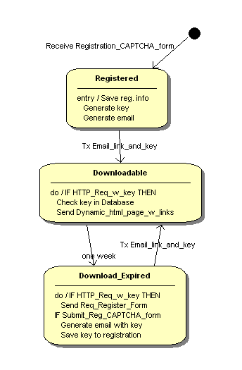
State Diagram
State Diagrams can ensure software:
Retains proper order of processing
Recognizes out-of-sequence steps
Can change behavior based on time or past history

Slide 31
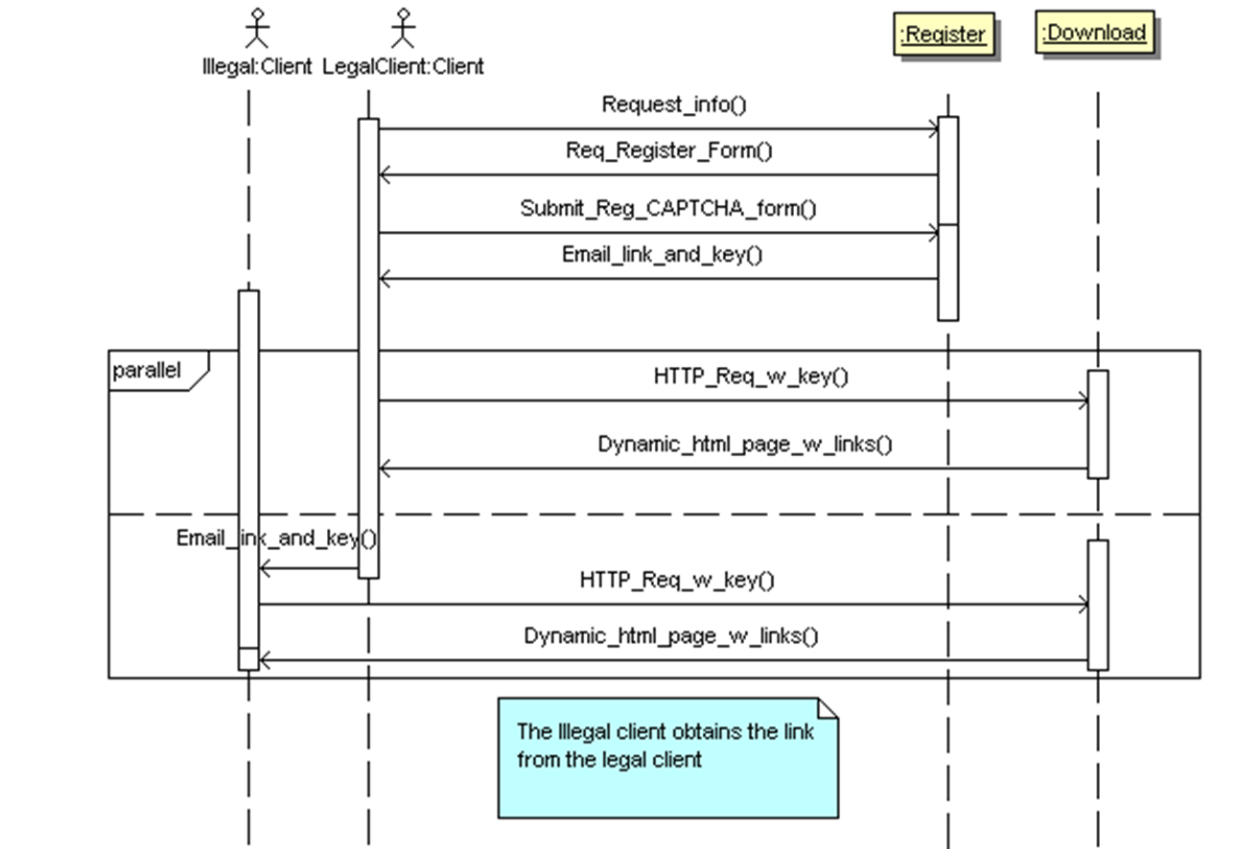
MisSequence Diagram

Slide 32
PCI’s Software Security Framework: Secure Software Requirements and
Assessment Procedures
Minimize the Attack Surface
Software Protection Mechanisms
Secure Software Operations
Secure Software Lifecycle Management

Slide 33
Minimize the Attack Surface: Risk Assessment
Risk assessment and prioritization.
Inventory assets: the card data elements and transactions processed
Classify information security CIA
Document assets’ internal environment including:
process of how and where each asset is processed (main memory, RAM, flash media vs. disk),
their duration of storage,
how and where encryption and third-party software is used.
Provide a process flow diagram showing details:
where information is input, processed, and sent,
when stored in storage devices, or sent as network segments, URLs, static IPs, and related channels: environmental/configuration data and authentication flows.
Mitigate known vulnerabilities (e.g., listed in a public vulnerability database)

Slide 34
Minimize the Attack Surface: Installation
installation process of the software:
Document any default passwords and accounts and required environmental files
Secured both during and after installation.
Remove any unnecessary services or ports, including in third-party software
Provide clear instructions on certificate and key installation
Ensure replacement of any default accounts and passwords
Define each configuration requirement
Ensure that transaction processing does not begin until fully, properly configured.

Slide 35
Minimize the Attack Surface:
Authentication, Access Control
implement least privilege (or minimum necessary) for the required roles:
e.g., administrators can change configurations but not access sensitive user data.
Enable onfigurable access control privileges to specific roles and persons
Restrict access control and data storage to business purpose:
e.g., if there is no need to store data, data shall not be stored.
Retain secure information for minimal timeframe
Explicitly clear transaction data after processing to prevent further exposure
Use strong encryption during storage and transmission
Expunge keys as soon as possible
Delete sensitive data wherever it may reside
swap space, partitions, and log files
to prevent side channel leaks, hardware (cache, screen, keyboard) or software (error messages, logs, and memory dumps).

Slide 36
Software Protection Mechanisms: Authentication and Access Control
Authentication and access control
Provide higher levels for roles: system administration, remote access, and roles with access to sensitive data.
require multifactor authentication for high security roles
require unique logins for all users.
Protect password credentials via requiring sufficiently complex to prevent guessing, leaking or bypass.
E.g., biometric devices should not be fooled by a forged copy
Provide access control models based on specific roles or identities
enable permissions based on allowable access times, enabled attributes, and dynamic decisions based on recent history.

Slide 37
Software Protection Mechanisms: Authentication and Access Control
Encrypt sensitive data transmitted or stored persistently with standard encryption and in some cases, integrity controls.
all places the data is stored or transmitted, including log files, third-party software and operating system(s)
encryption must meet accepted national or international standards, such as NIST, ANSI, ISO or EMVCo.
Protect encrypted sensitive data with appropriate key-management processes, or a one-way hash or one-time pad to render data unreadable. (A
  one-time pad is a randomly generated number used once to encrypt and decrypt one transaction
Protect integrity hash algorithms via a quality random number generator, strong salt, and a reputation for collision resistance.

Slide 38
Software Protection Mechanisms:
Key management
Understand key management processes thoroughly, to ensure strong process
Rules:
Use separate keys for key storage, data encryption, authentication, different transactions
The encryption used for key storage must be at least as strong as for data encryption
Store the two keys (key generation, encryption) separately.
Encryption used for key delivery must be at least as strong as the encryption key being delivered
New keys shall not be generated from old keys, where the generation process could be reversible
Maintain an inventory of keys, including key name, type/length, purpose, location and expiration date (including through third-party software).

Slide 39
Software Protection Mechanisms:
Random Number Generator & Keys
All secret keys must be at least 128 bits or longer.
Expire keys at end of their crypto-period and retire or replace them thereafter.
Recommendation: use a two-part key storage for certain keys (e.g., private keys) so that knowledge of both parts are required to identify the full key.
Key secrecy is heavily dependent on the quality of the random number generator, its configuration and initialization.
Random number generators are defined by:
Entropy: defines the size of the period before random numbers repeat.
Entropy is affected by the initialization seed.

Slide 40
Secure Software Operations: Logging
Many events need to be logged, including
user actions and incidents
attacks, such as password guessing and changes in configuration after installation
access to sensitive data
changes in configuration of sensitive functions (encryption, logging, authentication, privilege escalation).
Logs shall clearly define the action taken, who did it, when they did it, and impacted critical assets.
Integrity of the logs is important. Log data should
ensure completeness and accuracy using integrity checks
ensure that the log file never gets overwritten upon restart, overflow or other failures.
check integrity hashes on critical data and software at least every 36 hours, and record any failures

Slide 41
Secure Software Lifecycle Management: Deployment
During deployment:
Manage software updates via patching, tracking patches, and release notes in commercial software
Deliver updates using secured communications (e.g., TLS), with integrity hashing or digitally signed certificates for integrity and authenticity.
Release notes
provide hash values to assure software legitimacy,
specify the purpose of the fix(es) with installation directions, and
discuss workarounds for defects not yet fixed.
must clearly state the version to which the documentation applies.
Provide methods to users to view the security status, including which patches are applied and functional, and whether the system considers itself fully secured.

Slide 42
PCI Secure Software Audits
Auditors will:
Examine documentation, program code contents, and analyze end products
Use forensic software, memory dumps, and protocol sniffers to ensure that requirements are met
Tests will include:
all environmental/configuration files are encrypted
no reduction in the strong encryption can be negotiated during transmission.
Documentation must clearly and accurately describe:
all setup requirements (e.g., cryptography libraries, random number generators, environmental files)
all configuration options (including setting account passwords and permissions, enabling/disabling features)
how to enable a secure state and track its status.

Slide 43
Health First Case Study
Jamie Ramon MD
Doctor
Chris Ramon RD
Dietician
Terry
Medical Admin
Pat
Software Consultant
Security Requirements

Slide 44
Security Requirements Process
OCTAVE Security Requirements Process
Identify critical assets
Define security goals
Identify threats
  Draw Misuse Diagram from Use Case Diagram
  Prepare Misuse Case Description
Analyze risks:
  Priority = Impact * Likelihood
Define security requirements
  Draw Misuse Diagram with Security Use Cases
  Define one Security Use Case Description (Lightweight or Midweight)
Notes:
The first two steps are done, so three steps remain. You will do them as part of the case study.

Slide 45
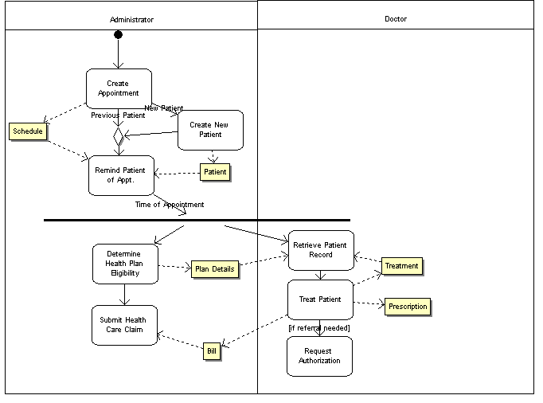
Step 1: Identify Critical Assets
All of this information is protected by HIPAA
HIPAA protects:
Confidentiality: In transmission, on disk, or any other form.
Integrity: All transactions are logged as to who did them and why. Hashing (sophisticated checksums) are also required.

Slide 46
Step 2: Define security goals
 | Confidentiality | Integrity | Availability
Patient Information: Appointments, Medical history, Treatment, Prescriptions, Bills
Impact Rating:
* Low Priority
** Medium Priority
*** High Priority

Slide 47
Step 2: Define security goals
 | Confidentiality | Integrity | Availability
Patient Information: Appointments, Medical history, Treatment, Prescriptions, Bills | HIPAA Requirement 10 | HIPAA Requirement, Malpractice law suit if accidental death 10 | Malpractice law suit if information not available 10
Impact Rating:
* Low Priority
** Medium Priority
*** High Priority

Slide 48
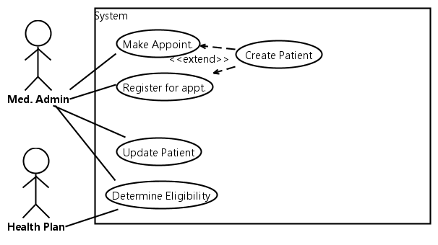
Step 3: Identify Threats
Medical Admin use cases include:
Make appointment: Patient may phone for an appt.
Create Patient Record To make an appt, a minimal patient record must exist or be created
Register for Appointment: When the patient arrives for his/her appt.
Update Patient: Update patient medical history
Determine Health Plan Eligibility: Ask HMO/PPO what the patient is eligible for in coverage – and conditions
Use Case Diagram
Notes:
This is partial coverage of the system. We start with a small portion of the system.

Slide 49
Step 3: Identify Threats
Open Threat Taxonomy, v. 1.1, Enclave Security (summary)

Slide 50
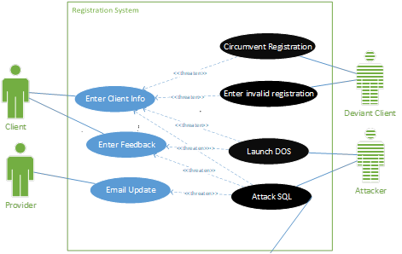
Step 3: Identifying Proper Threats
In the Registration case we are talking about clients registering at our Documentation Database (DD).
Which of these are valid misuse cases?
Attack SQL: Directly affects DD
Password guessing: Directly affects DD if there is a login page.
Phishing: Affects OS: does not directly affect DD
Virus: Affects OS, does not directly affect DD.

Slide 51
Step 3 (cont’d):
Misuse Case: Circumvent Registration
Misuse Case: Circumvent Registration
Summary: Deviant Client bypasses registration by going directly to the download web page.
PreCondition: Client does Google search and finds link to download web page OR obtains link reference from a colleague
Basic Path: 1. DeviantClient obtains web reference from Google or friend. 2. DeviantClient uses web reference to download materials without registering.
Mitigation Points: MP1: Web page has no other web references. MP2: Registration is confirmed by an email response. MP3: Email response includes a dynamic web page with unique reference. This web page is accessible only if a key is provided during registration. Key expires in one week.
Related Business Rule: Users must register to obtain materials.
Mitigation Guarantee: MP1 and MP3 solves Google search problems. MP3 could be used by friends for one week, which is acceptable.
Notes:
Here we use inheritance with threats, since many threats relate to both use cases.
This diagram is drawn with BoUML, which doesn’t have Misuse cases. However, you can change colors of the misuse cases, but not of the Misuser.

Slide 52
Step 4: Analyze Risks
Threat | Impact | Likelihood | Priority = I*L
DOS | 7 | 5 | 35
SQL Attack (affects integrity, confidentiality) | 10 | 8 | 80
Invalid Input | 3 | 10 | 30
Circumvent input | 3 | 5 | 30
Notes:
This is straight from risk management. Again:
* = low priority = 1
** = medium priority = 2
*** = high priority = 3
Priority = Impact * Likelihood

Slide 53
Step 5: Define Security Requirements using Security Use Case Diagram
Notes:
The Security Use Case describes how the Use Case is modified to handle the misuse case.

Slide 54
Stage 5: Define Security Requirements:
Validate Input Security Use Case Descr.
Security Use Case: Validate Input
Summary: This validates all client and provider entries.
Precondition: A name, email, job function, and Captcha or login are provided.
Basic Path: Do for 5 attempts or until valid CAPTCHA: Rerequest form with new CAPTCHA For each valid field: name, email, job, password (if included) The system checks for valid characters, to prevent SQL injection. The system checks for valid name, email, password and job function Log both attacks and successful registrations If email is unique in database Save record to database The system returns success or failure to calling routine.
Postconditions: The input has been checked for bot attempt, SQL injection, and validity. Status=fail if Provider password attempted but not correct
Notes:
Here is the ‘included’ security use case.

Slide 55
Misuse Deployment Diagram
Shows attacks/defenses
Shows where attacks are handled
Useful for:
  Security Planning
  Audit
  Test - QC
  S/W Development
  Drawn with MS Visio

Slide 56
Security Requirements Process
OCTAVE Security Requirements Process
Identify critical assets
Define security goals
Identify threats
  Draw Misuse Diagram from Use Case Diagram
  Prepare Misuse Case Description
Analyze risks:
  Priority = Impact * Likelihood
Define security requirements
  Draw Misuse Diagram with Security Use Cases
  Define one Security Use Case Description (Lightweight or Midweight)
Notes:
The first two steps are done, so three steps remain. You will do them as part of the case study.

Slide 57
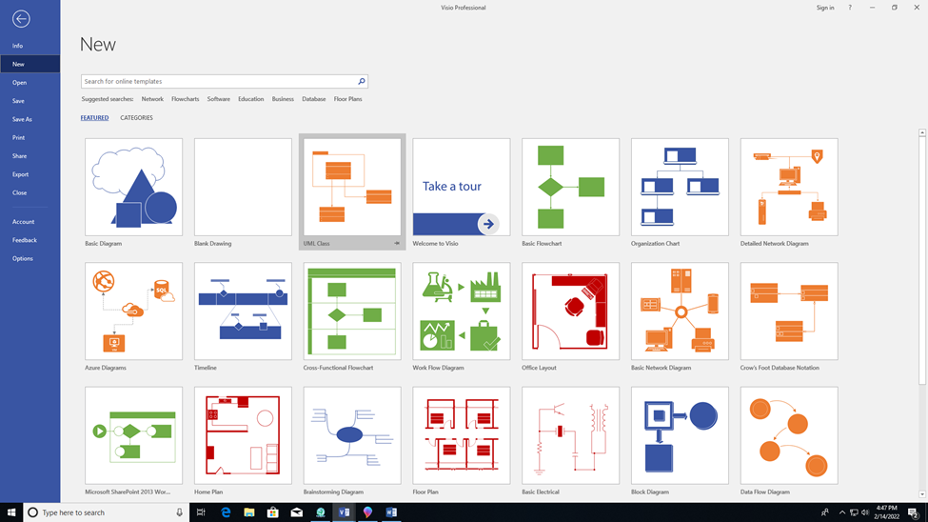
MS Visio: Open UML Class Diagram

Slide 58
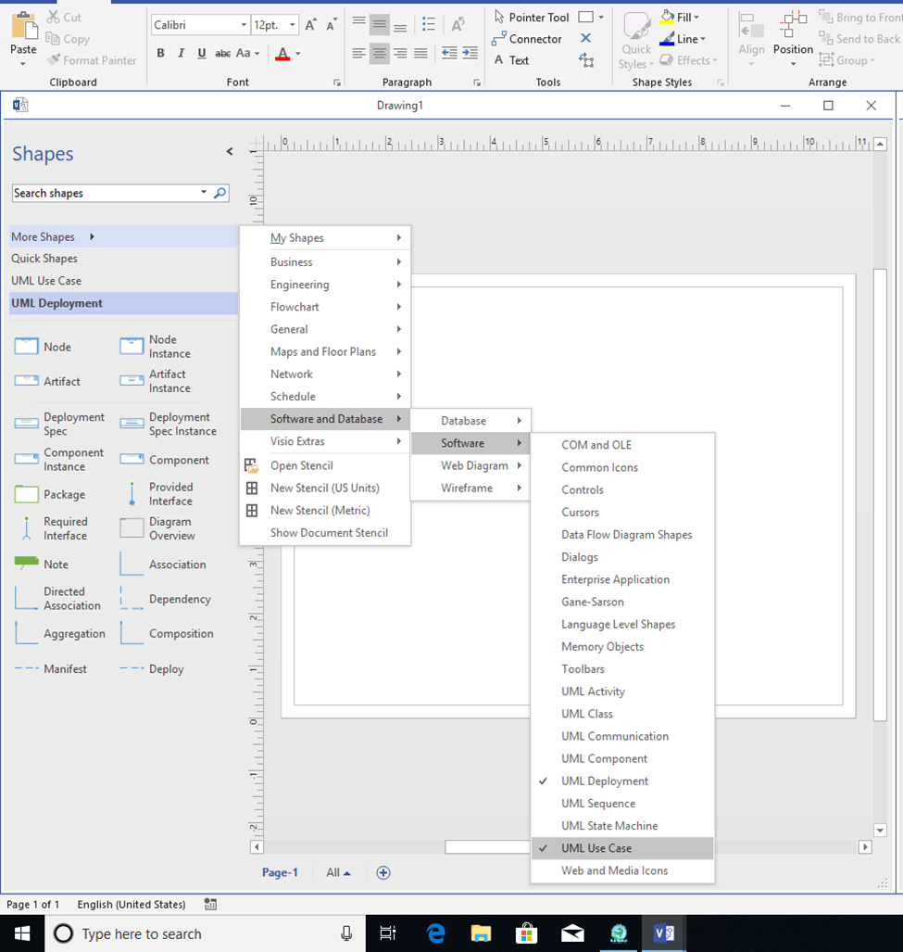
MS Visio
Once in UML Class Diagram
Open More Shapes
Select Software and Database
Select Software
Select UML Deployment and UML Use Case
Change color by clicking on an object-> right click-> format shape-> change fill

