Slide 1
Security Awareness:
Brave New World
Information Security Planning
Susan Lincke

Slide 2
Study Sheet
The student shall be able to:
Describe the following attack types, who is involved and the information they hope to obtain or actions they hope to accomplish: Hacktivism, cyber-crime, cyber warfare, surveillance state
Define attacks: virus, worm, logic bomb, trojan horse, social engineering, phishing, pharming, botnet, zombie, man in the middle, rootkit, dictionary attack, spyware, keystroke logger, ransomware, exfiltration.
Define the role of these security techniques and technologies: firewall, security patches, secure behavior
Define passwords using three techniques.

Slide 3
Why is Cybersecurity Important?
Cyber-criminals want:
Money: Stolen ID, credit cards, medical insurance, social security numbers,
bank ID
Ransom: Corrupted disks, disable network (DDOS)
Computer Resources: disk space, processing power, cryptocurrency calculation, engineering plans
Governments want:
Information: Espionage, traitors, competitive information
Corporate secrets: Engineering plans, business plans, customers
Disable operations: electricity, banks, news, communications
Misinformation: Biased news
Hackers want:
Deface: web pages,
Disable operations: DDOS

Slide 4
History of Cybersecurity
Information Warfare
Espionage
Cyber Crime
Hacktivism
Vandalism
Experimentation
Exfiltration: Stolen information:
Personal information (37%)
Password credentials (42%)
Payment card info (5+%)
Motive of attack=cybercrime
System Intrusion: Advanced Persistent Threat (93%)
Social Engineering (89%)
Web App Attacks (65%)
Lost & Stolen Assets (98%)
Employee Privilege Misuse (78%)
Notes:
DBIR 2022

Slide 5
Breaches
Most lost or stolen information impact organizations financially:
Personal 77%
Medical 43%
Other 15%
Bank 9%
It is difficult to confirm that data was stolen by outsider
Notes:
DBIR 2022

Slide 6
ATM – Point of Sale
Credit Card Fraud
Payment Card Skimmers used at ATMs, gas stations.
Point of Sale Intrusions used at hotel and food services
Common method: RAM scrapers reads memory
Most payment card crime now attacks online retail.
Microchips have reduced this fraud
Notes:
[Gonz10] Anon, “U.S. Department of Justice; Leader of Hacking Ring Sentenced for Massive Identity Thefts from Payment Processor and U.S. Retail Networks”, Biotech Business Week, April 12, 2010.
[Ver13] “Verizon 2018 Data Breach Investigations Report”, www.verizonenterprise.com/DBIR/2018.

Slide 7
War Driving and Hacking
Gonzalez cracked and exposed over 170 million credit card numbers
  Stole from: Barnes & Noble, Boston Market, OfficeMax, Sports Authority, TJ Maxx, Dave & Buster’s, Marshall’s, Heartland Payment Systems, 7-Eleven, and Hannaford Brothers
Sentenced to 20 years prison, 2009
Effect: Payment Card Industry Data Security Standard (PCI DSS)
Notes:
[Gonz09] Reuters, “Man Accused of Stealing Stores’ Data Pleads Guilty”, New York Times, Aug. 29, 2009.
[Gonz10] Anon, “U.S. Department of Justice; Leader of Hacking Ring Sentenced for Massive Identity Thefts from Payment Processor and U.S. Retail Networks”, Biotech Business Week, April 12, 2010.

Slide 8
Ransomware
“You are infected. Buy antivirus.”
“You’ve stored underage pornography. Pay a fine or go to jail. Notice from FBI”
Data Extortion: If you don’t pay, we will release data
CryptoLocker: Revenue: “Your disk has been encrypted. Pay to decrypt.”
  Petya/NotPetya: Disruption: spreads, disk wiper
  Phonywall: Decoy: Steals info then writes over disks to hide tracks
  Colonial Pipeline ransomware attack on business network
  Nearly $5 million paid to ransomers
  Controls 45% of gasoline, diesel, jet fuel to east coast U.S.
  Pipeline off for nearly 1 week, starting May 7, 2021
Notes:
ISTR 2018
DBIR 2020: Recent ransoms; data extortion, ransom 2019
Pay up or your data dies: CryptoLocker ransomware hits Australia
Chris Griffith, The Australian, December 05, 2013
Pipeline Attack Yields Urgent Lessons About U.S. Cybersecurity
By David E. Sanger and Nicole Perlroth
Published NYTimes May 14, 2021Updated June 8, 2021

Slide 9
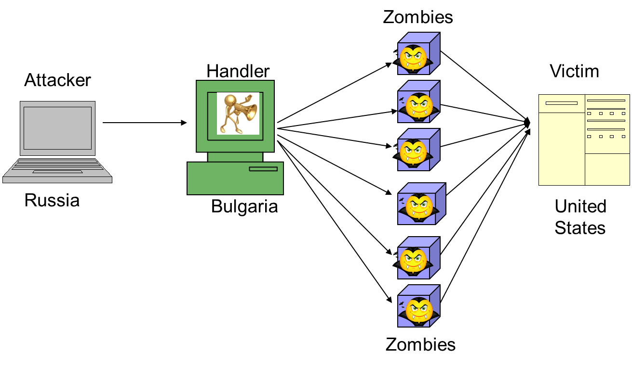
Botnet
Cross international boundaries
Distributed Denial of Service: Attack web pages
1.3 Gbps for the most common mode
On average last 4 hours; attacked < 10 times/year
Notes:
When your computer becomes infected, it is likely to become a bot. Because attacks are international, they are hard to eliminate. Statistic from forensically-analyzed breaches, 2022 Verizon DBIR
Zombie: a compromised computer which may host pornography, illegal music and/or movies
Botnet: a “zombie army,” or collection of compromised computers, zombies, used to send out spam, viruses or distributed denial of service attacks.
[SC06]

Slide 10
Coin Mining – Crypto Currency
Steal computer, cloud processing power to mine cryptocurrency
Effects:
slows down computers,
overheats batteries,
can make processors unusable
Monero can be run on a personal computer
Monero price: $321 (Dec. 2017)
2.5% of malware
Notes:
2.5% is 2020 DBIR

Slide 11
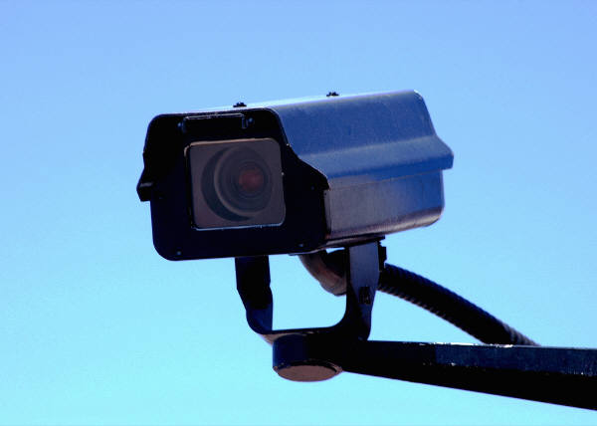
History of Cybersecurity
Information Warfare
Espionage
Cyber Crime
Hacktivism
Vandalism
Experimentation
Often: State affiliated
Motive of attack=espionage
System Intrusion (6%)
Social Engineering (11%)
Web Attacks (31%)
Employee Privilege Misuse (8%)
Notes:
2018, 2020 Verizon Data Breach Investigations Report

Slide 12
Surveillance State: Stalkerware
Stalkerware an app allows others to stalk or spy on a user.
MobileSpy: “View your child or employees’ smartphone and tablet usage”
Collects from a phone without consent: GPS location, emails, text messages, call logs, contacts lists, pictures, private social media activity, etc.
Hidden, may operate user’s mic, camera or phone remotely.
Available in Google Play and Apple’s iTunes stores.

Slide 13
Surveillance State
NSA has requested/manipulated:
  Water down encryption
  Install backdoors in software
  Collect communication data
At its worst, Verizon, Google, Yahoo, Microsoft and Facebook were coerced into …?
  Gag orders prevent companies from speaking
  Yahoo/Google: nearly 200 million records, Dec 2012
  Includes email metadata (headers) and content
  In the U.S., international communications can be spied upon
  National communications do require a warrant
Notes:
[NYT112613] Perlroth, N. and Markoff, J. “NSA may have hit companies at a weak spot”, New York Times, Nov. 26, 2013.
[WP13] “NSA Infiltrates links to Yahoo, Google data centers worldwide, Snowden documents say”, Washington Post, Oct. 30, 2013.
[NYT9513] Perlroth, N., Larson, J. and Shane, S. “NSA Able to Foil Basic Safeguards of Privacy on Web”, New York Times, Sept. 5, 2013.

Slide 14
Hidden communications
Steganography: used by malware authors to smuggle code or data inside images.
images tend to be excluded from web scanners due to their size.
WebSocket: lesser known web protocol enables bidirectional obfuscated messages
Encryption
Notes:
2020 State of Malware Report

Slide 15
History of Cybersecurity
Information Warfare
Espionage
Cyber Crime
Hacktivism
Vandalism
Experimentation
2010 Stuxnet worm:
Developed by U.S., Israel
Hit Iranian nuclear power plants
damaged nearly 1000 centrifuges
nearly 1/5 of those in service
Iran attacked American banks, oil companies
Notes:
[NYT060112] “How a Secret CyberWar Program Worked”, graphic, New York Times, June 1, 2012.
[NYT013013] Perlroth, N. “Hackers in China Attacked the Times for Last 4 Months”, New York Times, Jan. 30, 2013.

Slide 16
Information Warfare
Next wars will be computer attacks to power, water, financial systems, military systems, etc
  Cyberweapons are MUCH cheaper than military
  Causes as much damage
  High priority: Protecting utilities, infrastructure
New black market in 0-day attacks.
  Governments pay more > $150,000/bug
  Govts. include Israel, Britain, India, Russia, Brazil, North Korea, Middle Eastern countries, U.S.
  New hacking firms openly publicize products
Notes:
[NYT0713] Perlroth, N. and Sanger, D. E. “Nations Buying as Hackers Sell Flaws in Computer Code”, New York Times, July 13, 2013.

Slide 17
History of Cybersecurity
Information Warfare
Espionage
Cyber Crime
Hacktivism
Vandalism
Experimentation
Example Hacktivist: Anonymous
Political causes, e.g.:
  Middle East Democracy
  WikiLeaks
  Mexican Miner’s rights
Bad ways, e.g.:
  Web defacement
  DDOS attacks on Visa, MasterCard, MPAA
  Computer hacking
  Generally < 2% of cases
  Web Application Attack (1%)
  Lost & Stolen Assets (2%)
Notes:
DBIR22

Slide 18
History of Cybersecurity
Information Warfare
Espionage
Cyber Crime
Hacktivism
Vandalism
Experimentation
Errors
Errors: Action done incorrectly (or by mistake) or not done
Example cases:
Lost laptops, memory, papers
Stolen backup memory(s) left in car
Emails mistakenly sent to unauthorized people
Misconfiguration
Important task not completed
Breached info:
Personal, medical, bank, other
13% of breaches
Notes:
DBIR 2022

Slide 19
Crackers
System Administrators
Some scripts are useful
to protect networks…
Get info from hacker
bulletin boards
Cracker:
Computer-savvy
programmer creates
attack software
Dark Web
For Sale:
Credit Cards
Medical Insurance
Identification
Malware
Script Kiddies:
Know how to
execute programs
Criminals:
Create & sell botnets -> spam
Sell credit card numbers,…
Nation States:
Cyber-warfare, spying, extortion, DDOS
For Sale:
Crimeware or Attack Kit
Malware-as-a-Service (MaaS)
Spam: 1 M Email addresses
Botnet of 10,000 PCs

Slide 20
How Attacks Occur
Enter
Social engineer
Entice to infection
Expand
Expand privileges
Hide tracks
Attack
Exfiltrate
Ransom
Gain foothold in network
Expand footprint and privileges - Hide tracks
Attack

Slide 21
Attacks often have multiple steps
Goals
Means of Access
Goals can include multiple ends:
Exfiltration: data breaches, company secrets, financial information
Extortion: Ransomware, DDOS
Adware
Disruption: Info Warfare
Coin mining
Means usually include multiple techniques:
Software engineering
Supply chain: Software updates
Password attacks
Rootkits, keystroke loggers
Vulnerabilities
Dumpster diving

Slide 22
Social Engineering – Phishing, Vishing
Social engineering manipulates people into performing actions or divulging confidential information. 22% of Breaches – 3.4% click rate
Transfer $ from Nigeria
ABC Bank has a problem with your account
Watch this funny video… see attached
I am attaching the (Word) document for your perusal.
Phone Call:
This is John, the System Admin. What is your password?
Vishing
Notes:
22% is from 2020 DBIR
Social Engineering can occur in-person, over the phone, in emails or fake web pages.
Social Engineering: non-technical or low-technology means - such as lies, impersonation, tricks, bribes, blackmail, and threats - used to attack information systems.
The next two slides discuss two types of Social Engineering: phishing and pharming.

Slide 23
Social Engineering: Waterhole
Secondary: Establishing a means of attack through compromised infrastructure
Waterhole: A webpage is known as a common site for targeted users.
The webpage is attacked, infected, so visitors become infected.

Slide 24
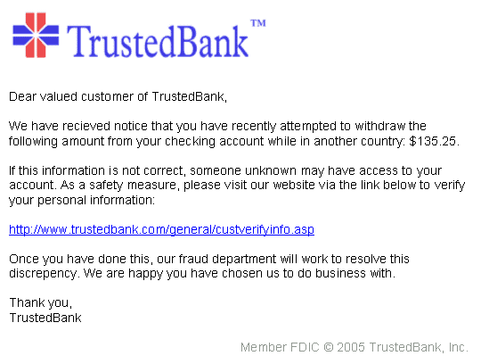
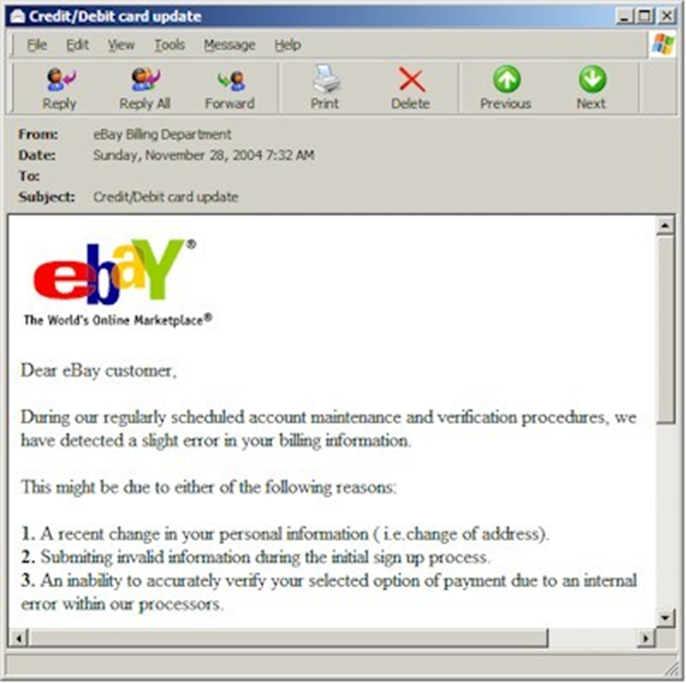
Social Engineering: Pharming =
Fake Web Pages
The fake web page looks like the real thing
  Extracts account information
Notes:
Pharming: Another type of social engineering. A user’s session is redirected to a masquerading website. At the fake website, transactions can be mimicked and information like login credentials can be gathered. With this the attacker can access the real site and conduct transactions using the credentials of a valid user on that website.

Slide 25
AdWare
NewTab: redirects searches in the web browser to illicit affiliate to earn revenue
Lead to webpages with fake flight or package tracking, fake maps, or fake directions
Example, a fake ‘package tracking’ page downloads a “PackagesTracker” app (with Instructions) but does not provide functionality.
Fake File Opener
Invoked when user opens a file that no app on the system knows how to open
Instead of offering to search the App Store, user is told to ‘run free scan’ to check for malware and is redirected to a page offering malicious downloads.
Notes:
2020 State of Malware Report;

Slide 26
Malware & Hacking
Malware: Malicious software run on a device that alters its operation, without the owner’s informed consent (30% of breaches)
Virus, worm, downloader, ransomware, botnet, scanning network
Hacking: Unauthorized access to systems bypasses security controls with the goal to seize, modify or harm information or assets.
Guess passwords, use stolen password credentials
Erase logs
Copy files
Exploit vulnerability or abuse desktop sharing
Social Engineering: Impersonating someone to obtain information or access through deceit. (20% of breaches)
Phishing: Click or open attachment
Pretexting: Establishing an ongoing relationship
Notes:
2022 DBIR

Slide 27
Malware: Virus
Program
A
A virus attaches itself to a program, file, or disk
When executed, the virus activates,
        replicates: Attaches to other files, disks;
        waits until the appropriate time; then
        performs the action it was designed for.
Virus Code
infects
Program
B
Notes:
[ISTR18]
Viruses
Computer viruses are software programs that are deliberately designed by online attackers to invade your computer, to interfere with its operation, and to copy, corrupt or delete your data. These malicious software programs are called viruses because they are designed not only to infect and damage one computer, but to spread to other computers all across the Internet.
Computer viruses are often hidden in what appear to be useful or entertaining programs or e-mail attachments, such as computer games, video clips or photos. Many such viruses are spread inadvertently by computer users, who unwittingly pass them along in e-mail to friends and colleagues.

Slide 28
Malware: Worm
Independent program sends copies of itself from computer to computer across networks
Click on attachment to execute the worm
May send itself to addresses in your email list
May carry other forms of malware
To Joe
To Ann
To Bob
Email List:
Joe@gmail.com
Ann@yahoo.com
Bob@uwp.edu
Notes:
Worms
Worms are more sophisticated viruses that can replicate automatically and send themselves to other computers by first taking control of certain software programs on your PC, such as email.

Slide 29
Trojan Horse
Trojan Horse: Masquerades as beneficial program
Common Banking Trojans
  Steals bank passwords and empties accounts
  Steal tax documents to impersonate people
  Emotet:
  Phishing Emails claiming Word attachments:
        Edward Snowden’s book, Permanent Record,
        “support Greta Thunberg,” Time Magazine’s Person of the Year
  Download-as-a-service (DaaS): Distribution of third-party malware
  TrickBot:
  Password collectors: harvest, brute force, defeat multifactor
  Spam sender
  Android: Pre-installed malware: Riskware and Adups steals personal information
Phishing
Trojan
Ransomware
Notes:
Emotet, TrickBot, Android: 2020 State of Malware Report, MalwareBytes
[Perlr13] Perlroth, N. “Malware that Drains Your Bank Account Thriving on Facebook”, New York Times, June 3, 2013.
[SC06] Hoffman, K. E. “Botnets 3.0”, SC Magazine, www.scmagazine.com, July 2013, p. 30-31.
Logic Bomb
Malware that destroys data when certain conditions are met. E.g., it may format a hard drive or change data files (possibly by inserting random bits of data) on a particular date or time or if a certain employee record is missing from the employee database.
Example: an employee places a logic bomb inside a system to destroy data when his/her record is removed upon termination.
Trojan Horses
A Trojan horse is a program which seems to be doing one thing, but is actually doing another. A Trojan horse can be used to set up back door in a computer system so that the intruder can gain access later.
The name refers to the horse from the Trojan War, with similar function of deceiving defenders into bringing an intruder inside.

Slide 30
Web Attacks: Two Causes
Stolen Password Credentials
Web Vulnerabilities
Using passwords to impersonate someone
Knowledge of personal interests
Keystroke logger
Phishing, pharming
Password guessing tools
Vulnerability: Software has defects that enables entry
Defects can exist in:
Application software
System software (Database, operating system)
Configuration
Patching is so important to fix these bugs!
Notes:
DBIR 2022

Slide 31
Password attacks
Dictionary attacks: uses a file of common passwords to guess passwords
    Password Spraying: perform logon attempts against multiple user accounts using a list of commonly used passwords
Brute force attack: Guessing a, b, c, … aa, ab, ac,… aab, aac, aad, …
Copying password hashes: Copying the password file with its hashes to test against
Enter
Social engineer
Entice to infection
Expand
Expand privileges
Hide tracks
Attack
Exfiltrate
Ransom

Slide 32
Password Cracking:
Dictionary Attack versus Brute Force
Pattern | Calculation | Result | Time to Guess (@ 2.6x10¹⁸/month)
Personal Info: interests, relatives |  | 20 | Manual 5 minutes
Social Engineering |  | 1 | Manual 2 minutes
American Dictionary |  | 80,000 | < 1 second
4 chars: lower case alpha | 26⁴ | 5x10⁵
8 chars: lower case alpha | 26⁸ | 2x10¹¹
8 chars: alpha | 52⁸ | 5x10¹³
8 chars: alphanumeric | 62⁸ | 2x10¹⁴ | 3.4 min.
8 chars alphanumeric +10 | 72⁸ | 7x10¹⁴ | 12 min.
8 chars: all keyboard | 95⁸ | 7x10¹⁵ | 2 hours
12 chars: alphanumeric | 62¹² | 3x10²¹ | 96 years
12 chars: alphanumeric + 10 | 72¹² | 2x10²² | 500 years
12 chars: all keyboard | 95¹² | 5x10²³
16 chars: alphanumeric | 62¹⁶ | 5x10²⁸
Notes:
The rate of attacks are 34% of hacking attacks (52% of breaches)
This chart shows the different combinations of passwords and password lengths and how long a dictionary attack or brute force attack would take to guess the password.
Discussion of proper password creation and change techniques will occur later in the User Practices section of the presentation.
At this stage just discuss the attacks and comparisons to password lengths and patterns.
Brute Force Attack: A cryptanalysis technique or other kind of attack method involving an exhaustive procedure that tries all possibilities, one-by-one.
Dictionary Attack: An attack that tries all of the phrases or words in a dictionary, trying to crack a password or key. A dictionary attack uses a predefined list of words compared to a brute force attack that tries all possible combinations.

Slide 33
Keystroke Logger
Silently tracks the keys you enter
Sends credit card info, password to the criminal
You see unusual charges on credit card statement
75% of Malware
37% of breaches stole or used credentials
Android malware: AndroStealer records SMS messages to steal two-factor authentication tokens

Slide 34
Rootkit
After penetration, hacker often installs a rootkit
Eliminates evidence of break-in
Modifies the operating system
Rate of infection/malware
  Downloader: 19%
  Rootkit:
  Backdoor: 19%
  Keystroke logger:12%
Backdoor entry
Keystroke Logger
Hidden user
Notes:
RootKit: A collection of programs that a hacker uses to mask intrusion and obtain administrator-level access to a computer or computer network.
Keystroke Logger: A program which logs passwords, credit card numbers, etc., and forwards them to the attacker.
Statistic from forensically-analyzed breaches, 2013.
19, 12% from 2020 DBIR

Slide 35
Example of Malware/RootKit
The initial script executed, named Zzz.bat, kicked off executing the following tasks:
Assigned new password for local accounts
Queried the OS for users in Local Administrator and Remote Access groups
Manipulated accounts and user group settings
Added new user accounts
Manipulated file system permissions to hide newly added accounts
Modified registry settings for remote access, disabling connection duration timeout limitations
Hid newly added accounts from the initial logon screen view
Created the directory System64Q.dll with additional tools start.cmd, Loog.bat, rdpclip.exe (renamed NSSM Service Manager) and payload.exe (Dharma)
Executed the start.cmd script, to create a new service called WindowsSystem set to execute ransomware payload
Executed the Loog.bat script, which cleared operating system event logs
Notes:
CROWDSTRIKE GLOBAL THREAT REPORT 2020

Slide 36
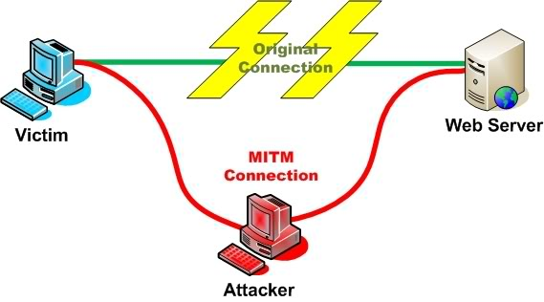
Man in the Middle Attack
An attacker pretends to be your final destination on the network.
The attacker may look like a strong WLAN access point.
Notes:
An easy way to do this is to log into a wireless network that is unusually strong that day.

Slide 37

Advanced Persistent Threat (APT)
Example: China & NY Times
People’s Liberation Army targets manufacturing, research, military aircraft
NY Times fought off China for 4 months
  Who gave info on P.M. Wen Jiabo?
  45 mostly-new malware
  Attacked from 8 AM-midnight China time
  Stole all passwords; hacked 53 PCs
Notes:
NY Times story tells us details that most companies will not divulge.
[NYT013013] Perlroth, N. “Hackers in China Attacked the Times for Last 4 Months”, New York Times, Jan. 30, 2013.

Slide 38
Supply Chain Attack on Software Update
Valid looking software updates are actually download attack software
Often permitted through firewalls
Techniques:
Compromise Software Supplier
Hijack DNS, IP, network traffic
Hijack third-party hosting services
However:
Patches often fix security problems
Older versions are vulnerable
Malvertising: a vector to distribute fake software updates.
Notes:
Malvertising: 2020 State of Malware Report

Slide 39
SolarWinds Attack
SolarWinds sells IT software: network/IT/database/app management
JetBrains: A software development platform (Russian leaders in Czech Republic)
a back door in a product like TeamCity is “the holy grail of a supply chain hack.” [1]
TeamCity tool allows developers to test and exchange software code before its release, used by SolarWinds (and many others)
Result: hacked the networks of 18,000 SolarWinds customers [2]
        Including U.S. Homeland Security Department, State Department, American nuclear research labs, and government contractors. [2]
Presumed hacked by Russian government
“It can allow an adversary to have thousands of SolarWinds-style back doors in all sorts of products in use by victims all over the world.,” Mr. Alperovitch added. “This is a very big deal.” NY Times 1/11/2021 [1]
Notes:
Widely Used Software Company May Be Entry Point for Huge U.S. Hacking, NY Times,
Published Jan. 6, 2021Updated Jan. 11, 2021
N Perlroth, D E Sanger, J E Barnes.
Why Was SolarWinds So Vulnerable to a Hack? NY Times, Feb 23, 2021, By Bruce Schneier,
https://www.nytimes.com/2021/02/23/opinion/solarwinds-hack.html?searchResultPosition=9

Slide 40
Defending: SaFeR User Practices
Notes:
What are the best practices to avoid all the threats we have been discussing?

Slide 41
Malware Detection
(Additional) Spyware symptoms:
  Change to your browser homepage/start page
  Searches end up on a strange site
  Firewall turns off automatically
  Lots of network activity while not particularly active
  New icons, programs, favorites which you did not add
  Frequent firewall alerts about unknown programs trying to access the Internet
  Often not recognized

Slide 42
Recognizing a Break-in or Compromise
Symptoms:
  Antivirus software detects a problem
  Pop-ups suddenly appear (may sell security software)
  Disk space disappears
  Files or transactions appear that should not be there
  System slows down to a crawl
  Stolen laptop (1 in 10 stolen in laptop lifetime)
  Often not recognized

Slide 43

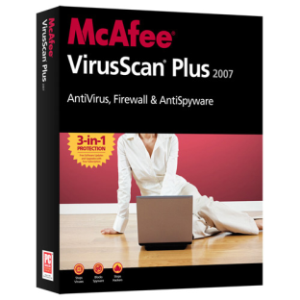



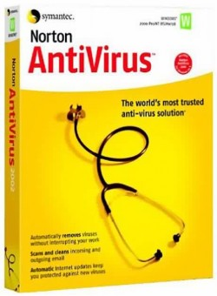
Antivirus - Antispyware
Anti-virus software detects malware and can remove it before damage is done
For PC, Tablet, Smartphone
Install, keep anti-virus software updated
Anti-virus is important but limited in capability
Notes:
Attackers are always creating new viruses, so it is important that anti-virus software stay updated.
Anti-virus and anti-spyware software should be updated on a regular basis.
Anti-virus should be set to auto update at 12 midnight and then do a scan at 12:30.
Anti-spyware should be set to auto update at 2:30 am and then a full system scan should be done at 3:00 am, this procedure makes sure that only one activity is performed at a time.
If the employees work from home, they should also have anti-virus and anti-spyware installed on their home computers.

Slide 44
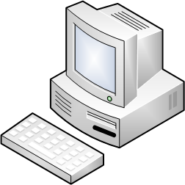

Use a Firewall
Web Response
Illegal Dest IP Address
Email
Response
Web Request
SSH Connect Request
DNS Request
Web
Response
Ping Request
Illegal Source IP Address
Email Response
FTP request
Microsoft NetBIOS Name Service
Email Connect Request
Telnet Request
Notes:
A Packet Filter firewall looks at the incoming packets. Some of them may be requests for connections, or responses to our connections. Normally PCs only initiate connections, such as web or email. Therefore, web and email requests we would expect to travel in the other direction (from PC to Internet). Most of these requests are illegal. Most likely a cracker is attempting to break into a server, or a PC which is willing to act as one.
Other attacks include uses of invalid IP addresses, such as an IP address representing the internal network (pretending to originate from the inside of the network).
In this case, the only packets that should make it through are replies to our web requests and email requests to a mail server.

Slide 45
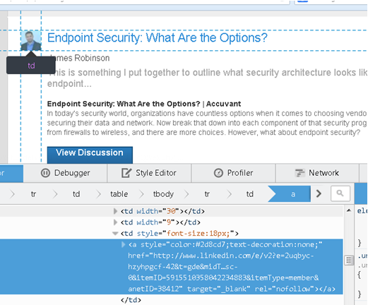
Avoid Social Engineering and Malicious Software
Do not open email attachments unless
  you expect the email with attachment
  you trust the sender
Do not click on links in emails unless you are absolutely sure of their validity
Only visit and/or download software from web pages you trust
Notes:
Email Attachments
Attachments should be opened only from trusted senders.
If you are not expecting an email attachment from the sender, it’s a good idea to call and confirm, before opening the attachment.
Spam email often asks for sensitive information.
Links in emails
Never click on link in email attachment, except only when you are expecting it.
If you are not expecting an email link from the sender, it’s a good idea to call and confirm, before clicking the email link.
If you hover the cursor over an email’s web link description, the link should be displayed on the bottom of the browser. Make sure both of them match.
Trustworthy Web Pages
Software download should be done only from trusted websites like Microsoft for Windows updates and Office application updates.
Avoid downloading and using freeware or shareware, since most of them either don’t come with technical support or full functionality.

Slide 46
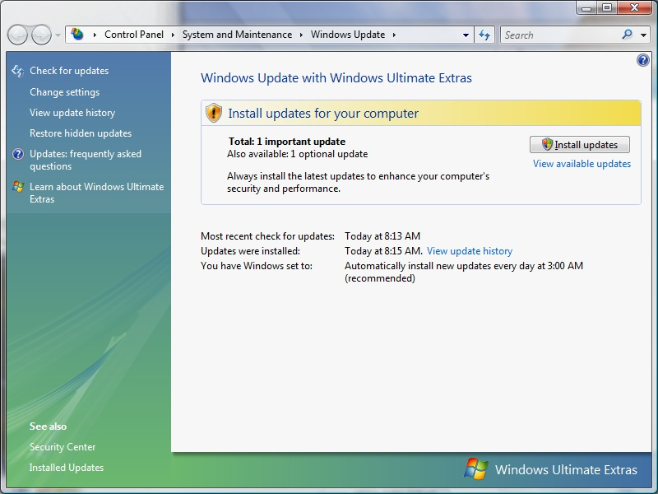
Patch Operating System and Applications
Microsoft regularly issues updates to fix security problems
Windows Update should automatically install updates.
Avoid logging in as administrator
Notes:
Windows has automatic update features that should be turned on.
Operating system should be regularly updated with the latest patches and updates provided by the vendors.
Major software applications like Microsoft Office should also be regularly updated.
Other installed business applications should also be updated on a regular basis.
Never use an admin account to surf the web, since in case of a compromise the malicious code would have admin rights.

Slide 47
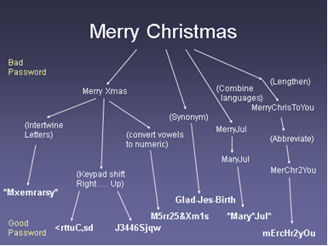
Create a Good Password

Slide 48
Create a Good Password, Cont’d
Combine 2 unrelated words | Mail + phone = mail*fone
Abbreviate a phrase | My favorite color is blue= Mfciblue
Music lyric | Deck the halls with boughs of holly, Fa la la la la la la la la la Dthwboh,F9xl
Notes:
Other password creation techniques:
Combining words using symbols and numbers
Abbreviating a phrase
Using music lyrics, poems or quotes

Slide 49
Password Recommendations
 | PCI DSS vers. 3 [PCIv3] | CIS Microsoft Windows 8 [CIS8]
Password length | 7 characters | 14 characters
Account lockout threshold | 6 invalid attempts | 5 invalid attempts
Account lockout duration (clears lockout counter) | 30 minutes | 15 minutes
Screen saver time-out | 15 minutes | 15 minutes
Max. password age | 90 days | 60 days
Min. password age | Not specified | 1 day
Password history retention | 4 | 24
Password complexity requirements | Numeric and alphabetic | 3 of 4: uppercase alpha, lowercase alpha, numeric, punctuation

Slide 50
More Advanced Technologies
Two-factor authentication
Unified threat management (UTM)—This network-based control category includes firewall, intrusion prevention, and various threat-detection capabilities.

Slide 51
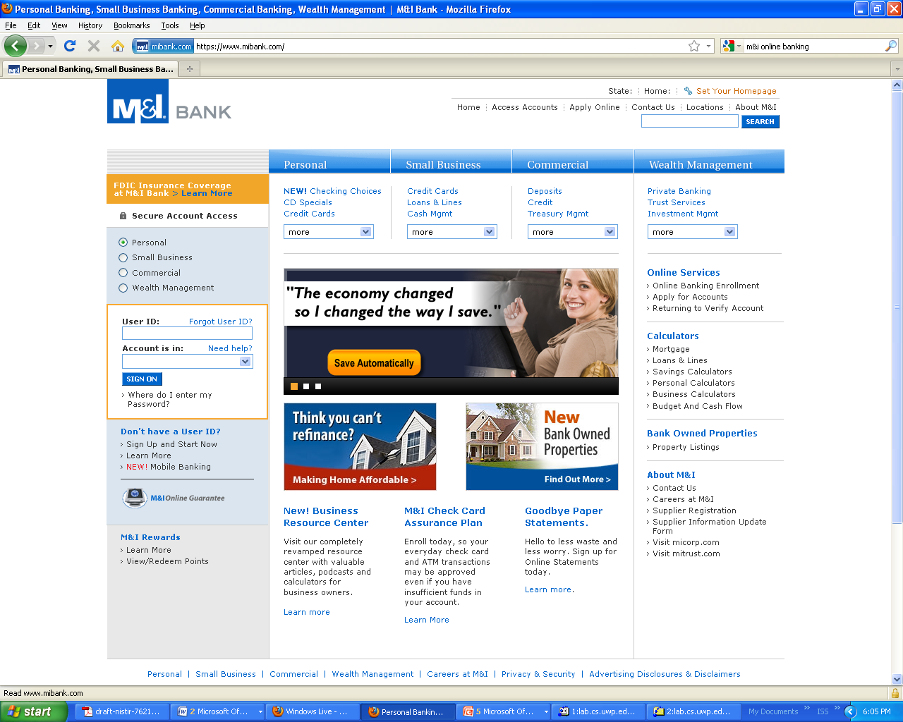
Kind-of Secure On-line Financial Transactions
Always use secure browser to do online purchasing
Never use a Debit card on-line.
Frequently delete temp files, cookies, history, saved passwords etc.
https://
Symbol showing enhanced security
Notes:
Always use secure browser to do online activities.
Frequently delete temp files, cookies, history, saved passwords etc.
Look for https and/or lock or secure symbol

Slide 52
Back up Important Information
Disappearing info: Malware, ransomware, disk failure, …
What information is important to you?
Is your back-up:
Recent?
Off-site & Secure?
Process Documented?
Tested?
Encrypted?
Notes:
Backup should be done (at least)once a week. If possible, store to a removable media.
The removable media should be big enough to hold 52 weeks of backup (e.g., 500GB).
Do a full backup once a month and store it in offsite location. This would be useful in case of a disaster in your office (fire, theft, flood, etc). On the removable media create 12 folders for each month.
Backup data should be tested periodically to ensure reliability.

Slide 53
Who-What-How
Cyber-attacks
Organized Crime (50%)
Point of Sale
CC skimmers
Ransomware
State-Affiliated (12%)
DOS
Insiders (28%)
Who
What
Ransomware
Data Breach 93%
How
Ransomware 56%
Cmd & Cntrll 36%
Phishing
Cmd & Cntrl
Backdoor
Malware
Privilege misuse
Collusion
Partners abuse
Verizon 2018 Data Breach Investigations Report

Slide 54
Summary – Examples of Types
Threat Type | Year: Example Threats
Experiment | 1984: Fred Cohen publishes “Computer Viruses: Theory and Experiments”
Vandalism | 1988: Jerusalem Virus deletes all executable files on the system, on Friday the 13th. 1991: Michelangelo Virus reformats hard drives on March 6, Michelangelo’s birthday.
Hactivism | 2010: Anonymous’ Operation Payback hits credit card and communication companies with DDOS after payment cards refuse to accept payment for Wiki-Leaks.
Cyber-crime | 2008, 2009: Gonzales re-arrested for sniffing WLANs and implanting spyware, affecting 171 million credit cards . 2013: In July 160 million credit card numbers are stolen via SQL Injection Attack. In Dec., 40 million credit card numbers and 70 million customer information are stolen through Target stores. California indicates 167 data breaches are reported this year. 2021: Colonial Pipeline pays $5 million in ransom after closing eastern U.S. pipeline for 6 days
Information Warfare | 2007, 2008: Russia launches DDOS attack against Estonia, then Georgia news, gov’t, banks 2010: Stuxnet worm disables 1000 of Iran’s nuclear centrifuges.
Surveillance State | 2012: State affiliated actors mainly tied to China quietly attack U.S./foreign businesses to steal intellectual property secrets, summing to 19% of all forensically analyzed breaches 2013: Lavabit closes secure email service rather than divulge corporate private key to NSA without customers’ knowledge.

Slide 55
Threat type | Year: Example threats
Experiment-ation | 1984: Fred Cohen publishes “Computer Viruses: Theory and Experiments” [37]
Vandalism | 1988: Jerusalem Virus deletes all executable files on the system, on Friday the 13th [7]
 | 1991: Michelangelo Virus reformats hard drives on March 6, Michelangelo’s birthday
Hacktivism | 2010: Anonymous’ Operation Payback hits credit card and communication companies with DDOS after payment cards refuse to accept payment for Wiki Leaks
Cyber-crime | 2008, 2009: Gonzales re-arrested for sniffing WLANs and implanting spyware, affecting 171 million credit cards [38]
 | 2013: In July 160 million credit card numbers are stolen via SQL Injection Attack. In Dec., 40 million credit card numbers and 70 million customer information are stolen through Target stores. California indicates 167 data breaches are reported this year [39]
 | 2016-2022: Uber pays $100,000 in ransom to criminals, but pretends instead to purchase bug information. For covering up a breach, Uber later pays $148 million to settle claims and the Chief Security Officer is tried and convicted. [Weigand22]
Information warfare | 2016: Russia takes down Ukraine’s entire electric grid a December evening – two years in a row [Greenberg17].
 | 2010: Stuxnet worm disables 1,000 of Iran’s nuclear centrifuges
 | 2012: State affiliated actors mainly tied to China quietly attack U.S./foreign businesses to steal intellectual property secrets, summing to 19 % of all forensically analyzed breaches [2]
Surveillance state
 | 2021 Solarwinds supply chain attacks install malware into 18,000 organizations through unknowingly infected third-party software [Schneier2021].
 | 2022 Instagram is charged €405 million for publishing children’s emails and phone numbers, as part of GDPR [Manancourt22].

Slide 56
Health First Case Study
Jamie Ramon MD
Doctor
Chris Ramon RD
Dietician
Terry
Licensed
Practicing Nurse
Pat
Software Consultant
Designing Personnel Security

Slide 57
Select the general threats that are likely to be a concern in your selected industry from the following list: Experimentation/Vandalism, Hacktivism, Cyber-crime, Information Warfare, Intellectual Property theft, Surveillance State.
List these threats in priority order and describe a likely fictional (or actual) scenario and the potential damage, for the top 4 threats.
List 8 exploits (or computer attacks) that are most likely to occur in your selected industry.
For each exploit, describe a sample scenario of how it might occur and an impact scenario for your workplace. Complete a table, which provides one example for the threat.

Slide 58
Exploit Type | Attack Scenario | Likely Impact on Organization
Example: Botnet | Students access websites and unknowingly download spyware and botnet software | School computer labs are turned into a bi botnet machine, resulting in massive transmissions to/from the school.

