Slide 1
Complying with Security Regulation & Standards
HIPAA
FISMA
Sarbannes
Oxley
Gramm-
Leach-
Bliley
PCI-DSS
Security Planning
Susan Lincke

Slide 2
Objectives
The student shall be able to:
Define the main purposes and basic protections of the following regulations or standards:
State Breach Notification Law
HIPAA
Sarbannes-Oxley
Gramm-Leach-Bliley
Red Flags Rule
FISMA
PCI DSS
Computer Fraud & Abuse Act
Electronic Communications Privacy Act

Slide 3
Security Vocabulary
Asset: Diamonds
Threat: Theft
Vulnerability: Open door or windows
Threat agent: Burglar
Owner: Those accountable or who value the asset
Risk: Danger to assets
Notes:
This is not only HIPAA but standard security vocabulary.
Vulnerability is not the threat itself, but the enabler for the threat.
To a computer, a threat could also be a power outage.

Slide 4
Security Assures…
Confidentiality
Integrity
Availability
Notes:
More Standard Security. These are the three goals of security.
Confidentiality: Only permitted people may see the data
Integrity: The data is correct
Available: The resources are available when needed.
(CIA) Remember it!!! You will see and hear it again, and again…

Slide 5
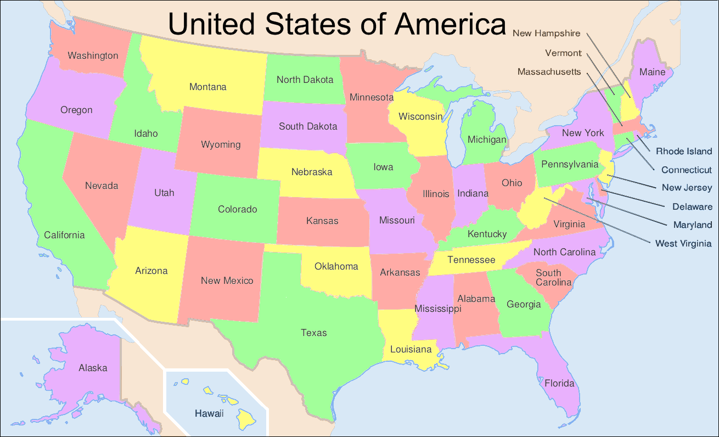
State Breach Notification Laws
Protect personal info for all states

Slide 6
Protected Data includes:
Social Security number
Driver's license number
State identification card number
Financial account number or credit or debit card number
  Security code, access code, or password associated with financial account
May include:
  Medical or health insurance information
  User names and passwords (e.g., CA)

Slide 7
Why? ChoicePoint Example
Data broker sells credit reports and info about consumers
Identity theft ring purchased personal information for potentially 160,000 people
ChoicePoint paid:
  $10 M in civil fines to FTC
  $5 M for a consumer relief program to FTC
  $500,000 to states
  sent notification letters to > 160,000 people
  CP agreed to create a security program with yearly independent audits until 2026

Slide 8
If a disclosure occurs…
Organization must notify affected parties in plain English; timely; at no cost to victim.
Law enforcement may delay notification for an investigation
Notification shall include (by state):
  Breach details: date and type of breach
  Step/plans the data collector intends
  Consumer reporting information or recommended actions.

Slide 9
To avoid breach:
Exempt from Disclosure:
Electronic media:
  Encrypted info – if encryption key not acquired
  Destroying or erasing the media; deleting does not count
Paper documents: redaction, burning, pulverizing, or shredding
Ignoring breach results in fines:
  $10-$2000 per victim
  max total penalty of $50,000-$150,000 per breach situation

Slide 10
California Consumer Privacy Act
Consumer rights include:
Right to request disclosure of PII that the business collected on consumer in last year
Right to know what PII was sold or shared
Right to limit use and disclosure of PII
Right of deletion
Right to opt-out of sales or sharing of PII
Private Right of Action (Right to sue e.g., for breach)
Right to no retaliation for exercising CCPA rights.
Personal information in all forms (electronic or not) are protected for California residents, while in California
Notes:
2020 implementation to CA residents; protected info includes medical info, biometric info, financial info, identification (ssn, drivers license,…) , address, email, browsing history, geolocation data, employment info, educational info. https://www.jdsupra.com/legalnews/summary-of-california-data-breach-14720/

Slide 11

Health Insurance
Portability & Accountability Act (HIPAA) 1996
HITECH 2009
Doctor’s offices, hospitals, medical consultants

Slide 12
Why HIPAA/HITECH?
Records of patients or insurance claims made publicly available by accident
Woman fired from job after positive review but expensive illness
35% of Fortune 500 companies admitted checking medical records before hiring or promoting
People avoid using insurance when they have AIDS, cancer, STD, substance abuse or mental illness
Medical Identity Theft: Stolen identity to acquire expensive health care;
  medical records get confused;
  risks lives.

Slide 13
Protected Health Information (PHI)
Health
Information
Relates to
Physical or
Mental health
or past/present/
future payment
Identifiers
Name
SSN
city or county
zip code
phone or fax
medical record #
fingerprint
Individually Identifiable
Health Information
Created or maintained by
CE or BA
Protected Health
Information
(PHI)
Covered by HIPAA
& HITECH
If YOU had cancer, how could such identifiers
Identify you?
Max. $1.5 M in penalties for willful neglect
of PHI Privacy
Notes:
Let’s assume that an organization knew someone had AIDS or cancer, who lived in a rural area (only a zip code was known). Would that be enough to figure out who it was? What if it was known that Alice visited a cancer center. Would it be necessary to see Alice’s records to know that Alice might have cancer? Therefore ANY Health Information – billing information or even a visit to a doctor’s office – associated with any Identifier (part of an address, name or fingerprint) is what is known as Individually Identifiable Health Information (IIHI). When this is created or maintained by a CE or BA, then the information is protected as Protected Health Information (PHI) covered by HIPAA.
Remember the term PHI – you will see it again and again and again and …

Slide 14
Privacy Rule:
Establish Privacy Safeguards
Required
Shut or locked doors
Keep voice down
Clear desk policy
Password protection
Auto screen savers
Privacy curtains
Locked cabinets
Paper shredders
Not Required
Soundproof rooms
Redesign office space
Private hospital rooms (semiprivate ok)
OK for doctors to talk to nurses at nurse stations
Safeguards should be REASONABLE
Notes:
The rules are supposed to be reasonable. The items on the left are considered reasonable, while the items on the right are considered to expensive to implement. As you can see these relate to non-computer privacy issues.

Slide 15
Security Rule Enforces
Privacy Rule on Computers
Privacy Rule Security Rule
With or w/o computer With computer
Protect PHI Protect EPHI
Minimum Necessary Authentication &
Access Control
Accounting of Disclosures Unique Login Credentials
Authentication
Track modifications to EPHI:
Who did what when?
Notes:
EPHI=Electronic Personal Health Information
This slide shows how Privacy Rule gets implemented on a computer, with the Security Rule.

Slide 16
Security Rule Standards
Comprehensive Technology Neutral Scalable
Administrative
Controls
Security
Rule
Small
or
Large
Physical Controls
Security
Rule
Technical Controls
Look to Best Practices
for Technology Answers
e.g. NIST
Notes:
Security Rule should be:
Comprehensive: affecting administrative, physical and technical controls.
Technology neutral: HIPAA does not want to promote any specific hardware vendor.
Scalable: For small or large companies
NIST: National Institute of Standards & Technology

Slide 17
Some Security Rule Services
Authentication
Access Control
Data confidentiality
Data integrity
Data backup & recovery
Risk Management
R=Required A=Addressible
Notes:
Authentication = login/password
Access Control = minimum necessary permissions provided (read/write/access/edit/delete)
Which address Confidentiality, Integrity, Availability?

Slide 18
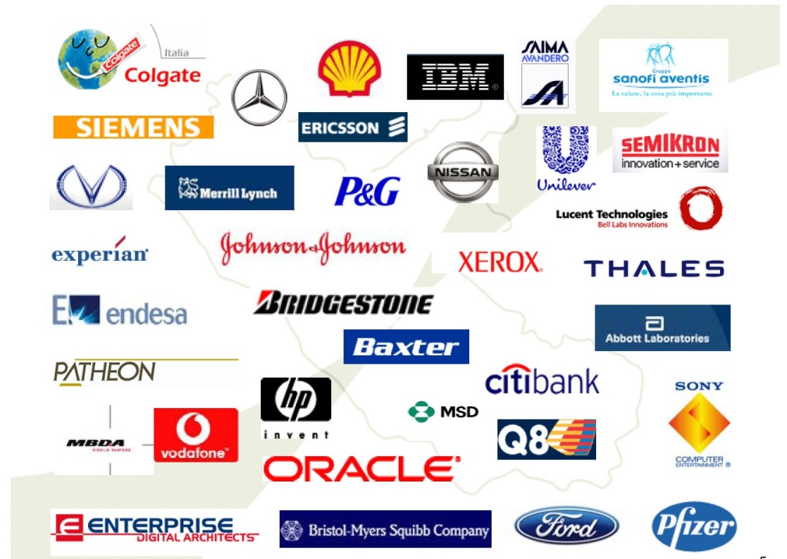
Sarbanes-Oxley Act (SOX), 2002
Corporations: Reduce Fraud

Slide 19
Applies to:
Publicly traded companies who sell stocks on an American stock exchange
  applies to many international companies
Some parts of SOX apply to not-for-profits

Slide 20
Why?
To report profits, ‘creative’ accounting used:
Misled regulators, investors, public
  Enron
  Arthur Andersen (accounting/audit firm) assisted in misleading financial reports of WorldCom, Enron, Sunbeam, Waste Management System.
      Felony conviction of Arthur Andersen in 2002, for obstructing justice
Results in:
corporate bankruptcies
loss of employee retirements savings
executive jail time for 15-25 years
restitution fines

Slide 21
Goal of SOX:
Address securities fraud
Define ethics for reporting finances
Increase transparency of financial reporting to stockholders and consumers
Ensure disclosure of stock sales to executives
Prohibit loans to top managers

Slide 22
Applies to Public, Private, Not-for-Profit:
Whistleblower Provision: Organizations must establish a means to:
  report financial improprieties/complaints,
  prevent punishing employees who report suspected illegal actions to gov’t.
Destroying evidence for a federal investigation: subject to a 20-year prison term and/or fines
  Apply to electronic records, voicemail, archives
  Policies should be well-known

Slide 23
Applies to Public Company
301: An audit committee must hire a registered accounting firm...
302: Signing officer testifies periodically to the accuracy and completeness of the audit report.
401: Clarifies requirements for financial reporting.
404*: Auditors must audit financials and internal control. Controls define how
  significant transactions are processed
  how assets are safeguarded, fraud is controlled
  how end-of-period financial reporting occurs

Slide 24
COBIT is an IT Standard for Internal Controls
COBIT applies to the IT lifecycle:
Evaluate, Direct and Monitor;
Align, Plan and Organize;
Build, Acquire and Implement;
Deliver, Service and Support; and
Monitor, Evaluate and Assess.

Slide 25
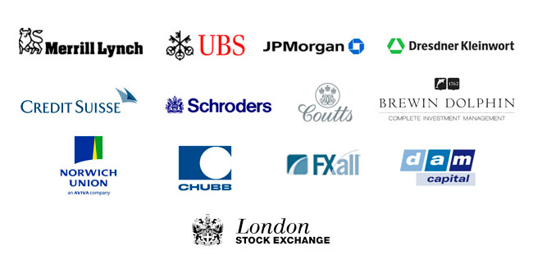
Gramm–Leach–Bliley
Mortgage brokering, credit counseling, property appraisals, tax preparation, credit reporting, and ATM operations

Slide 26
Gramm-Leach-Bliley
Protects personal financial information
Allows banks, securities and insurance companies to merge:
  One-stop-shopping for financial needs

Slide 27
Privacy Rule requires…
Notice of Privacy Practices (NPP)
Protect Nonpublic Personal Information:
  name, address, phone, social security number, financial account numbers, credit card numbers, birth date, customer relationship information, details of financial transactions
May share credit reports/applications with third parties unless customer ‘opts out’

Slide 28
Additional GLB Rules
Pretexting Rule
Safeguards Rule
Outlaws counterfeit documents and social engineering to obtain customer information.
Requires employee training for security awareness
Employees shall report social engineering attempts
information security program
designated employee(s) to coordinate security
risk assessment
control over contractors
periodic review of policies
personnel security
physical security
data and network security
intrusion detection
incident response

Slide 29

Red Flags Rule
Creditors: provide credit card accounts, utility accounts, cell phone accounts, and retailers providing financing

Slide 30
Red Flags Applies to:
‘Creditor’ applies to any organization that:
provides credit or defer payment or bill customers for products and services OR
provides funds for repayment OR
uses credit reports OR
provides information to credit reporting agencies about consumer credit.

Slide 31
Red Flags Rule
Red Flag Category | Example Red Flag Cases
Suspicious Documents | Identification or application looks forged or altered. Info is inconsistent btwn ID, what client says, and their records. Picture or signature differs.
Personal Identifying Information | Info matches other clients Info. looks suspicious: phone number is answering service; SSN is on Death Master File; info. inconsistent with credit report. Incomplete application and client fails to submit additional info Client cannot provide authenticating info beyond name address phone
Account Activity | A major change in spending or payment habits. A change in address, followed by unusual requests: e.g., multiple credit cards. Initial use of credit card shows unusual activity: first payment only; purchase of products easily converted to cash: electronics, jewelry. Inactive accounts become suddenly active. Mail is undeliverable but transactions continue.
Warnings from a Credit Agency | Changes to a credit report, inconsistent with client’s history. Indication of fraud, credit freeze or other abuse. Changes in recent credit transactions: increase in inquiries or new accounts.
Other Sources | Tip indicates an account has been opened inappropriately or used fraudulently.

Slide 32
Identity Theft Prevention Program
Addresses how Red Flags should be detected and handled by employees
  Agency established 5 categories and 26 examples of red flag situations (in Ch. 2 Fraud).
  Employees shall be trained for Red Flags
  Contractual agreements must detail
Program reviewed periodically
  Approved by the board of directors

Slide 33
Family Educational Rights and Privacy Act (FERPA)
Students in public schools

Slide 34
FERPA Protects:
Personally Identifiable Information (PII)
  Name, social security number, student number.
  Although not PII, grades are protected
Not protected information includes:
  police records, student majors, grade level, honors and awards, dates of attendance, status (full/part-time), participation sports or clubs

Slide 35
FERPA Information Security
Schools may disclose directory information for students, but students may opt out.
Students and their guardians
  may view records,
  request corrections to their records,
  receive a disclosure notification annually
Who qualifies: parents of students < 18, students >=18, and students of higher ed.

Slide 36
Children’s Internet Protection Act (CIPA)
Schools, libraries restrict access to websites

Slide 37
Children’s Internet Protection Act (CIPA)
Applicable to: schools, libraries receiving federal funding
Filter web content for children under 17
  Pornography, obscene materials, and materials deemed harmful to minors
  Filters may be disabled for adults
Internet Safety Policy describes access and restrictions for minors.

Slide 38
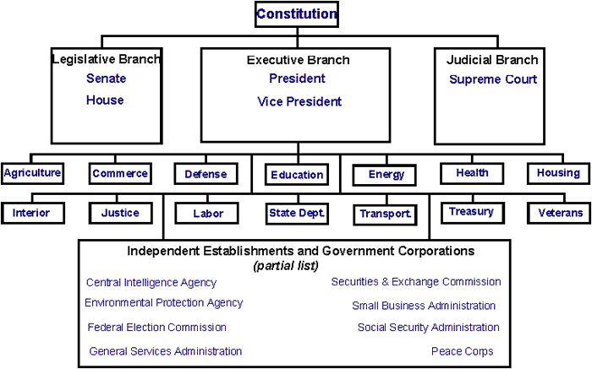
Federal Information Security Management Act (FISMA)
Federal agencies, their contractors, and other entities whose systems interconnect with U.S. government information systems

Slide 39
FISMA Allocated:
Federal CIO Kundra said (2010): government computers are attacked millions of times each day
National Institute for Standards and Technology (NIST)
  Federal Information Processing Standards (FIPS): Minimum required standards
  Special Publications (SP): Guidelines
US-CERT: a national incident response center.

Slide 40
Fundamental FISMA
FISMA adherents perform risk-based security according to NIST Risk Management Framework
risk analysis determines which controls are recommended.
Recommended controls are listed as Federal Information Processing Standards (FIPS): NIST 800-53 Security and Privacy Controls for Information Systems and Organizations.
NIST 800-53 classifies Security Category (SC) requirements as:
high, moderate, low impact or not applicable.
on per system basis
each for confidentiality, integrity, and availability.
An example SC rating would be:
SC sensor data = {(confidentiality, NA), (integrity, MODERATE), (availability, HIGH)}

Slide 41
FISMA Requirements
Access control
Awareness and training
Audit and accountability
Assessment, authorization and monitoring
Configuration management
Contingency planning
Identification and authentication
Incident response
Maintenance
Media protection
Physical and environmental protection
Planning
Program management
Personnel security
PII processing & transparency
Risk assessment
Systems and services acquisition
System and communications protection
System and information integrity
Supply chain risk management

Slide 42
Anti-Hacker Laws
Laws protecting use of computers

Slide 43
Computer Fraud and Abuse Act, 1984
CFAA protects against traditional cracking.
USA Patriot Act (2001) amended CFAA by lowering damage thresholds, raising penalties.
Current CFAA protects against:
Trespassing on a Government, financial institution or other ‘protected’ computer
protected computer = any computer that participates in interstate or foreign commerce or communications
Misdemeanor crimes include negligent damage, trafficking in passwords, and unauthorized access or access in excess of authorization.
Felony crimes include:
$5,000 damage, or transmission of malware exceeding $5000 damage
threat to public safety, justice, national security, or physical injury, or
crimes of fraud, extortion, recklessness or criminal intent or
Convictions result in fines and/or 10 years in prison.

Slide 44
Electronic Communication Privacy Act (ECPA), 1986
Disallows eavesdropping of network (felony) and stored data (misdemeanor).
The USA PATRIOT Act of 2001 amended ECPA:
allows the government to intercept electronic communications for national security reasons, by requiring a low level of justification,
enables service providers to request help from law enforcement or government agencies to capture communications of intruders.,
enables service providers to release communications to law enforcement if they suspect crimes or danger to life.
Any such freely provided communications, obtained without warrant, may then be used as evidence in court.

Slide 45
Other Abuse Laws…
Child Protection and Obscenity Enforcement Act, 1988: Prohibits known possession of printed, video, or digital file containing child pornography, transported across state lines.
Identity Theft and Assumption Deterrence Act, 1998: Protects the transfer and use of personally identifiable information. Violations can result in fines and 15-30 years in prison.
Anti-Cybersquatting Consumer Protection Act, 1999: Enables suing of cybersquatters: who acquire a domain name which is a registered trademark or trade name for another org.
Controlling the Assault of Non-Solicited Pornography and Marketing, 2003: Commercial e-mailers must follow specific requirements, such as using clear subject lines and enable recipient to opt out of future emails.
International Traffic in Arms Reg. (ITAR), Export Administration Reg. (EAR), Reg’s from the Office of Foreign Asset Control (OFAC): Prohibit export of certain technologies and information overseas, without a license (when export allowed).
Patent Act, 1952; Trademark Act, 1946; Copyright Act, 1976; Digital Millennium Copyright Act, 1998; Economic Espionage Act, 1996, 2012: Deal with patents, copyright and trademarks.

Slide 46
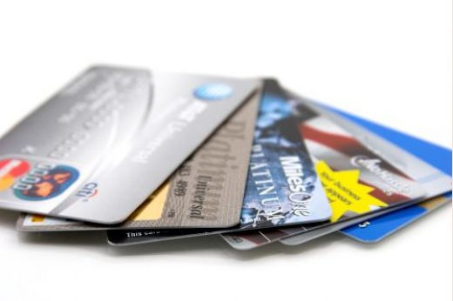
Payment Card Industry Data Security Standard (PCI DSS)
(Discussed in Chapter 3)
Any organization accepting Visa, MasterCard, American Express, Discover, and JCB International payment cards

Slide 47
Going to Court in the U.S.
Hierarchy of Laws, Courts; Expectations of Evidence

Slide 48
The Hierarchy of U.S. Laws
1. U.S. Constitution:
5. Common Law:
2. Federal Laws:
3. State Constitution:
Includes the Bill of Rights: personal freedoms.
Defines structure of federal gov’t and relationship to states.
Passed by Congress in the U.S. Code.
Regulates commerce btwn states, declare war, print $, maintain post office, armed forces.
4. State Laws:
State gov’ts pass laws affecting state residents
Describes the structure of state gov’t, relationship between state and citizens.
Defines an additional set of personal rights on a state-by-state basis.
Tradition provides precedent when regulations do not explicitly address a situation
Lower levels of law must not violate upper levels.

Slide 49
Hierarchy of Courts
Federal Courts | State Courts
Supreme Court: Hears appeals of federal cases. Hear cases between different state gov’ts Perform judicial reviews when state or federal laws may violate the Constitution | State Supreme Court Hears appeals from lower state courts.
Circuit Court of Appeals: Hears appeals of federal cases. | State Court of Appeal Hears appeals from state Trial Courts.
Federal District Courts Hear cases relating to the constitution or federal laws. Hear cases btwn residents of different states summing to losses over $75,000. | Trial Court State courts may address cases of state or federal law, but must always apply the hierarchy of laws and consider Supreme Court decisions as precedent. Internet, crimes may originate outside the state, but can be prosecuted within the state if the crime occurred within state boundaries.

Slide 50
Advanced: Going to Court
Criminal Law
Federal & State Criminal Codes
Evidence > “beyond a reasonable doubt”
Civil Law
A person, org., or gov’t can ask for redress
Based on regulation or common law (from England)
Evidence more probable than not (>50%): “preponderance of the evidence”
Administrative Law
Federal and state gov’ts enable agencies to create and enforce rules, judge cases
Some cases require a higher “clear and convincing evidence”
Cases may be reviewed by a federal court
e.g. FTC: unfair or deceptive acts or practices affecting commerce
Evidence at the lowest “not arbitrary or capricious” level

Slide 51
Summary: Requirements of Regulation
Chapter Notation: R=Required A=Advisable | State Breach | HIPAA | SOX | GLB | Red Flag | FISMA | FERPA | PCI DSS
1. Security Awareness | A | R | R | R | R | R | A | A
2. Fraud | A | A | R | R | R | R |  | A
4. Risk |  | R | R | R | R | R |  | R
5. Business Continuity |  | R | R | R |  | R |  | R
6. Policy |  | R | R | R | R | R | R | R
7. Information Security | R | R | R | R | R | R | R | R
8. Network Security | R | R | R | R | A | R | R | R
9. Physical Security | R | R | R | R | A | R | A | R
10. Personnel Security |  | R | R | R | R | R |  | R
11. Incident Response | R | R | R | R | R | R | A | R
12. Metrics |  | A | R | A |  | R
13. Audit |  | R | R | R | A | R |  | R

Slide 52
Health First Case Study
Jamie Ramon MD
Doctor
Chris Ramon RD
Dietician
Terry
Licensed
Practicing Nurse
Pat
Software Consultant
Complying with U.S. Security Regulation

Slide 53
Exercise
What regulations apply to this organization?
What concerns do these regulations bring up?
How might these concerns impact the organization?
Regulation | Aspects of Organization: Protected Information

