Slide 1
Advancing Networks: Cloud Computing and Zero Trust
Security Planning
Susan Lincke
Notes:
1
This covers most of the CISA Chapter on Business Continuity and Disaster Recovery.

Slide 2





External Solutions: Cloud Computing
Laptop
Database
Cloud Computing
Web Server
App Server
VPN Server
PC
Notes:
Definition:
Cloud Computing: A shared pool of configurable computing resources (such as Servers, Applications, Databases, Services, Computers) that can be rapidly customized and released with minimal management effort or service provider. Any user within the network is allow access to the shred configurable resource by providing authentication. Once authentication is approved, user is allowed to customize resource.
Advantages:
Cost
Since the cloud provider supplies the organization’s infrastructure, cloud computing becomes an operational cost rather than a capital cost. Also cost is reduced by reducing technical staff and centralizing computing resources
Scalability
Reduces or eliminates physical space for storing data
Reliability
Large cloud computing providers have redundant sites for users, which may address business continuity and disaster recovery risk
Performance
Provider continuous and consistent monitoring
Agility
Rapidly providing infrastructure resources
Disadvantage:
Potential for High Risk/Security Concerns
Since cloud computing is new technology, there maybe unknown bugs or holes
Technical Support is not familiar dealing with arising problems
Solutions may take longer to solve
Source: CISM® Review Manual 2012, © 2011, ISACA. All rights reserved. Used by permission.

Slide 3
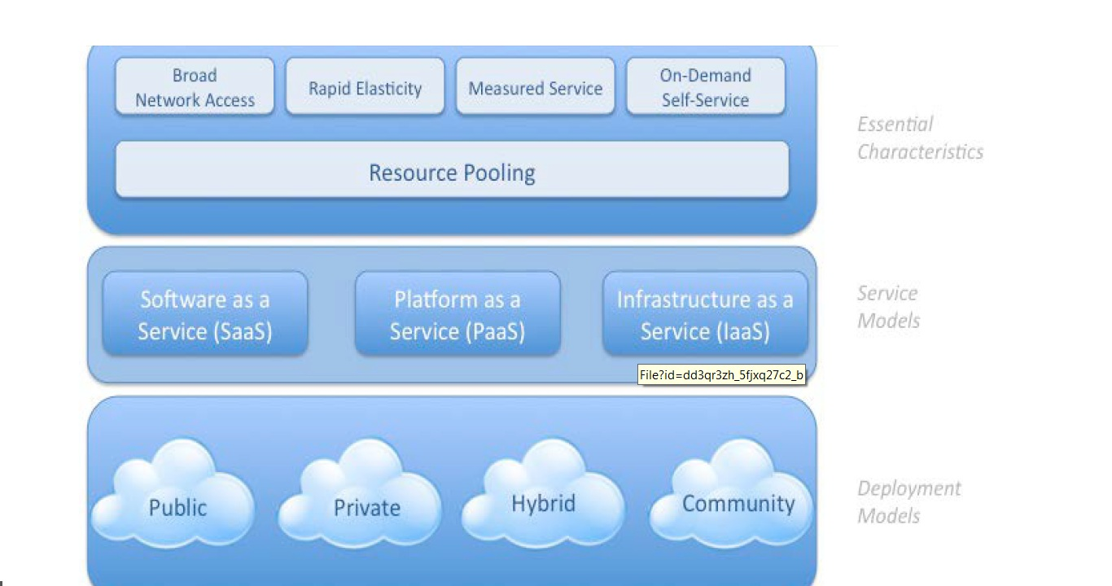
Introduction to Cloud
This would cost $200/month.
This would cost $200/month.
NIST Visual Model of Cloud Computing Definition
National Institute of Standards and Technology, www.cloudstandards.org

Slide 4
Basic Cloud Services
Software (SaaS): Provider runs own applications on cloud infrastructure.
Platform (PaaS): Consumer provides apps; provider provides system and development environment.
Infrastructure (laaS): Provides customers access to processing, storage, networks or other fundamental resources
SaaS
Cloud Software & Apps
PaaS
Your application
E.g., Cloud’s OS, DB
IaaS
Your OS, software
Cloud’s computer, hardware

Slide 5
Various Subset Cloud Services
Cloud Service
Software As a Service
Software (SaaS)
Data (DaaS)
Platform as a Service
Container (Caas)
Infrastructure as a Service
Disaster Recovery (DRaaS)
Retrieve DB data from cloud provider
Drop a VM into a Container
Backup Data to Cloud

Slide 6
Additional Cloud Models: Container as a Service
One PaaS implementation is the Container service
Users develop a container image, or a code execution environment, for deployment.
Containers may run directly on hardware or within a virtual machine.
Examples include: Google’s Kubernetes Engine (GKE), Amazon’s Elastic Container Service (ECS), Azure’s Kubernetes Service (AKS), and Red Hat’s OpenShift.
Programming tools automatically configure containers
      ensure a consistent hardened implementation by establishing policy needs and reducing configuration errors
      Tools include Kubernetes, Docker and Open Shift.
Can enforce egress firewall rules, network logging, vulnerability testing via container image scanning, default container login, and incident/event notification methods.

Slide 7
Additional Cloud Models: Disaster Recovery
Disaster Recover as a Service (DRaaS): provides a hot-site backup service for services hosted at the customer site, potentially bringing up a site in 0-60 minutes.
Also consider that the cloud does not assume redundancy
Redundancy must be specified in the contract
Better backup capability costs more
Different versions of this service may include (Baginda et al. 2018):
Backup and Restore: Backup data is sent continuously to the DRaasS, but no software is operational on the cloud (except for disaster recovery testing)
Warm Backup or Pilot Light: Backup data is sent continuously and the program is loaded but zero to minimal transactions are run on the cloud.
Notes:
Baginda et al. 2018):

Slide 8
Cloud Deployment Models
Private Cloud: Dedicated to one organization
Community Cloud: Several organizations with shared concerns share computer facilities
E.g., Financial or Medical
Public Cloud: Available to the public or a large industry group
Hybrid Cloud: Two or more clouds (private, community or public clouds) remain distinct but are bound together by standardized or proprietary technology
Notes:
Some things to consider:
Private Cloud:
Cloud services with minimum risk
May not provide scalability and agility of public cloud services
Company wants higher control over the environment
Community Cloud:
Data may be stored with the data of competitors
Company needs more than one organization in the company access to the cloud
Public Cloud:
Data may be stored in unknown locations and may b easily retrievable
Company wants general public/large industry group access to the cloud
Hybrid Cloud:
Aggregate risk from having different cloud computing development models
Data should be classified and labeled to assign correct type
Source: CISM® Review Manual 2012, © 2011, ISACA. All rights reserved. Used by permission. Exhibit 3.16

Slide 9
Process of Deployment
Define security and compliance requirements
Select a cloud provider and service/deployment model
Define the architecture
Assess security controls
Identify gaps in control
Address and implement missing security controls
Monitor and manage changes
Define Security/Compliance Requirements
Select a cloud provider & deployment model
Define architecture
Assess shared security responsibility: yours & cloud’s
Monitor and manage changes

Slide 10
Define Security Requirements
Additional Cloud Security Issues include:
Privacy: retrieval of personal information for curiosity or greediness.
access of users’ identity, preferences, habits by cloud employees, auditors;
Multitenancy: ensure data protection from other cloud customers: segmentation, isolation, policy
Reduced control: reliability of network, backup service
May rarely accessed data to be removed to improve cloud profitability?
Cloud misconfigurations (yours or theirs)
vulnerabilities in software or API interfaces.
Shadow IT: Are employees using unapproved apps in the cloud?

Slide 11
Define Security Requirements
Workbook
Confidentiality: Security issue: Grades are released resulting in FERPA investigation. Security issue: Assignments are unknowingly copied from 1 student to another. Security issue: Cloud employee sells or gives answers to students. Privacy issue: Copied files from top student is thought to be cheating; student earns a zero.
Integrity: Security issue: Submitted assignments are mixed up, lost or deleted by system failure, attacker or rogue employee. Security Issue: Ransomware deletes all homework; ransom is too high to pay; no grades are available for courses for semester. Privacy issue: Students whose work is lost suffer undeserved bad grades.
Availability: Security issue: Assignments are due but students can’t access the system to submit. This is particularly problematic during homework and exam submission deadlines. Privacy issue: Students worried about not submitting on time; late grade assigned results in course failure.

Slide 12
Select Cloud Provider and Deployment Model
Service Level Agreement (SLA): contract between cloud provider and customer
May be personalized for smaller organization
May be configurable with larger organization (e.g., programmed configuration)
Ownership of data: privacy policies, security controls, monitoring performed, data location, data subpoena
Audit report: Penetration testing, security/availability metrics, logs, policy change notifications
Incident Response: Disaster recovery, informational reports
Contract termination: at any time, data export, costs, data destruction
Define Security/Compliance Requirements
Select a cloud provider & deployment model
Define architecture
Assess shared security responsibility: yours & cloud’s
Monitor and manage changes

Slide 13
SLA: Regulatory issues
What do my nation’s laws require in protecting my data?
What international laws, data privacy laws and state breach laws are my data subject to?
Where (e.g., which country) will my client data reside?
What government intrusion, security and privacy laws might my data be subject to?
What is cloud provider policy if law enforcement subpoenas a client’s sensitive information?
What cloud controls are in place to address these regulations?
How will breaches be notified and handled? (Ultimately the cloud customer is responsible for security)
What are cloud provider privacy policies related to client data?
What security controls and monitoring are provided for the client?

Slide 14
SLA: Cloud Provider Security Implementation
What controls are implemented by the cloud provider for confidentiality, integrity and availability?
What controls relate to authentication, access control, digital certificate exchange, IDS, trusted platform?
What network security controls exist?
What policies and security implementations prevent cloud personnel from accessing and leaking client data?
What third-party audit processes exist?
What does the audit involve and how are results disseminated?
How often are audit/compliance results provided?
What have previous audit results shown?
Does the cloud provider maintain and publish metrics on availability (or downtime)?
What cloud tools are available for testing and monitoring of security? What protocol and restrictions exist for the cloud user to perform vulnerability and penetration testing?
What types of alarm/logs does the cloud provider monitor for?
Are client-system logs available to clients?
Can clients monitor the usage and access of their data?

Slide 15
SLA Incident/Disaster Recovery Issues
How does the cloud provider handle disaster recovery?
What are the cloud server provider policies for disaster recovery?
What is included in the contractual agreements?
What rates of availability does the cloud provider maintain?
Can data be maintained redundantly in multiple regions? How is data synchronization achieved?
Can the organization’s recovery point objectives and recovery time objectives be achieved?
How is incident response handled by the cloud provider?
What tools are available to clients to forensically analyze incidents?

Slide 16
SLA Contractual Issues: Meeting Contracts, Reputation, Programmability
Is the cloud provider reputable, financially stable, protected by insurance, located primarily (or entirely) in the home country?
What is the cloud provider standard Service Level Agreement? Can this SLA be personalized to client’s needs?
What happens at contract termination?
What are the cloud provider’s data privacy policies?
How does data export to another system work, what is this cost, and what are cloud provider policies for data destruction?
If we are under contract to another organization, does the cloud proposal meet our contracts’ requirements? What issues does our contract specify or imply?
What security APIs or form interfaces are supported to automatically configure a security configuration? Does the cloud provider support the API required by the client?

Slide 17
Define Architecture
Architectures are generally layered, consisting of the following layers:
Software as a Service: Contains the presentation layer software (e.g., web user interface), API to a multitenant application with local data;
Platform as a Service: Consists of integration and middleware software, including base software such as OS with database;
Infrastructure as a Service: Consists of the virtual machine abstraction, hardware, networking and storage facilities.
Virtualization: Virtualization used to separate services and tenants.
Cloud provider may secure the hardware and hypervisor
Customer secures controls within the VM environment.
Multicloud system: When multiple cloud services are used, potential interface issues may result
Define Requirements
Select a cloud provider & deployment model
Define architecture
Assess shared security responsibility: yours & cloud’s
Monitor and manage changes

Slide 18
Assess Shared Security Responsibility
Networks
Firewall Configuration
Network Configuration
Storage/OS
Operating System
Storage/Network
Hardware
Infrastructure
Hardware
Client Encryption
Customer Data
Customer Data
Encryption
Server Encryption
Application
Application Management
Platform Management
Cloud provider, users both responsible for security, depending on cloud service model
You can transfer security responsibility but not accountability
cloud provider provides security for the bottom portion that it configures and manages;
cloud user responsible for user part it defines and manages.
Cloud Security Alliance (CSA 2021) recommends:
  providers clearly define security features they implement;
  Users should complete a security matrix defining:
    controls provided by the cloud provider
  necessary controls they must add
  CSA provides a (free) baseline Cloud Controls Matrix for this process.

Slide 19
Assess Shared Responsibility Model
Infrastructure as a Service
Software as a Service
Networks
Firewall Configuration
Network Configuration
Storage/
Compute
Compute (Server)
Storage/Network
Hardware
Infrastructure
Hardware
Client Encryption
Customer Data
Customer Data
Encryption
Server Encryption
Application
Application Management
Platform Management
Networks
Firewall Configuration
Network Configuration
Storage/
Compute
Compute
Storage/Network
Hardware
Infrastructure
Hardware
Client Encryption
Customer Data
Customer Data
Encryption
Server Encryption
Application
Application Management
Platform Management

Slide 20
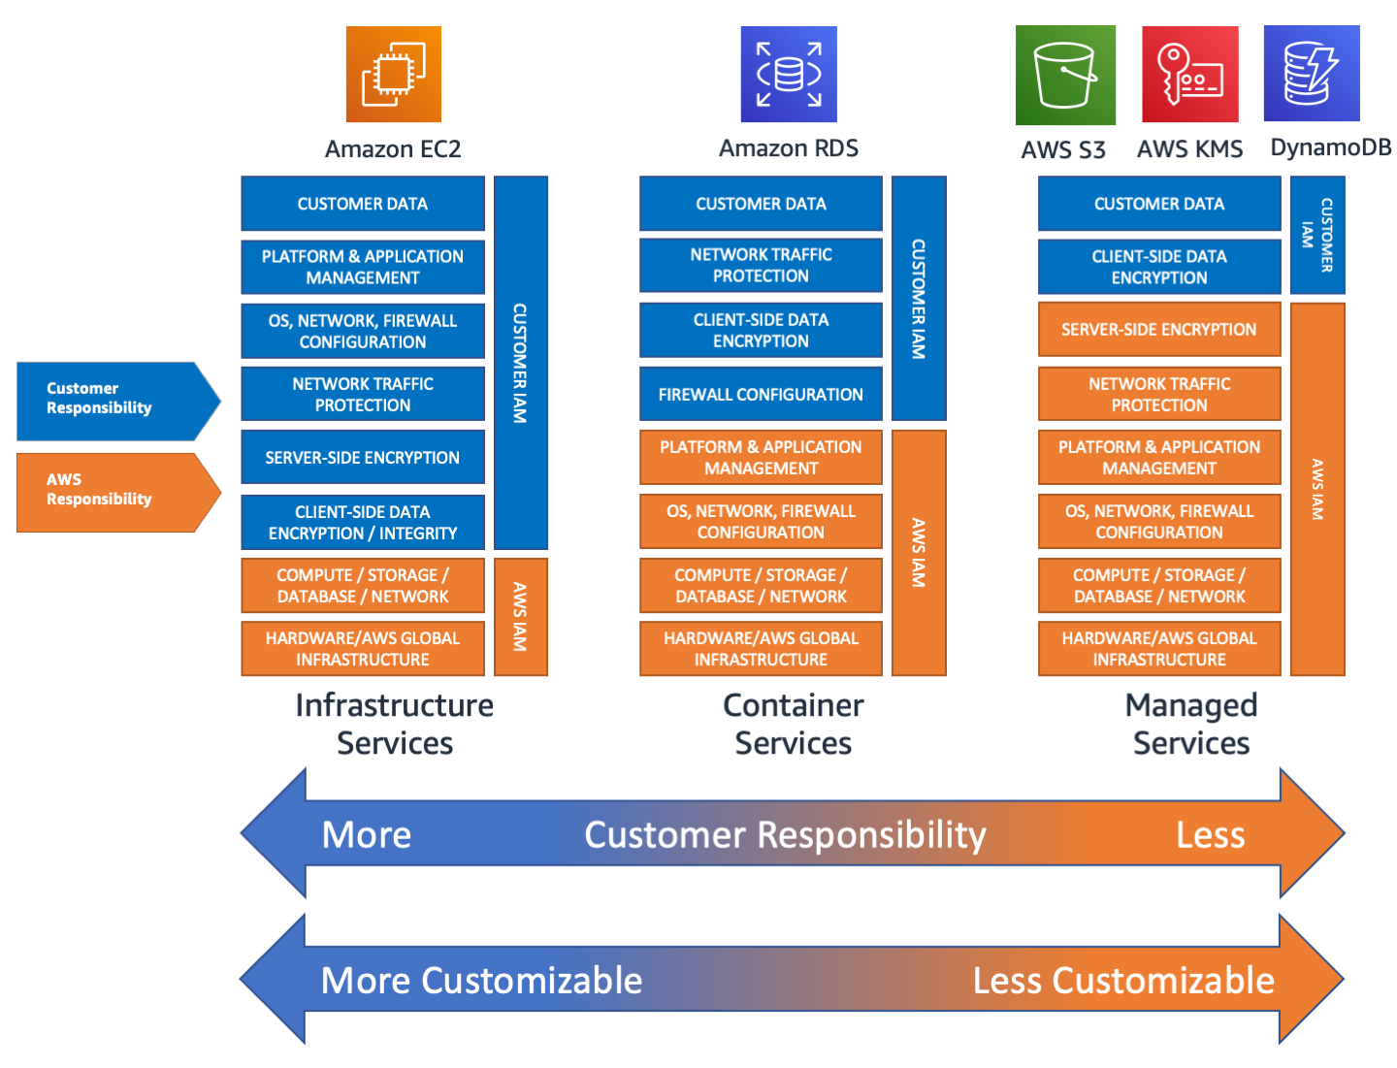
Shared Responsibility Model - AWS

Slide 21
Assess shared security responsibility: Your part (S/W)
When software is developed in-house, before software deployment (Bird and Johnson 2021):
static analysis: scans code automatically looking for programming vulnerabilities and bugs.
container image scanning: Static scanning of container can check configuration issues and known vulnerabilities;
automated testing: includes regression testing and fuzzing before release
other software development techniques: risk analysis, code reviews, etc., covered in later chapters.
After software deployment:
runtime application self-protection: monitors an application to notify of unusual system uses or violations of policy.
web application firewalls: tracks user accesses to the application and validates some input.
vulnerability scanning and penetration testing: testing the run-time environment after deployment
network detection and response (NDR) and network traffic analysis (NTA): monitor for unusual network traffic patterns, preferably via machine learning;
host intrusion detection systems: track changes to system, files and configuration to adhere to policy.

Slide 22
Monitor and Manage Changes in the Cloud
Key Process Indicators (KPI) or Metrics related to cloud deployment may include:
Number of open security vulnerabilities
False positive rates of reported vulnerabilities
Time to detect security vulnerabilities
Time to fix security vulnerabilities
Number of security vulnerabilities found after deployment
Cost to fix audit issues
KPIs related to cloud software deployment include:
Automated test coverage
Change cycle time: Time to build and deploy
Rate of build delays due to security issues
Define Security/Compliance Requirements
Select a cloud provider & deployment model
Define architecture
Assess shared security responsibility: yours & cloud’s
Monitor and manage changes

Slide 23
Advanced: Dev-Sec-Ops
Dev-Sec-Ops refers to Development-Security-Operations, who work closely together to secure software during development and deployment.
Continuous Integration/Continuous Delivery (CI/CD): Automated build, integration, testing, and deployment ensures that both new applications and software patches are automatically configured and deployed quickly, according to compliance policies.
Requires automated, thorough testing.
To counter ‘software update’ attacks, SolarWinds analyzes builds against their source code to ensure correctness.
Specific programming languages automatically configure and provision a software stack for deployment on the cloud.
E.g., Terraform has an HCL high-level language that can be used across multiple cloud providers.
Compliance testing: Asserts or guard rails are true/false tests that enable policy checking within the code,
These automated test results facilitate auditing, called audit hooks.
Open source tools help: AWS CloudFormation Guard, Chef InSpec, Conftest, Dev-sec.io, and Terraform Compliance.
Continuous Monitoring: The Cloud Trust Protocol (CTP) defines an API that enables customers to automatically query the security status of their cloud services.

Slide 24
Blockchains
Blockchain is a solution that helps to encrypt and ensure integrity for transmissions.
Applications: bitcoin, smart contracts, financial transactional requests and expanding use in Internet of Things (IoT)
Blockchains provide a decentralized, system of distributed and replicated nodes.
Transactions must be correctly ordered through all nodes using consensus algorithms: “unanimously-ordered transactions”

Slide 25
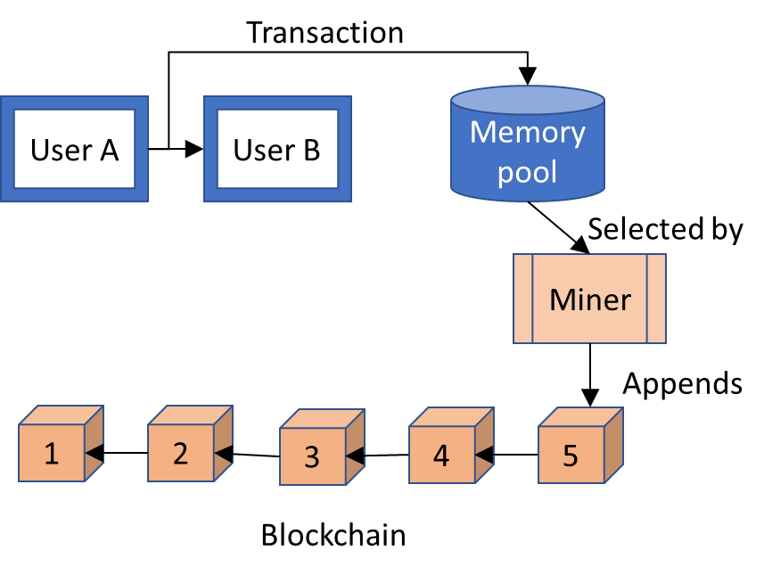
How Blockchains work example:
Public-style Proof-of-Work Blockchain
User A submitting a transaction to User B which is broadcast and saved in the blockchain memory pool.
A ‘peer’ miner process selects a transaction, generates a numerically complex hash to confirm the transaction and creates a block, and adds the block to the blockchain and back to the distributed memory pool.
Transaction processing confirms that the sender has the required finances
sender signs the transaction with their digital signature, providing non-repudiation.
Users submitting transactions pay a mining fee to incentivize miners to perform the necessary processing.

Slide 26
Blockchain Issues
Public blockchains (including Bitcoin) can be problematic: they provide anonymous access to the public.
DDOS attacks have considerably slowed down processing.
Integrity hash code failures have resulted in spoofed transactions costing $ millions.
Private blockchains are more protected because users are vetted, known and trusted.

Slide 27
Question
Match the vocabulary
Employees may be using cloud services without their business knowing about it
A customer uses multiple cloud platforms to implement software solutions
Cloud build is patched and deployed automatically
Customer can get security status on their cloud system
An issue where a customer may share cloud hardware/software with other customers
A business contract between a cloud provider and cloud user
Continuous Monitoring
Shadow IT
Multicloud
Multitenancy
Continuous Integration/ Continuous Delivery
Service Level Agreement

Slide 28
Question
Match the vocabulary
Employees may be using cloud services without their business knowing about it
A customer uses multiple cloud platforms to implement software solutions
Cloud build is patched and deployed automatically
Customer can get security status on their cloud system on demand
An issue where a customer may share cloud hardware/software with other customers
A business contract between a cloud provider and cloud user
Continuous Monitoring
Shadow IT
Multicloud
Multitenancy
Continuous Integration/ Continuous Delivery
Service Level Agreement

Slide 29
Question
Container as a Service best fits under this type of model:
Software as a Service
Infrastructure as a Service
Platform as a Service
Disaster Recovery as a Service
Notes:
1 – Retina. Others change form when person may be sick or hurt, or may accumulate grime. In the case of signature, it is hard to write on a tablet.

Slide 30
Question
Shared Security Model means that:
The cloud provider provides full security for everything within its service model
The cloud user must analyze and configure for security for systems provided by both cloud provider and its own areas of control
The cloud user must audit areas of security only for the cloud users’ responsibility
The cloud user must audit areas of security for both the cloud provider and cloud user’s responsibility.

Slide 31
Zero Trust Architectures

Slide 32
Zero Trust
Before Architecture:
Untrusted Network
After Architecture: False assumption:
Once within the firewall’s perimeter, the network traffic can be trusted
  Social Engineering/Phishing: Once inside the network, criminals find it easier to move around
  Deperimiterization: Limit network trust based on location
  Resources may lie outside the internal network: e.g., cloud services, third party
  Devices within the internal network may not be enterprise-managed (Bring-Your-Own-Device: BYOD)
Any internal or external network may be compromised to read/modify data
Firewall
Trusted Internal
Network
Notes:
NIST Special Publication 800-207 Zero Trust Architecture, Scott Rose Oliver Borchert Stu Mitchell Sean Connelly, Aug 2020

Slide 33
Zero Trust Architecture
Zero Trust Architecture:
Untrusted Network
Assume Breach: Assume internal network is compromised
Least Privilege limits access to authorized individuals
Zero Trust: Evaluate on a per-transaction basis to resources: devices, data
Policy Enforcement Point: Proxy validates requests to:
  Identity-based access: granular permissions allocated based on source identity
      Micro-segmentation: individual or set of resources protected by gateway
      Software defined network: dynamic micro-network reconfigures as necessary
PEP
PEP
Data 1
Data 2
PEP
PEP
Device 3
Set 4
Notes:
NIST Special Publication 800-207 Zero Trust Architecture, Scott Rose Oliver Borchert Stu Mitchell Sean Connelly, Aug 2020

Slide 34
Security Principles for Zero Trust
Zero Trust: Evaluate on a per-transaction basis to resources (devices, data)
Authentication: Confirm the subject’s identity who initiates the transaction
Determine confidence in risk in subject’s identity based on:
Authentication based on n-factor authentication
Subject’s device configuration, location, time, etc.
Subject’s permissible and traditional behavior
Authorization: Determine whether the source has the required permissions
Access control
Authorization may change due to time-of-day, state of resource, subject’s behavior

Slide 35
Zero Trust Principles (Part 1)
All data sources and computing services are considered resources: All enterprise-owned resources should be carefully classified
All communications are secured regardless of network location: All transmissions inside or outside an enterprise network are equally subject to CIA.
Access to individual enterprise resources is granted on a per-session basis: Authentication is provided on a per resource basis (not per transaction).
All resource authentication and authorization are dynamically and strictly enforced before access is allowed: Policy and risk decide (re)authentication and permissions

Slide 36
Zero Trust Principles (Part 2)
Access to resources is determined by a dynamic policy: Risk is evaluated based on multiple factors, such as client identity, service requested, asset configuration, past history and other situational factors.
The enterprise monitors and measures the integrity and security posture of all owned and associated assets: All devices and assets must be monitored for intrusion, vulnerabilities, patching; associated assets include bring-your-own-device
The enterprise collects as much information as possible about the current state of assets, network infrastructure and communications and uses it to improve its security posture. Risk must be determined by monitoring the current state of the enterprise network.

Slide 37
Zero Trust Architecture
Policy Decision Point includes:
Policy Engine decides and logs accept/reject decision based on input and policy
Policy Administrator: Executes the decision
Policy Enforcement Point: Enables, monitors, and terminates connections
From: NIST Special Publication 800-207 Zero Trust Architecture, Aug 2020.
Notes:
NIST Special Publication 800-207 Zero Trust Architecture, Scott Rose Oliver Borchert Stu Mitchell Sean Connelly, Aug 2020

Slide 38
Zero Trust Inputs – Zero Trust Analysis
Access Policies: Policy and permissions for access control
Industry Compliance System: Policy related to regulation, such as HIPAA, Gramm-Leach-Bliley, FISMA, etc.
ID Management system: Manages user accounts and identity (e.g., Microsoft Lightweight Directory Access Protocol or LDAP) with associated roles and permissions
Enterprise Public Key Infrastructure: Generates certificates for use with authentication/authorization
Security Information & Event Management (SIEM): Network & system activity logs
Thread Intelligence Feed: Internal or external sources of newly found threats, such as malware or current attacks.
Continuous diagnostics and mitigation (CDM) system: Monitors vulnerabilities, patching, metrics collection
Policy
Threats
Identity
Notes:
NIST Special Publication 800-207 Zero Trust Architecture, Scott Rose Oliver Borchert Stu Mitchell Sean Connelly, Aug 2020

Slide 39
ZTA Policy Decision Point
Policy Decision Point includes:
Policy Engine: Makes accept/reject decision.
Best to track Subject history to make good decisions:
Unusual number of accesses
Unusual time or location
Policy Administrator: Informs PEP to establish and/or close communication between Subject and Resource
Policy Decision Point
Policy Engine
Policy Administrator
Policy Enforcement Point (PEP)
Notes:
NIST Special Publication 800-207 Zero Trust Architecture, Scott Rose Oliver Borchert Stu Mitchell Sean Connelly, Aug 2020

Slide 40
Zero Trust Architecture (ZTA)
Notes:
NIST Special Publication 800-207 Zero Trust Architecture, Scott Rose Oliver Borchert Stu Mitchell Sean Connelly, Aug 2020

Slide 41
Varying Zero Trust Architectures
  Identity-based access: granular permissions allocated based on source identity
  Useful for Cloud Services
  Agent may be separate from local device
  Agent may be in a container or VM
  Little visibility into client system configuration
      Micro-segmentation: individual or set of resources protected by gateway
      Legacy systems use gateways serving multiple resources
      Higher possibility of cross-contamination
      Software defined network: dynamic micro-network reconfigures as necessary
      PEP configures communications channel for Subject to interface with Resource (e.g., IP address/port, encryption key)
      PEP may be software agent within Resource or separate device

Slide 42
Zero Trust Architecture:
Network Requirements
Network must be able to validate that Source device is an enterprise-owned/managed device and uses enterprise-issued credentials
e.g., IP/MAC address can be spoofed
Resources may only be accessed after being filtered through a Policy Enforcement Point (PEP)
Resources should not be discoverable except through PEP (except network devices e.g., DNS)
The data plane and control plane are logically separate.
They may be physically separate also.
Enterprise tracks all network data
communication metadata informs PE enabling dynamically updated policy
Metadata includes time, destination, device ID from data plane
Notes:
NIST Special Publication 800-207 Zero Trust Architecture, Scott Rose Oliver Borchert Stu Mitchell Sean Connelly, Aug 2020

Slide 43
ZTA Network Requirements (cont’d)
The Zero Trust Architecture must be scalable to support expected and increased traffic capacities
It is not necessary to travel across enterprise-owned network to access a Resource
E.g., Cloud implementations should not require Virtual Private Network or enterprise-infrastructure traversal.
PEPs are accessible by policy-approved devices.
PEPs may not be accessible by all enterprise devices (e.g., international locations)
Notes:
NIST Special Publication 800-207 Zero Trust Architecture, Scott Rose Oliver Borchert Stu Mitchell Sean Connelly, Aug 2020

Slide 44
ZTA Cloud Configurations
Common apps may be available in cloud (email, web)
Cloud PE/PA(s) provide high availability and remote access
Clouds may use different systems
PEP is located with Resource
May/may not be located with PE/PA
PEP provides statistics to PE/PA
PEP gets configuration for permissions from PE/PA
Cloud: PDP
Cloud: PEP/ Resource
permission
data
Branch Office
Remote Worker
Enterprise Network
Notes:
NIST Special Publication 800-207 Zero Trust Architecture, Scott Rose Oliver Borchert Stu Mitchell Sean Connelly, Aug 2020

Slide 45
Zero Trust Planning
Inventory & assess data flows, workflows, subjects
Assess risk
Deploy & monitor operations
Develop policy
Step 1: Inventory and assess data flows, workflows, subjects
Leverage information classification and role-based access control from Information Security
Step 2: Assess risk and develop policy
Test a small application first
Expand applications as the organization gains confidence in zero trust.
Pilot applications that may benefit from zero trust:
require higher levels of confidentiality and integrity
are accessed often remotely
small application(s) with lower availability/reliability requirements

Slide 46
Zero Trust Planning
Inventory & assess data flows, workflows, subjects
Assess risk
Deploy & monitor operations
Develop policy
Step 3: Develop policy
zero trust can:
further restrict access to roles
verify device configurations
tighten policy around selected application(s)
but do not hinder valid access
Issue: find technical compatibility between ZT components
Step 4: Deploy and monitor operations
helpful to be lenient in policies initially
use greater logging and monitoring while:
training to recognize anomalous behavior automatically

Slide 47
Vocabulary – Zero Trust Network
Micro-segmentation
Software defined network
Policy enforcement point
Policy decision point
Identity-based access
a) A configuration where individual or small set of resources are protected by a Policy Enforcement Points (PEP)
b) A component in a zero-trust network responsible for evaluating the appropriateness of a transaction, based on user authorization, past history, recent actions, current threats
c) A configuration where granular permissions are allocated based on source identity (login, IP, time, date)
d) A configuration where micro-networks may be reconfigured dynamically as necessary
e) A component in a zero-trust network that serves as a firewall; implementing policy to accept or reject transactions

Slide 48
Question
Which of the following might not be automatically caught by a full Zero Trust implementation
A user executes more transactions than is allowed
A user stays logged in beyond their allowed work duration
Someone impersonates a customer using their login-password
Multiple SQL attacks are generated by an IP address

Slide 49
Question
The device which decides whether permissions are granted to allow the transaction is:
Enterprise system with agent
Policy Administrator/Policy Engine
Policy Enforcement Point
Decisions are granted on a per connection basis only

Slide 50
Question
The Policy Decision Point may make decisions based on:
User identity
Threats reported by SIEM
Changes in policy
All of the above

Slide 51
Question
Zero trust is meant to protect:
Primarily organizations who use the cloud
Primarily external connections to the internet
Protecting all internal and external connections
Protecting all internal and external transactions

Slide 52
Question
In what type of implementation would a Policy Decision Point update the Policy Enforcement Point that an existing IP connection should no longer be allowed:
Software-Defined Network
Micro-segmentation
Identity-based access
Cloud implementation

Slide 53
Case Study - Cloud

Slide 54
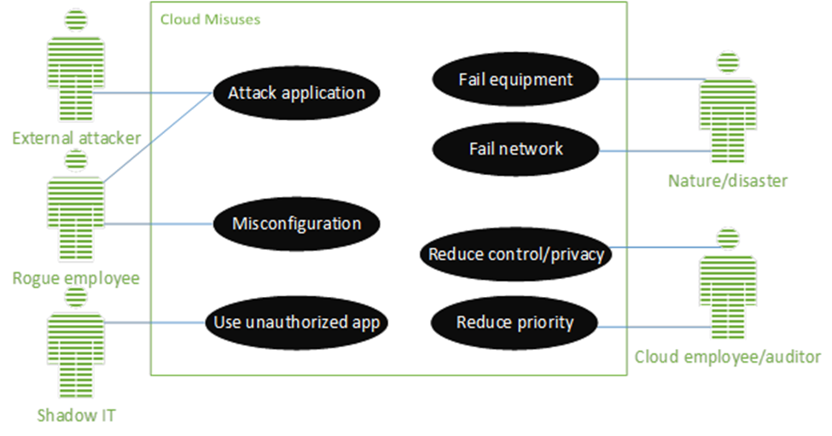
Step 1: Define Security and Compliance Requirements
Workbook
Confidentiality: Security issue: Grades are released resulting in FERPA investigation. Security issue: Assignments are unknowingly copied from 1 student to another. Security issue: Cloud employee sells or gives answers to students. Privacy issue: Copied files from top student is thought to be cheating; student earns a zero.
Integrity: Security issue: Submitted assignments are mixed up, lost or deleted by system failure, attacker or rogue employee. Security Issue: Ransomware deletes all homework; ransom is too high to pay; no grades are available for courses for semester. Privacy issue: Students whose work is lost suffer undeserved bad grades.
Availability: Security issue: Assignments are due but students can’t access the system to submit. This is particularly problematic during homework and exam submission deadlines. Privacy issue: Students worried about not submitting on time; late grade assigned results in course failure.
Regulation: FERPA: School grades are protected. State Breach Notification: Student identifiers must be protected. Social security numbers and financial records are not maintained in this DB

Slide 55
Step 2: Select a Cloud Provider and Service/Deployment Model
Regulatory Issues
Workbook
Questions | Notes
What do my nation’s laws require in protecting my data? What international laws, data privacy laws and state breach laws are my data subject to?
Where (e.g., which country) will my client data reside, and what government intrusion, security and privacy laws might my data be subject to? What is cloud provider policy if law enforcement subpoenas a client’s sensitive information?
What cloud controls are in place to address these regulations? How will breaches be notified and handled? (Ultimately the cloud customer is responsible for security)
What are cloud provider privacy policies related to client data? What security controls and monitoring are provided for the client?

Slide 56
Cloud Provider Security Implementation
Workbook
Questions | Notes
What controls are implemented by the cloud provider for confidentiality, integrity and availability, or more specifically, authentication, access control, digital certificate exchange, IDS, trusted platform? What network security controls exist?
What policies and security implementations prevent cloud personnel from accessing and leaking client data?
What third-party audit processes exist? What does the audit involve and how are results disseminated? How often are audit/compliance results provided? What have previous audit results shown?
Does the cloud provider maintain and publish metrics on availability (or downtime)?
What cloud tools are available for testing and monitoring of security? What protocol and restrictions exist for the cloud user to perform vulnerability and penetration testing?
What types of alarm/logs does the cloud provider monitor for? Are client-system logs available to clients?
Can clients monitor the usage and access of their data?

Slide 57
Cloud Incident and Disaster Recovery
Workbook
Questions | Notes
What rates of availability does the cloud provider maintain? Can data be maintained redundantly in multiple regions? How is data synchronization achieved? Can the organization’s recovery point objectives and recovery time objectives be achieved?
What are the cloud server provider policies for disaster recovery? How does the cloud provider handle disaster recovery? What is included in the contractual agreements?
How is incident response handled by the cloud provider? What tools are available to clients to forensically analyze incidents?

Slide 58
Contractual Issues – Cloud Provider and Third Party
Workbook
Questions | Notes
What is the cloud provider standard Service Level Agreement? Can this SLA be personalized for my needs?
If we are under contract to another organization, does the proposed cloud implementation meet our contracts’ requirements? What issues does our contract specify or imply?
What happens at contract termination? What are the cloud provider’s data privacy policies? How does data export to another system work, what is this cost, and what are cloud provider policies for data destruction?
Is the cloud provider reputable, financially stable, protected by insurance, located primarily (or entirely) in the home country? What recent legal cases have involved the cloud provider? (casetext.com can provide details.)
What security APIs or form interfaces are supported to automatically configure a security configuration? Does the cloud provider support the API required by the client? What kind of scripting and key management options does the cloud provider provide?

